Slide 1
Cost-Effective Data Annotation using Game-Based Crowdsourcing
Jingru Yang¹, Ju Fan¹, Zhewei Wei¹, Guoliang Li², Tongyu Liu¹, Xiaoyong Du¹

Slide 2
Large-Scale Data Labeling
In many applications, it is indispensable to obtain large-scale data labels with high quality
E.g., Deep learning, Data Integration, etc.
Google Cloud & YouTube Video Understanding
10 M labeled video
Visual QA
300K labeled images
1M aligned QA
Notes:
In many applications, such as data integration and machine learning, it is indispensable to obtain large-scale data labels with high quality.
Deep Learning (DL) achieves state-of-the-art performance in many tasks, such as image classification.
However, most of the DL methods require massive training sets to achieve good performance and avoid over-fitting
Some media even argues that data labeling will become a new blue collar job of the AI era.

Slide 3
Existing Methods for Data Labeling
Crowdsourcing
Tuple-level data labeling at relatively low cost per task
Limitation: large labeling cost for big datasets
E.g., 0.01 $/task * 10 M tasks = 100,000 $$$
Step 1: Task Selection
Step 2
Answer Collection
Unlabeled Data
Step 3: Answer Inference
e.g., Transitivity
Notes:
Crowdsourcing can be utilized to harness the crowd to directly annotate tuples in a dataset at relatively low cost
Explain the general steps of crowdsourced data labeling
Many datasets contain tens of thousands to millions of tuples, such tuple-level labeling still inevitably incurs large annotation cost.

Slide 4
Existing Methods for Data Labeling
Weak Supervision
Leveraging probabilistic labeling rules to annotate tuples.
Example: the Snorkel system from Stanford
Relation Extraction
Extracting spouse relation
Entity Matching
Matching product records
A. Ratner, S. H. Bach, H. R. Ehrenberg, J. A. Fries, S. Wu, C. Ré: Snorkel: Rapid Training Data Creation with Weak Supervision. PVLDB 11(3): 269-282 (2017)

Slide 5
Existing Methods for Data Labeling
Weak Supervision
Leveraging probabilistic labeling rules to annotate tuples.
Limitation: hard to construct good labeling rules
Hand-crafted: High quality vs. low coverage
Automatically-Generated: high coverage vs. low quality
E.g., Is “Apple-Samsung” a good negative rule for entity matching?
Such rules may be very noisy and provide wrong labels

Slide 6
Comparison with Existing Methods
More cost-savings
Weak
Supervision
Cost saving vs. Error-prone
Our Goal
Accurate & Cost saving
Cost Reduction
Tuple-level Crowdsourcing
Accurate vs. Expensive
Label Quality
Higher quality

Slide 7
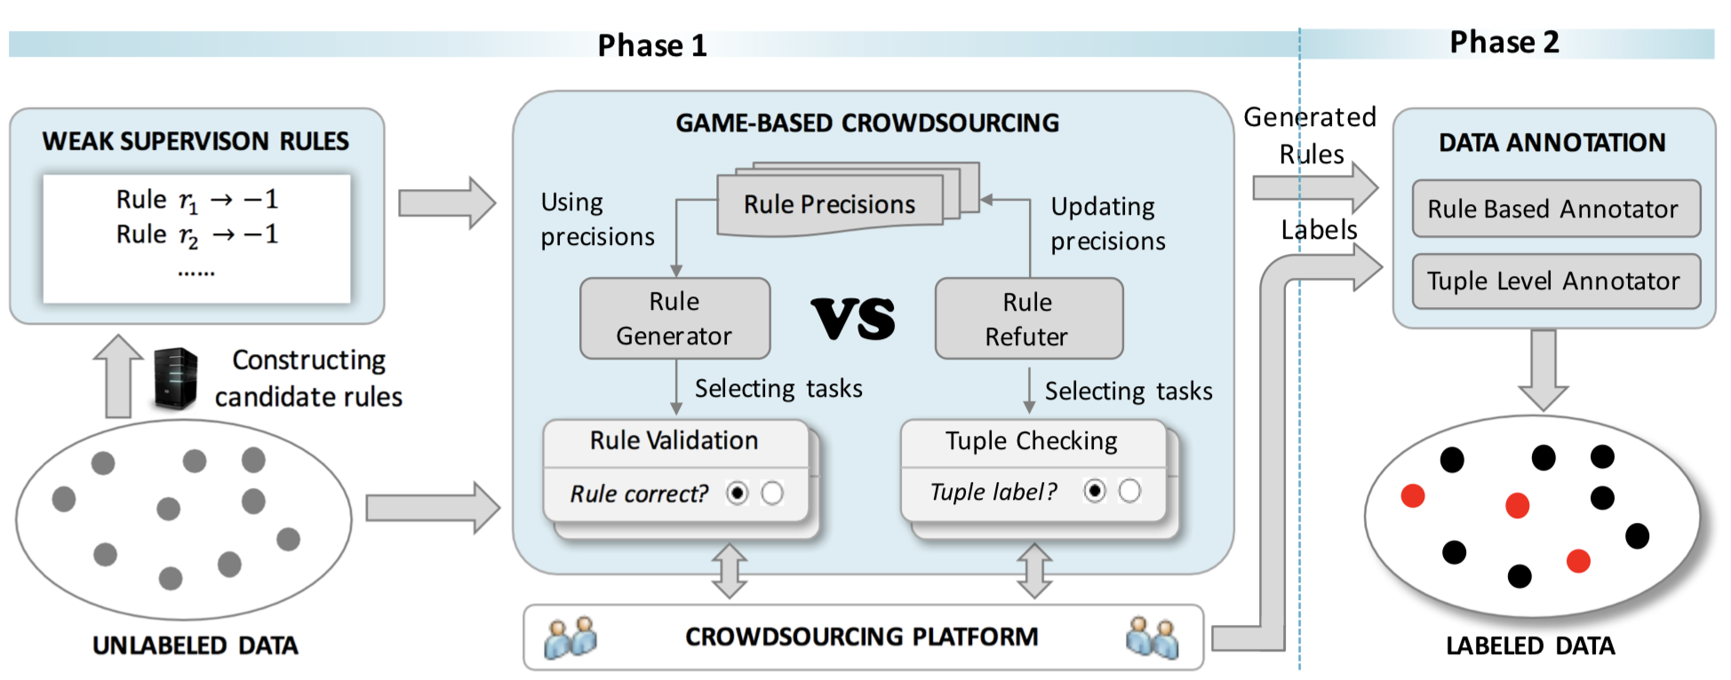
Our Solution: CrowdGame
Our framework takes a set of unlabeled tuples as input and annotates them utilizing labeling rules in two phases.
Jingru Yang, Ju Fan, Zhewei Wei, Guoliang Li, Tongyu Liu, Xiaoyong Du: Cost-Effective Data Annotation using Game-Based Crowdsourcing. PVLDB 12(1): 57-70 (2018)

Slide 8
A Running Example
Entity Matching: Identifying matched products
Crowdsourcing Platform: Amazon Mechanical Turk
A set of products
Product pairs to be labeled

Slide 9
Candidate Rule Construction
Entity Matching
Word Embedding + Word Mover’s Distance (WMD)
Relation Extraction
Distant Supervision + Phrase Detection
Candidate rules have diverse coverage and accuracy

Slide 10
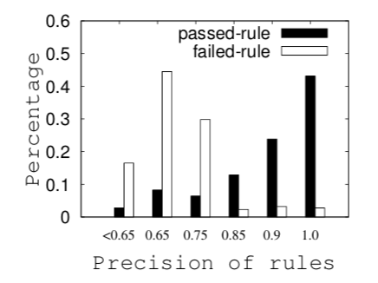
Two-Pronged Crowdsourcing Tasks
False Positive Rules
E.g., “Apple-Android”
Rule Validation Task
Crowd may give wrong answers for rule validation
They may not know if the rule works for the current dataset

Slide 11
Two-Pronged Crowdsourcing Tasks
Tuple Checking Task
It is expensive to crowdsource many tuple checking tasks
Can we combine these two types of tasks together?

Slide 12
Game-Based Crowdsourcing
We let two groups of workers play a GAME
vs.
Rule Generator (RuleGen)
Rule Refuter (RuleRef)

Slide 13
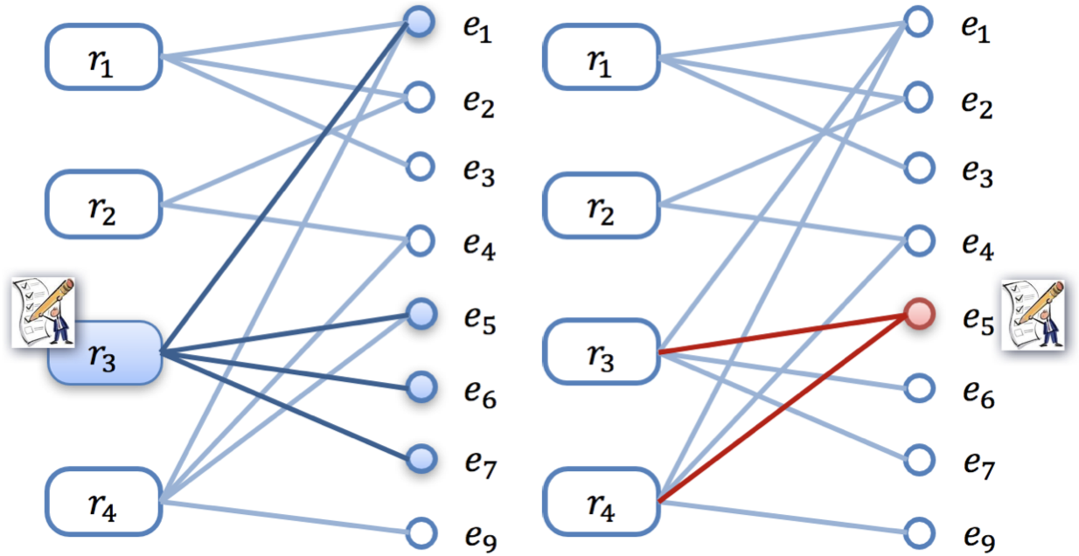
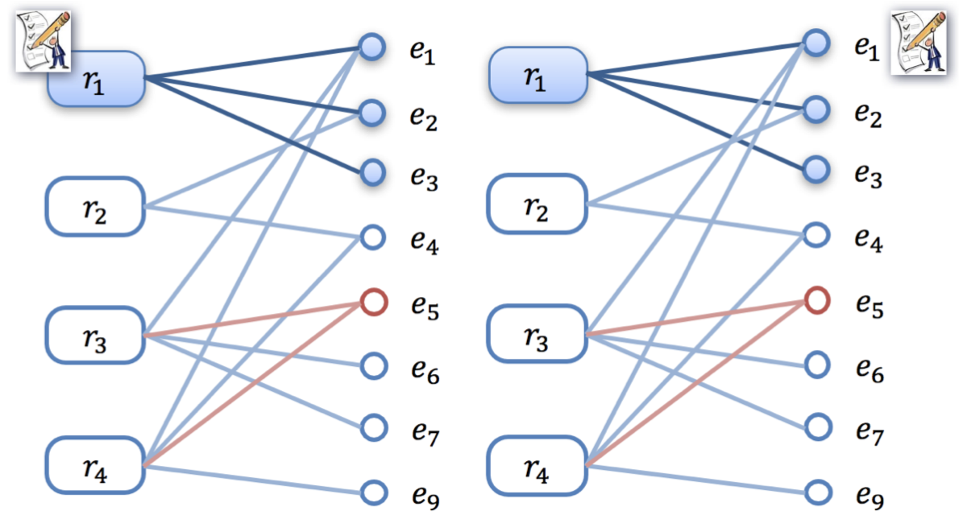
Game-Based Crowdsourcing
An adversarial game
Rule generator identifies rules with coverage improvement
Rule refuter tries to refute rule generator by checking representative tuples that degrade accuracy of the rules.
RuleGen (1st round)
RuleRef (1st round)
RuleGen (2st round)
RuleRef (2st round)

Slide 14
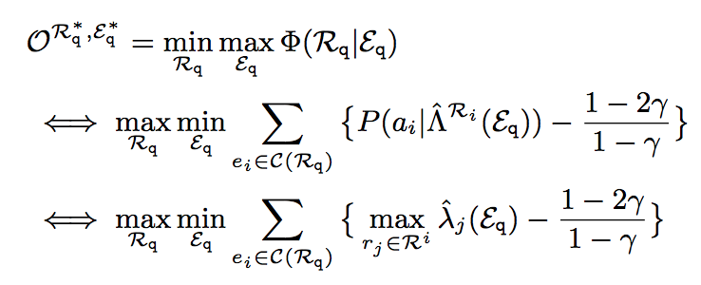
Technical Challenges & Solutions
How to formalize the game objective to balance the preference among coverage and accuracy
Minimax Optimization
C(R), a set of tuples covered by rule set R.
λ_{j}, precision of rule r_{j}

Slide 15
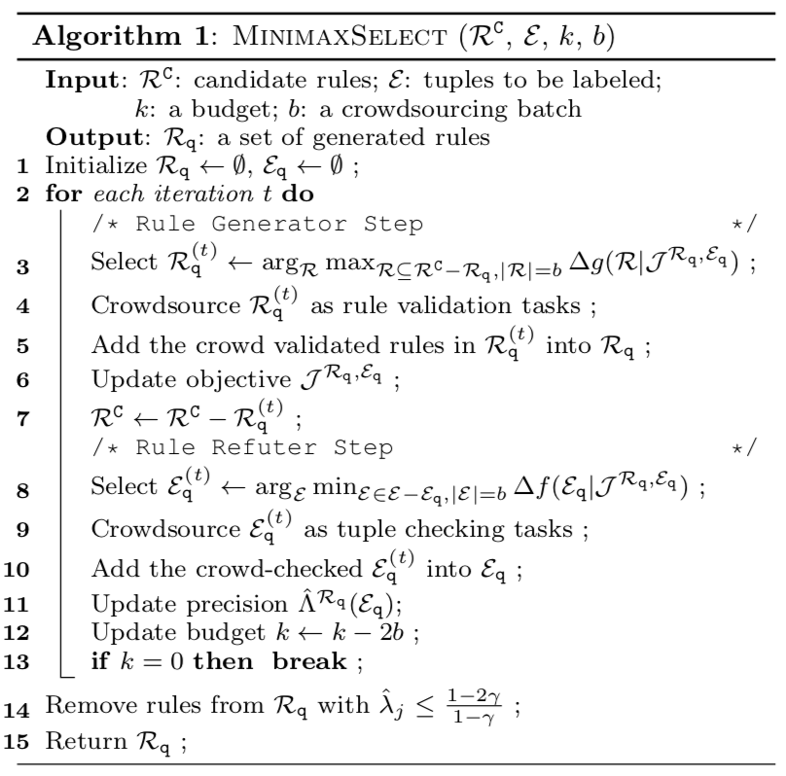
Technical Challenges & Solutions
How to achieve the minimax objective
We develop an iterative crowdsourcing algorithm.
RuleGen plays as a minimizer.(NP-Hard)
RuleRef plays as a maximizer .(NP-Hard)
Heuristics with Theoretical Bounds

Slide 16
Experimental Evaluation
Labeling Scenarios
Entity Matching & Relation Extraction.
Compared Approaches
Crowdsourcing: Trans, PartOrder, ACD
Weak Supervision: Snorkel.
Datasets

Slide 17
Experimental Evaluation
Evaluation on Minimax Crowdsourcing
Evaluate the minimax crowdsourcing objective and task selection algorithms.
CrowdGame with our proposed task selection strategies achieves the minimum loss.

Slide 18
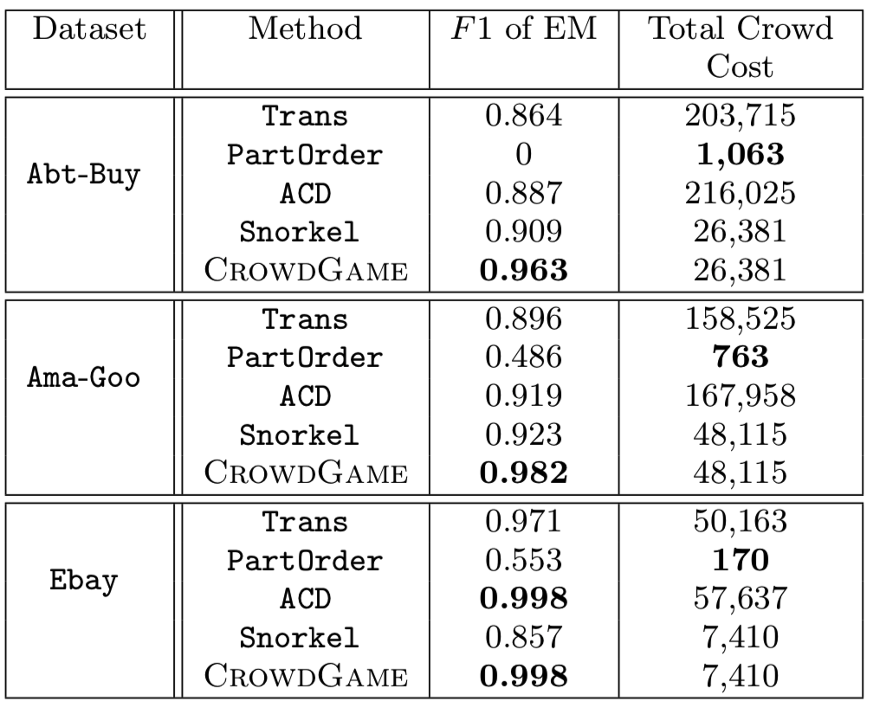
Experimental Evaluation
Comparisons for Entity Matching
Approach Comparison .
CrowdGame achieves better result quality with low cost.

Slide 19
Experimental Evaluation
Comparison for Relation Extraction
Approach Comparison .
CrowdGame learns good rules from noisy candidates, and it outperforms the manual rules from domain experts.

Slide 20
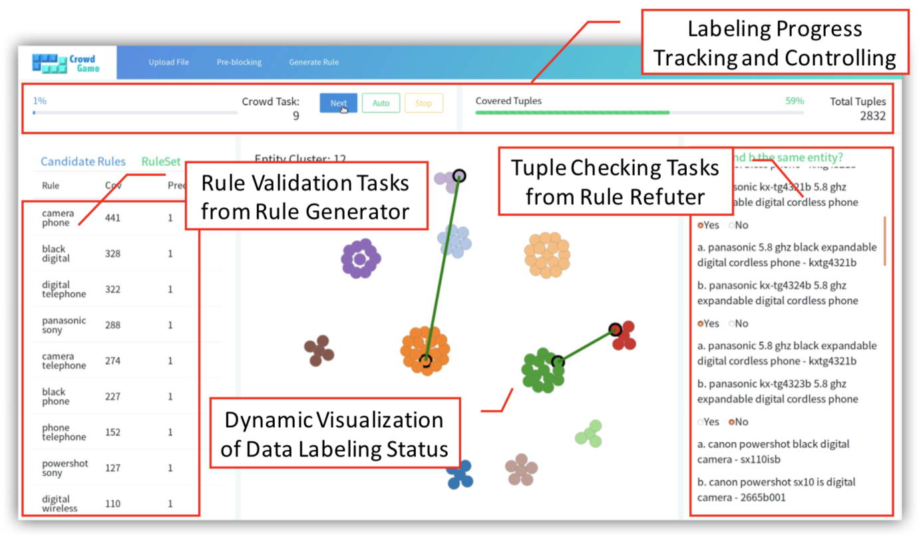
The CrowdGame System
User Interface of CrowdGame

Slide 21
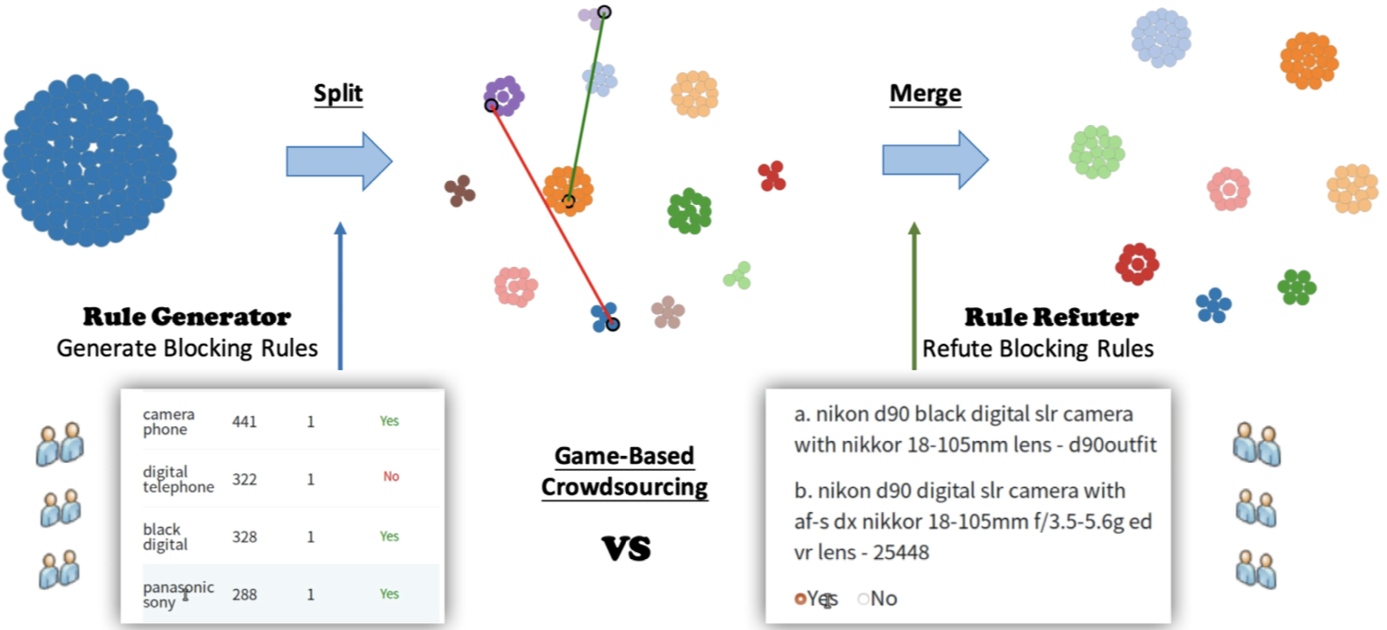
The CrowdGame System
Demonstration scenarios of CrowdGame for entity matching.

Slide 22
Thanks

Slide 23
Experimental Evaluation
Evaluation of CrowdGame on Entity Matching and Relation Extraction.
Increasing rule generation budget can improve both quality and cost.

