Slide 1
Maximizing Multifaceted Network Influence
Yuchen Li, Singapore Management University
Ju Fan, Renmin University of China
George V. Ovchinnikov, Skolkovo Institute of Science and Technology
Panagiotis Karras, Aarhus University
Notes:
I am glad to present our paper, entitled “maximizing multifaceted network influence”.
I am Ju Fan from RUC.
This is a joint work with Yuchen from SMU, George from Skoltech, and Panos from Aarhus Univ.

Slide 2
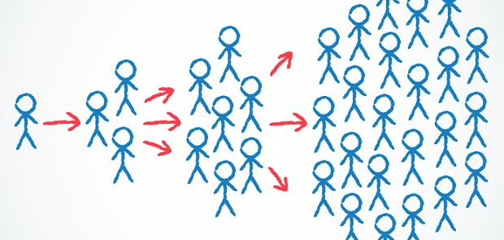
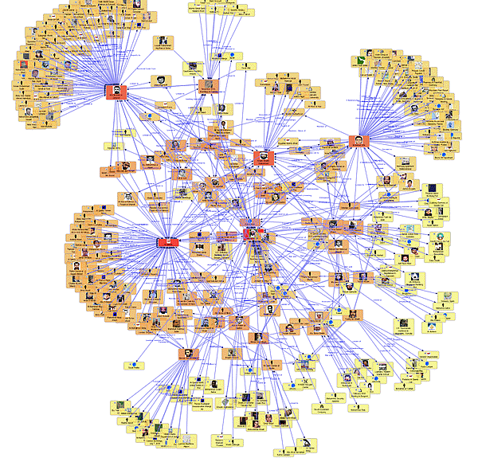
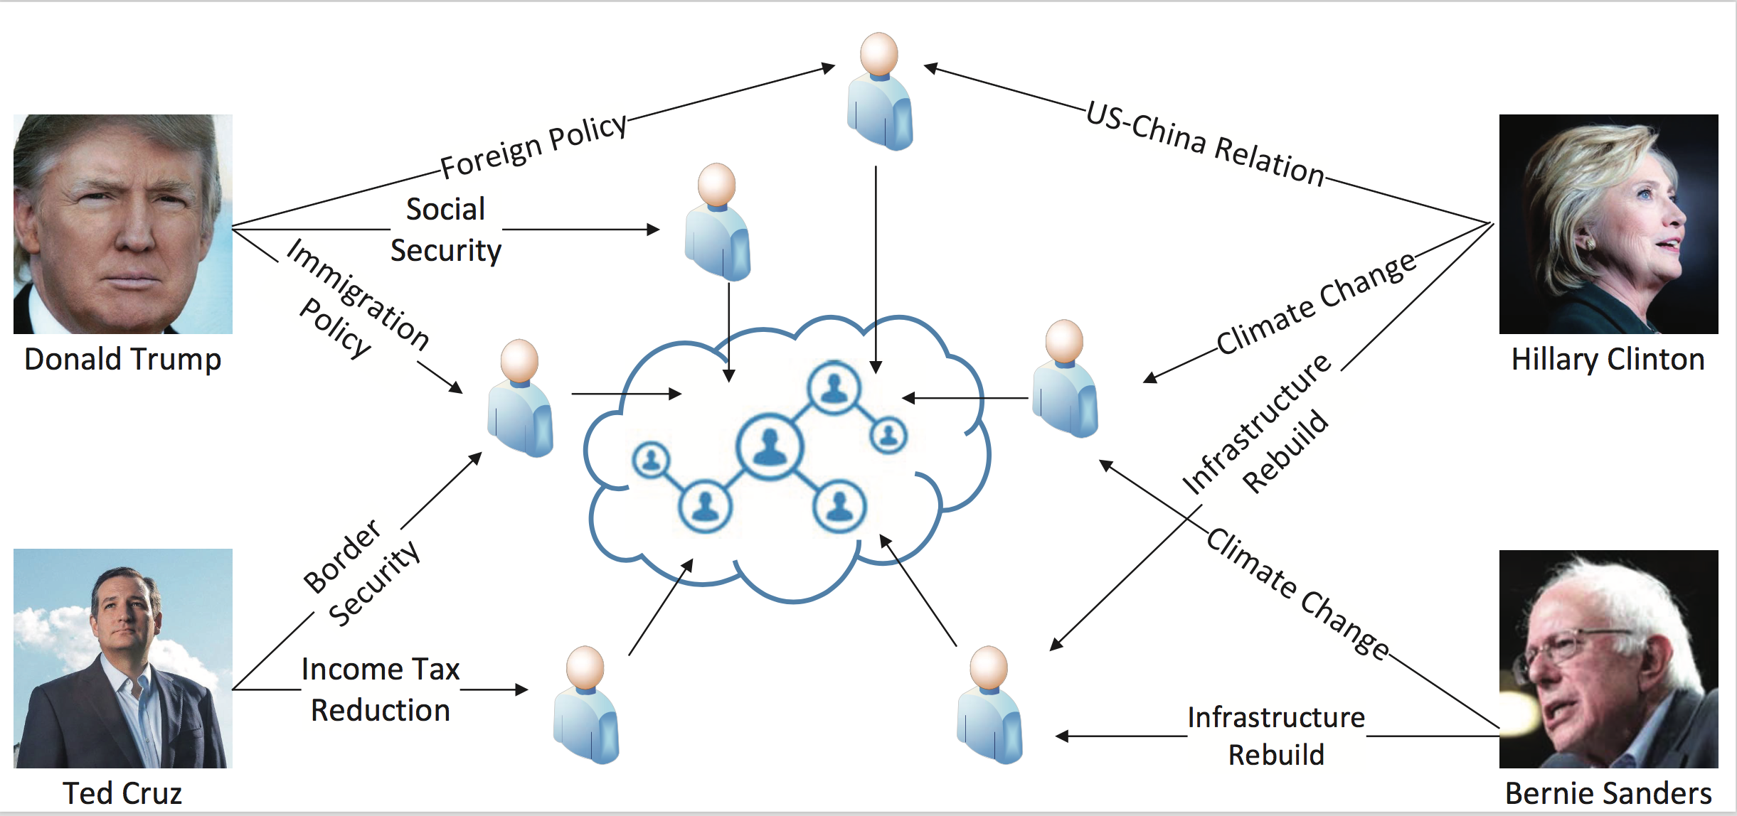
Background: Social Influence
Social influence occurs when a person's emotions, opinions, or behaviors are affected by others
Online Social Influence, e.g., Klout
Applications
E.g., Viral Marketing
Notes:
First of all, I will present some background of social influence.
In the last decades, there are plenty of works on social influence analysis. For example, Klout measures an influence score of each individual based on their behaviors in online social networks. Meanwhile, social influence has been revealing potentials on many applications, such as viral marketing and political campaign.

Slide 3
Background: Influence Maximization (IM)
Data: a directed graph $G=\left(V,E\right)$
The IM problem: Finding k nodes in a network, such that the expected influence is maximized.
4
9
4
9
2
1
2
1
5
3
7
8
5
3
7
8
6
6
A Recent Survey: Y. Li, J. Fan, Y. Wang, and K. Tan. Influence maximization on social graphs: A survey. IEEE TKDE, 30(10):1852–1872, 2018.
Notes:
One central problem in social influence analysis is influence maximization. Given a social network formalized as a directed graph, the problem aims at finding k nodes, such that the expected influence is maximized.
There are many existing works on solving the IM problem. See a recent survey at TKDE.

Slide 4
Assumption of Existing IM Works
Homogeneous influence network:
All viral information gets the SAME influence.
How about propagating multiple viral information with different topics?
4
9
4
9
4
9
0.2
0.8
1
1
0
1
1
0.3
0
0.1
0
0
2
1
2
1
2
1
0.9
1
Flip coin
1
1
1
0.7
0.9
1
1
0.8
0
0
5
3
7
8
5
3
7
8
5
3
7
8
0.7
1
0
1
0.5
0
0
0.8
0
0
0.3
0
6
Time step $t_{1}$
6
Time step $t_{2}$
6
Notes:
One assumption used in most IM works is that all viral information gets the SAME influence.
For example, let us consider the well-known Independent Cascade (IC) model. The model assigns a probability to each edge in the social network, without considering the items to be propagated in the network.
Let us consider to choose two users as seeds, say u2 and u7.
It first flips a coin for each edge according to the corresponding probabilities, which determines whether a user can activate its neighbors through the edges.
For example, at time t1, u2 can activate u3 and u5, but cannot activate u4 as the edge is not activated.
At time step 2, the activated users continue to activate neighbors’ neighbors.
We iteratively perform this activation process, until no more node is activated.
Finally, we obtained 6 nodes, which reflects influence spread of the two seeds.

Slide 5
Assumption of Existing IM Works
Influence = Adoption
Once a user is activated, it is considered to be influenced.
How to convert users to adoption / taking meaningful action?
4
9
4
9
4
9
0.2
0.8
1
1
0
1
1
0.3
0
0.1
0
0
2
1
2
1
2
1
0.9
1
Flip coin
1
1
1
0.7
0.9
1
1
0.8
0
0
5
3
7
8
5
3
7
8
5
3
7
8
0.7
1
0
1
0.5
0
0
0.8
0
0
0.3
0
6
Time step $t_{1}$
6
Time step $t_{2}$
6
Notes:
The second assumption is that influence is equal to adoption.
Consider the IC model again. Once a user is activated, it is considered to be influenced. Can give some examples in the figures.
However, one activated user may not take meaningful action, such as buying the products, or adopting a political idea.

Slide 6
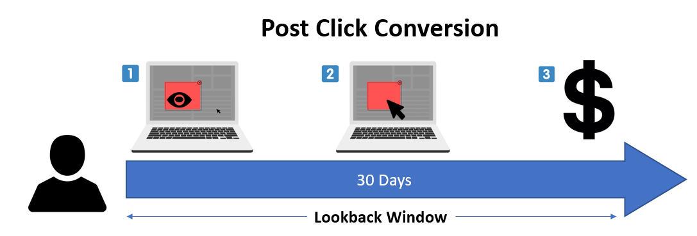
Real-World Campaigns Need to be Multi-faceted
Click to LIKE vs. Click to BUY?
More and non-redundant information is required for a user to buy a product.
WATCH a video vs. SUBSCRIBE a channel?
Watching a number of interesting and diverse videos would convert the user to a subscriber.
Notes:
Evidently, real-world campaigns often need to be multi- faceted, that is, they are composed of multiple constituent message pieces.
One example is from online advertising. There are many studies on post-click marketing. The idea of these practices is that the number of clicks does not mean sales. And more and more…
Another example is about subscribing to a video channel. We may not subscribe to a channel only after watching or liking a single video of the channel. Watching more interesting and diverse videos would convert us to be a subscriber.

Slide 7
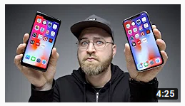
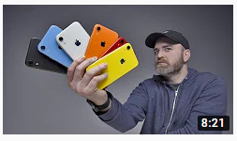
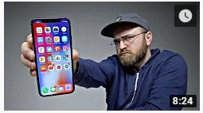
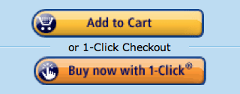
Multifaceted Network Influence
Challenge 1:
How to quantify the adoption process given multiple message pieces?

Slide 8
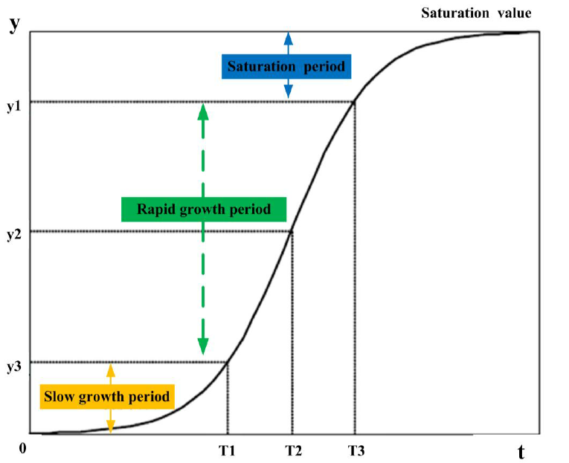
Logistic Adoption Model
$$I_{S_{2}}^{v}$$
$$I_{S_{1}}^{v}$$
$$I_{S_{3}}^{v}$$
Adoption Utility (AU)
User v
Notes:
Logistic adoption model is frequently used in consumer behavior studies.
I_{S_1}, I_{S_2}, I_{S_3} are Bernoulli random variables indicating if the user is influenced during an influence propagation process.

Slide 9
Maximizing Adoption with Multifaceted Network Influence
Challenge 2:
How to maximize adoption with multifaceted network influence?
$OIPA$: Given a social network $G$, a viral campaign $T$ containing $l$ viral pieces and a number k as the budget to constraint the number of seeds, the Optimal Influential Piece Assignment (OIPA) problem finds the assignment plan $S$ such that the plan maximizes the overall adoption utility of T over G.
Notes:
User a is selected to promote piece 1 and User e is selected to promote piece 2.

Slide 10
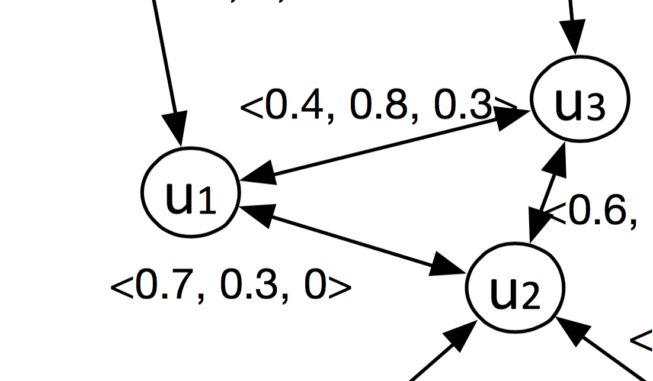
Information Propagation Model
Topic-Aware Independent Cascade Model
Consider an example: the influence from u1 to u2 has multiple topics
<0.7, 0.3, 0>
A viral message is modeled as probabilistic distribution <0.2, 0.8, 0>
The Influence from u1 to u2 is 0.7*0.2 + 0.3*0.8 + 0 = 0.38
Nicola Barbieri, Francesco Bonchi, Giuseppe Manco: Topic-Aware Social Influence Propagation Models. ICDM 2012: 81-90
Notes:
To model viral message pieces with diverse topics, we utilize the topic-aware independent cascade model
Different from the traditional IC model, it assign multiple influence probs to each edge, each of which corresponds to a topic. On the other hand, a

Slide 11
Running Example
Consider a topic-aware influence graph as below
Consider two viral message pieces:
t1: <1.0, 0>
t2: <0, 1.0>

Slide 12
Strategy A
Strategy B
Notes:
The first strategy is to select user a for all these two message pieces. We can see that the strategy is good for the t1, but bad for t2.
A better solution is strategy B. Explain strategy B.
So, it is useful if we solve the OPIA problem.

Slide 13
Problem Hardness
Traditional IM when one viral piece is propagated => NP hardness.
A Greedy Solution can guarantee approximation ratio due to the submodular property of the objective function.
However, Non-submodular objective function in multifaceted IM => Greedy solution does not guarantee approximation ratio.
Notes:
1. Proof is done via a reduction to the maximum clique problem.

Slide 14
Branch and Bound Framework
$$S=\{∅,∅,…,∅\}$$
$$S=\{\left\{v_{1}\right\},∅,…,∅\}$$
$$S=\{∅,\left\{v_{1}\right\},…,∅\}$$
$$S=\{∅,∅,…,\left\{v_{1}\right\}\}$$
$$S=\{∅,∅,…∅\}$$
$$S=\{\left\{v_{1}\right\},\left\{v_{2}\right\},…,∅\}$$
$$S=\{∅,\left\{v_{1},v_{2}\right\},…,∅\}$$
$$S=\{∅,\left\{v_{1}\right\},…,\left\{v_{2}\right\}\}$$
$$S=\{∅,\left\{v_{1}\right\},…,∅\}$$
Given any partial solution S, we compute two values:
Upper bound: the maximum objective value that bounds the solution space containing S.
Lower bound: the objective value of a plan containing S.
Notes:
We introduce a branch and bound framework.
Initially, we assign an empty set for each message piece. Then, select the seed set for each message iteratively.
For example, the first level consider if v_1 is selected as a promoter. The second level consider if v_2 is selected as a promoter. The last entry in each level means v is not selected as a promoter.

Slide 15
Technical Challenge: Bound Computation
For each partial solution S, compute the maximum AU score of all possible complete plans that contain S.
Non-Submodular
$$\max_{\left|S^{C}\right|≤k}{\sum_{i=1…θ}{\frac{1}{1+exp⁡\{α−β\sum_{j=1…l}{I_{S_{ j}^{c}}^{i}}\}}}}$$
s.t. $S_{j}^{C}⊇S_{j}, ∀S_{j}^{C}∈S^{C}$
$θ$ Reverse-Reachable (RR) Sets
$l$ message pieces
Notes:
1. We consider all possible complete plans that contain S.
2. For each such plan S^C, we first generate theta RR sets, and then compute the AU score based on the equation by aggregating the effects of l message pieces. One challenge is that the equation is non-submodular.

Slide 16
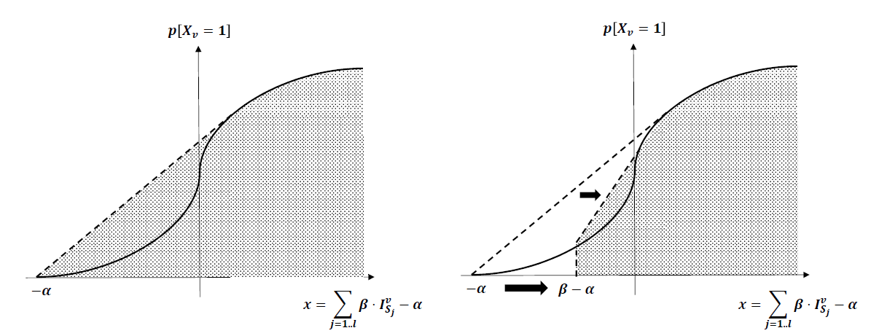
Technical Challenge: Bound Computation
tangent line
For each partial solution S, update a submodular upper bound over the logistic function and run greedy heuristic to complete the partial solution and get the upper bound value wrt. the submodular upper bound function.
The plan obtained by the greedy heuristic automatically implies a lower bound on the logistic function.
Notes:
We address the challenge to compute a tangent line of the S-curve. Then, for each

Slide 17
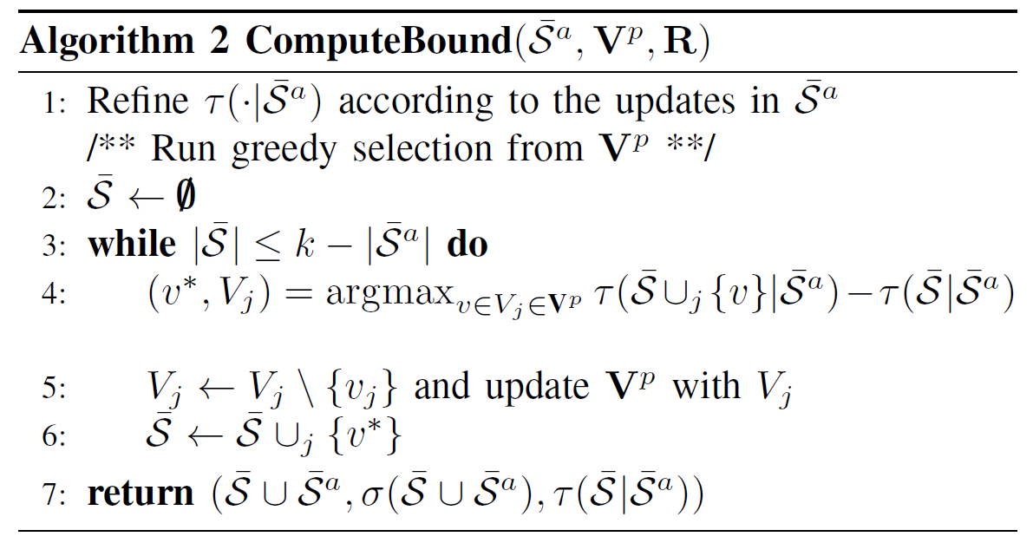
Expensive Bound Estimation
Invoke the upper bound estimation many times and each upper bound estimation is also expensive.
Notes:
Explain \tau
Explain why a greedy algorithm is used.
Given the audience a brief review of the greedy heuristic.
Greedy heuristic needs to scan a large number of users to compute the marginal value for each iteration.

Slide 18
Progressive Bound Estimation
Set a threshold h, include a user $v$ if the marginal value exceeds $h$.
Progressive lower $h=\frac{h}{\left(1+ε\right)}$.
Non-trivial termination condition on $h$:
Near constant number of marginal value evaluations for each upper bound estimation in power law influence graphs.
Theoretical guarantee on the approximation ratio.

Slide 19
Experimental Evaluation
Compared Approaches & Datasets:
IM: using state-of-the-art IM solution to find a seed set S, choose the piece which S generates the largest adoption.
TIM: using state-of-the-art topic-aware IM solution to find $S_{i}$ for each piece $i$, select $S_{i}$ with the largest adoption.
BAB: branch and bound framework.
BAB-P: BAB with progress upper bound estimation.

Slide 20
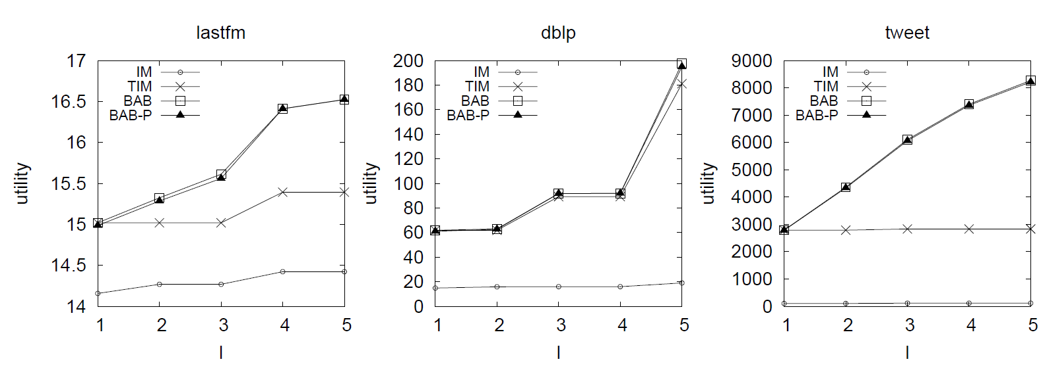
Effectiveness Study
Notes:
Note that the quality of IM and TIM is severely poor in the tweet dataset.
This is because the number of topics having influence zero in the dataset is very high. Among 50 topics, the average number of non-zero topical influence between two users is only 1.5.
Thus, optimizing a single viral piece results in low influence spread thus produces poor overall adoption utility.

Slide 21
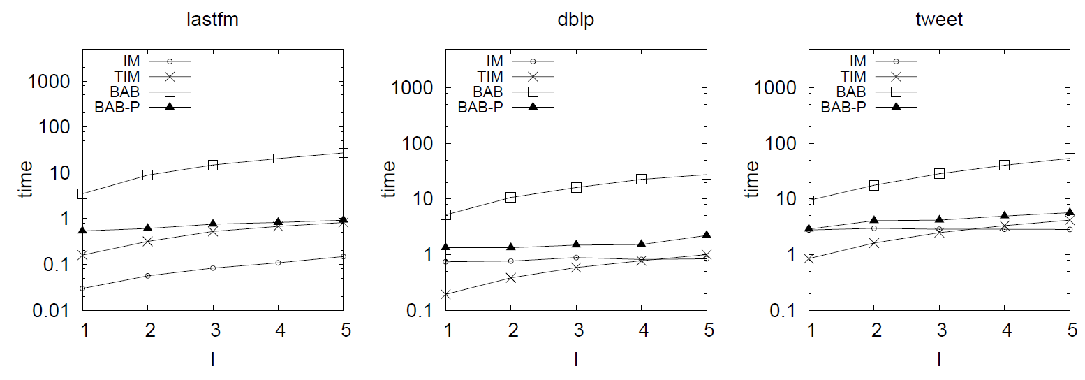
Efficiency Study

Slide 22
Conclusion
We introduce a novel multifaceted network influence problem for maximizing user adoption.
We show that the problem is NP-hard to approximate within any constant factor in the general setting.
We propose a branch-and-bound framework that effectively prunes search space via introducing a submodular upper bound function.
We devise a progressive upper bound estimation technique to speedup the branch-and-bound framework.

Slide 23
Background: Influence Maximization (IM)
0.4
0.2
0.3
0.8
0.5
0.5
0.6
0.1
Finding k nodes in a network, such that the expected influence is maximized.

Slide 24
Assumptions of Influence Maximization
Homogeneous influence network:
All viral information gets the SAME influence.
How about different products, different political ideas, different videos?
Influence = Adoption
Once a user see a viral message, it is considered to be influenced.
How to convert users to adoption/take meaningful action?

