Slide 1
Blender: Toward Practical Simulation Framework of BLE Neighbor Discovery
Yukuan Ding, Tong Li, Jiaxin Liang, Dan Wang

Slide 2
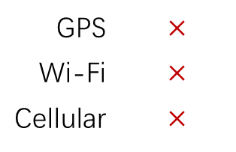
A Practical Scenario: the OFN
Example: Apple’s AirTag
Image Source: https://www.apple.com/hk/en/airtag/
Lost-Device
Lost-Device’s
Owner
The Offline
Finding Network (OFN)
System
GPS | $$×$$
Wi-Fi | $$×$$
Cellular | $$×$$
Notes:
Why practical simulation? There’re practical scenarios.
In this case, there is a lost device, and the owner requires the location.
As the lost-device has to work for a long time without charging, no GPS wifi cellular (functionalities trigger significant power consumption)

Slide 3
A Practical Scenario: the OFN
Lost-Device
Widely
Spread
Scanner
Devices
Cloud
Server
Lost-Device’s
Owner
1.Device Identifier
2.Location Information
3.Notification
Notes:
OFN requires a large number of scanner devices. Millions of iphone devices.
Broadcast Bluetooth signal, captured by scanners.
Scanners can have GPS modules. Send the location and the identity of lost device to server.

Slide 4
The Discovery Process
Lost-Device
(Advertiser)
Scanner
Device
Advertising Sequence $Q_{A}$
$$T_{a}$$
$$φ_{a}$$
$$L\left(φ_{a},φ_{s}\right)$$
$$φ_{s}$$
$$T_{s}$$
$$W_{0}$$
$$W_{1}$$
Scanning Sequence $Q_{S}$
Radio Range
Discovery Latency $L\left(φ_{a},φ_{s}\right)$: time from range-entrance event to discovery event
Depending on the range-entrance case $\{φ_{a},φ_{s}\}$
The Range-Entrance Event
Notes:
The process that the scanner tries to find the lost-device
Not continuous advertising. Duty-cycling, interval between consecutive events
Before talk about scan, know when the discovery process actually starts.
Have radio-range. Outside signal strength to weak to be captured. Start when enter.
Red line. First next advertise event.
Similarly, scan also duty-cycle.
When activated, last for a period of time: scan window
Range-entrance to the end of 1st scan window.
Phi_a and phi_s => can be a discovery (orange)
Cannot wait forever. Know when achieved.
Despite parameters.

Slide 5
Desired Output
Advertising Sequence $Q_{A}$
$$T_{a}$$
0.8
$$φ_{a}$$
CDF
$$L\left(φ_{a},φ_{s}\right)$$
$$φ_{s}$$
$$T_{s}$$
p-80 latency
Latency
$$W_{0}$$
$$W_{1}$$
Scanning Sequence $Q_{S}$
$p$-percentile latency $L_{p}$
OR
probability $p$% so that $L<L_{p}$
Apparently, $φ_{a}∈\left[0, T_{a}\right),φ_{s}∈\left[0, T_{s}\right)$
Notes:
While each phi_a phi_s pair correlates to a discovery value, there are many pairs.
Ranges
Therefore, probability, or cumulative distribution function
80 percentile
Suppose 10s
Means the probability to discover in no more than 10s is 80%
Usage in commercial product is discussed in article

Slide 6
Barriers before Retrieving Results
1
Large Number of Range-Entrance Cases (i.e., {$φ_{a},φ_{s}$} pairs)
Random sampling has drawbacks
Unknown suitable sample size
Resulting in non-deterministic output
2
Notes:
Before reaching our target, there are some problems.
Large Number. Assume we 1ms as time unit, phi can be thousands of ms, resulting in millions of cases.
Intuitively, random sampling. But drawbacks
Also, stay in sampling prevents exploration of ND’s mechanism.
19min left.

Slide 7

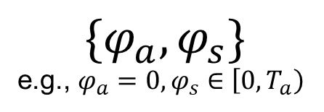
Solutions Optimizing Deterministic Simulation
Brute-Force Simulation
Simulation with Case-Projection
$$\{φ_{a},φ_{s}\}$$
e.g., $φ_{a}=0,φ_{s}∈\left[0, T_{a}\right)$
$$\{φ_{a},φ_{s}\}$$
$$φ_{a}∈\left[0, T_{a}\right),φ_{s}∈\left[0, T_{s}\right)$$
“Base Cases”
Single-Case Simulation
Single-Case Simulation
(e.g., timeline traversal)
Latency of Selected Cases
Case Projection
All Latency Values/PDF
Latency Values/PDF of All Cases
Notes:
When we want a faster but also deterministic solution.
Basically we can traverse through all cases. Ends up in brute-force.
Conduct traversal on timeline. Reach the discovery event and produce latency.
In our analysis, there are similarities between cases.
Improve to
Reduced to several thousands in practical.
Still apply Single-Case, get latency
How do we get all? Use case-projection to derive the latency of each remaining cases from a corresponding base case.
Derivation requires much less calculation than single-case-simulation

Slide 8
Solutions Basis and Examples of Case-Projection
Advertising Sequence $Q_{A}$
$$A_{0}$$
……
$$A_{j}$$
$$A_{0}$$
$$A_{1}$$
……
$$A_{j+1}$$
$$A_{0}$$
……
$$A_{j}$$
$$φ_{a1}=0$$
$$φ_{a3}$$
$$L_{D}$$
$$L_{D}$$
$$L_{D}$$
$$T_{a}$$
$$φ_{s1}$$
$$φ_{s1}$$
$$φ_{s1}$$
$$φ_{s2}$$
$$φ_{s3}$$
$$W_{0}$$
……
$$W_{0}$$
…
…
$$W_{0}$$
$$W_{i}$$
$$W_{i}$$
$$W_{0}$$
$$W_{i}$$
Scanning Sequence $Q_{S}$
Case 1:
$$L\left(0,φ_{s1}\right)=L_{D}$$
Case 2:
$$L\left(0,φ_{s2}\right)=L_{D}+T_{a}$$
Case 3:
$$L\left(φ_{a3},φ_{s3}\right)=L_{D}+φ_{a3}$$
Notes:
How do we decide the which base case is projected to which remaining case? Use several examples to illustrate the basis.
Recall the figure discovery process in previous slides
A_0, Phi_a zero, phi_s, discovery
Case 2. A_0 same pos. Apply projection (ani). Dist from A_1 to W_0 is the same as A_0 to W_0 in case 1.
A new case. Diff Phi_s.
Because adopt duty-cycle, given a pair of event/window with fixed relative position, the pattern of the advertising and scan sequence after them remains the same no matter where that event/window pair is on the timeline.
Therefore in case 1, the pattern after A_0 w_0 is the same as the pattern in case 2 after A_1 w_0. And, we have a discovery, L_D later than A_1.\
Latency, add value, no simulate again.
A_0 not fixed
A Discovery.
This is just the basis. In acticle, more detailed design of the projection, especially on selecting the base cases.

Slide 9
Barriers before Retrieving Results
1
Large Number of Range-Entrance Cases (i.e., {$φ_{a},φ_{s}$} pairs)
Random sampling has drawbacks
Unknown suitable sample size
Resulting in non-deterministic output
2
Practical Scenarios are Far from Ideality
Discovery latency is affected by stochastic factors of
environment: e.g., Possible loss in wireless transmission
mechanism: the $adv_delay$ in BLE
Notes:
Now we can produce determined result with faster simulation. But here remains another problem.
There are some stochastic factors that can make the performance in practical scenarios different from analysis.
Environment. Channel collision, physical obstruction are common.
Mechansim. Advertise interval no longer constant.
How do we deal with them together in simulation?
15min left.

Slide 10
Solutions Simulation with Packet Loss
What Happens with Loss (e.g., each discovery failure is i.i.d under Binary Distribution)
$$A_{j}$$
$$L_{D_{1}}$$
……
$p\left(L=L_{D_{1}}\right)=1−p_{loss}$
No loss at $A_{j}$
$$W_{i}$$
$$A_{j}$$
……
$$A_{y}$$
Loss at $A_{j}$
……
$p\left(L=L_{D_{2}}\right)=p_{loss}∙\left(1−p_{loss}\right)$
$$L_{D_{2}}$$
$$W_{i}$$
……
$$W_{x}$$
……
Given $\left\{φ_{a},φ_{s}\right\}, p_{loss},$ we have $S_{L}=\{L_{D_{1}},L_{D_{2}},L_{D_{3}},…\}$, where
$p\left(L=L_{D_{i}}\right)=p_{loss}^{i−1}∙\left(1−p_{loss}\right)$
Notes:
Independent and identically distributed
Originally should be discovery if no loss.
Loss is probabilistic event.
If loss, find next possible discovery.
A set of latency and corresponding probability.

Slide 11
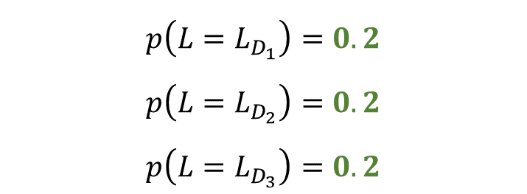
Solutions Simulation with BLE Random Advertising Delay
What Happens with $adv_delay$ (Example with an $adv_delay$ of 4 time units)
$$p\left(L=L_{D_{1}}\right)=0.2$$
$$p\left(L=L_{D_{2}}\right)=0.2$$
$$p\left(L=L_{D_{3}}\right)=0.2$$
$$A_{1}$$
$$L_{D_{1}}$$
$$L_{D_{2}}$$
……
$$L_{D_{3}}$$
$$W_{i}$$
$$T_{a}$$
$p\left(L=L_{D_{4}}\right)=0.2∙0.2$
$$A_{1}$$
$$A_{2}$$
$$p\left(L=L_{D_{5}}\right)=0.2∙0.2+0.2∙0.2$$
……
$$W_{i}$$
……
$$W_{x}$$
$$p\left(L=L_{D_{6}}\right)=0.2∙0.2+0.2∙0.2$$
$$T_{a}$$
Notes:
Now we have treated the simulation with loss.
A_0 no longer a single event, but events of 5 (4+1) possible positions.
Green columns, discovery.
What happens to non-discovered advertising events. Let’s see A_2.
Each in A_1 have 5 possible position for subsequent ad event. Overlapping, totally 9.
Remember in A_1, first 3 discovered, discovery latency only considers first discovery event. don’t care. Eliminate the probability of the pos in A_2 derived from the discovered position.
Two undiscovered positions, purple and blue.
Purple derive first pos in A_2.
Purple and blue collaboratively derive the second pos in A_2

Slide 12
Solutions When Blending the Stochastic Factors Together
$∗adv_delay$ of 1 time units
$$A_{1}$$
$$A_{2}$$
w/o
loss
………
Probability Distribution of
$A_{2}$’s Position
$$L_{D_{1}}$$
$$W_{i}$$
$$W_{i+1}$$
………
$$W_{x}$$
$$A_{1}$$
$$A_{2}$$
loss
………
$$W_{i}$$
$$W_{i+1}$$
………
$$W_{x}$$
Notes:
In practical scenarios, we believe the stochastic factors can have a mixed effect. So how do we blend the effects of the factors together?
If no packet loss occurs at A_1, everything remains the same as the previous slide.
The advertising event in A_1 at the first possible position is discovered, eliminates some probabilities in A_2.
If A_1 is lost, this probability elimination no longer exists

Slide 13
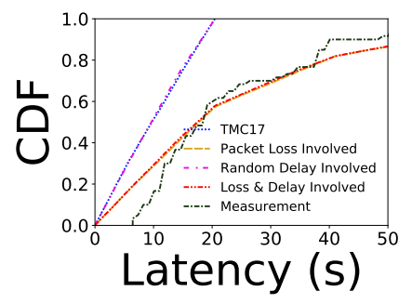
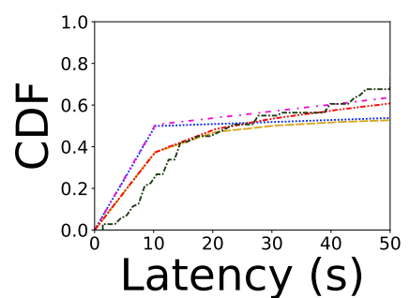
Evaluation Setup & Results
$T_{s}=5120ms d_{s}=512ms$
Parameter Configuration
$$T_{a}=1860ms$$
Ideal
Simulation
Real-World
Measurement
(with Android BLE)
Comparison
Environmental
Factors
(e.g., loss rate)
$$T_{a}=2050ms$$
Practical Simulation

Slide 14
Conclusion and Future Work
We developed a practical simulation framework that can
simulate BLE and BLE-like neighbor discovery process
take full consideration of the ‘range-entrance’ event
produce determined distribution of discovery latency
involve the stochastic factors in practical cases
Future Works
Integrate more factors/variants of existing factors
Accelerate Case-Projection
…

