Slide 1





The 29th IEEE International Conference on Network Protocols (ICNP 21)
R-AQM: Reverse ACK Active Queue Management in Multi-tenant Data Centers
Xinle Du¹, Tong Li², Lei Xu², Kai Zheng², Meng Shen³, Bo Wu¹, Ke Xu^{1,4,5}
¹Tsinghua University, ²Huawei Technologies, ³Beijing Institute of Technology, ⁴BNRist, ⁵PCL
Notes:
Hello everyone, I’m Xinle Du from Tsinghua University. Today I’m going to present R-AQM, Reverse ACK Active Queue Management in Multi-tenant Data Centers. This is joint work with multiple institutes including Huawei technologies, Beijing Institute of Technology, Beijing National Research Center for Information Science and Technology, and peng cheng laboratory.

Slide 2

High Throughput and Low Latency Demand
High-performance storage
Distributed deep learning
compute
compute
compute
Network IO
storage
storage
HDD→SSD→NVMe
Higher-throughput, lower latency
1M IOPS / 50~100us
CPU→GPU, FPGA, ASIC
Faster compute, lower latency
E.g. latency <10us
Notes:
Data centers have evolved rapidly over the last few years, providing a wide variety of cloud services.
Most services use TCP as the dominant transport protocol.

Slide 3
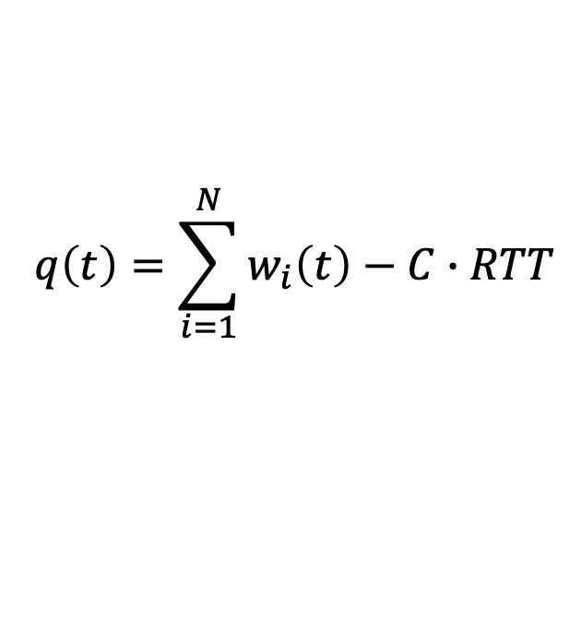
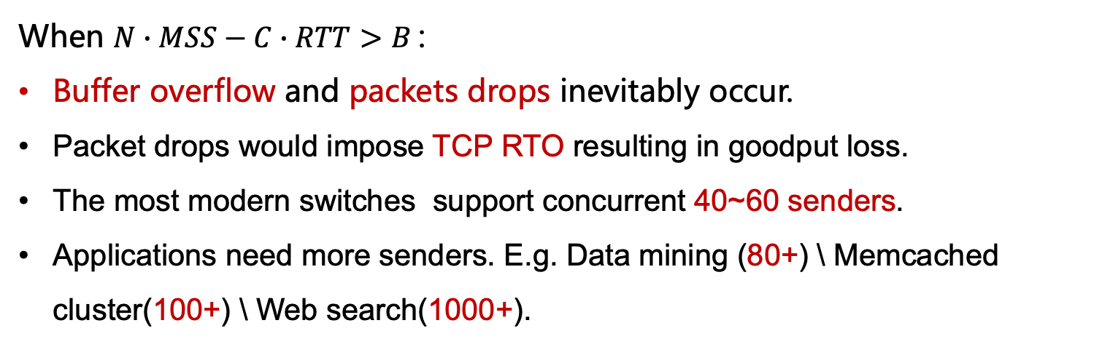
TCP Incast
Bottleneck queue length:
S₁
S₂
S₃
S_{N}
Notes:
However, the TCP incast problem causes performance degradation.
Multiple senders synchronously send data to one receiver.
The queue size q(t) can be shown in this formula. In the case of a large number of concurrent flows when N times MSS minus C times RTT bigger than B, bottleneck switches can quickly become overfilled.
Inevitable packet drops would impose TCP retransmission timeout for hundreds of milliseconds.
The goodput can be reduced up to 90%, which affects the performance of applications.
Depending on the configuration of the existing data center, the switch buffer supports up to 40 to 60 senders.
However, Applications need more senders. E.g. Data mining (eighty+) \ Memcached cluster(one handred+) \ Web search(one thusend+).

Slide 4
Multi-tenant Data Centers
In multi-tenant datacenters, admins can not control VM TCP stacks.
Because VMs are setup and managed by different entities.
New technologies are hard to deploy.
AC/DC TCP and vCC work in the hypervisor, which require full TCP state tracking and full TCP finite-state machines.
DCTCP was implemented in the lastest kernel, but it still has incast problems.
New Congestion
Control Algorithms
Virtual Machines
DCQCN
OS
OS
CP NDP
pFabric
OS
OS
AC/DC TCP and vCC
Notes:
Although many works have been done to address TCP Incast problems, they face a great challenge on real-world deployment in public and multi-tenant data centers. This is because that the common physical infrastructures such as switches and network interface cards are shared by multiple tenants in the form of virtual machines. Consequently, from the perspective of operators, when the tenants have already run the VMs, it requires more effort to modify the network protocol stack than to modify the common physical infrastructures. New technologies are hard to deploy.
Some work like AC/DC TCP and vCC works in the hypervisor, enable DTCTP in the vSwitch.
However, these methods require full TCP state tracking and full TCP finite-state machines in the hypervisor, which may overload the hypervisor and slow it down considerably.
And DCTCP was already implemented in the latest kernel, which can be used by tenants, but it still has the TCP incast problems.

Slide 5
Simulation Results
The result to show the incast problem.
Even one RTO occurs, the loss of goodput is enormous.
Even if the sending window is always 1 MSS, only about 80 concurrent flows can be maintained.
Notes:
To better understand the incast problems, we further conduct a simulation.
Three common CCs (NewReno with ECN, NewReno without ECN, DCTCP) and one particular CC that always sets the congestion window to 1 MSS are investigated.
From the simulation, we can find that:
(1) Even one RTO occurs, the loss of goodput is enormous.
(2) NewReno does not work well. Even with ECN, the number of senders cannot exceed 10.
(3) DCTCP can alleviate the occurrence of incast collapse, but the concurrency can only be maintained around 60.
(4) Even if the sending window is always 1 MSS, only about 80 concurrent flows can be maintained.

Slide 6
Goal & Our Approach
Goal
Transparent to TCP end-systems to handle the TCP Incast problems
R-AQM
Proactively intercepts and releases ACKs on congested swiches
ACK-triggered in-flight packets can fully utilize the bottleneck with short queues
Notes:
Our goal is to design an incast control mechanism in the multi-tenant data center Transparent to TCP end-systems to handle as many concurrent connections as possible effectively. We came up with a new active ACK control approach called R-AQM. The critical factor that inspires the new ACK control approach is that if a sender does not receive an ACK, the sender cannot send the next data packet. If the ACK can be intentionally delayed, the senders’ following sending action will also be delayed accordingly.

Slide 7
Forward delay v.s. Backward delay
The forward delay is important for the experience of the application.
The backward delay is used only for packets acknowledgement and CC decisions.
R-AQM offers a new trade-off.
Original
Data Packets
Sender
Receiver
ACKs
Sender
Receiver
R-AQM
Extra delay
Notes:
The rationale of R-AQM is to lower the nontrivial forward data queuing delay by introducing a trivial backward ACK queuing delay. In the incast traffic pattern applications, the for-ward packet is usually the service request packet (e.g., Reduce in MapReduce [21]), while the reverse packet is usually only the ACK without piggybacked data. Compared with the ACK’s backward queuing delay, applications pay more attention to the forward queuing delay of the data packets. Forward delay refers to the time taken by a packet departing from the sender to the receiver, which is very important for the application’s QoE. Backward delay in the reverse direction only delays the confirmation of a data packet.
R-AQM offers a new trade-off to lower the nontrivial forward data queuing delay by introducing a trivial backward ACK queuing delay.

Slide 8

Forward delay v.s. Backward delay
Data
ACK
Delay
Data Packets
Sender
Receiver
Switch
Notes:
We use a graph to show this.
The forward queue was congested at first.

Slide 9
Forward delay v.s. Backward delay
Data
ACK
Delay
Data Packets
Sender
Extra delay
Receiver
Switch
Notes:
R-AQM adds the extra delay for ACK.

Slide 10
Forward delay v.s. Backward delay
Data
ACK
Delay
Data Packets
Sender
Receiver
Switch

Slide 11
Forward delay v.s. Backward delay
Data
ACK
Delay
Data Packets
Sender
Receiver
Switch

Slide 12
Forward delay v.s. Backward delay
Data
ACK
Delay
Data Packets
Sender
Receiver
Switch

Slide 13
Forward delay v.s. Backward delay
Data
ACK
Delay
Data Packets
Sender
Receiver
Switch
Notes:
The next ACK has an extra delay and the data packet is sent later.

Slide 14
Forward delay v.s. Backward delay
Data
ACK
Delay
Data Packets
Sender
Receiver
Switch

Slide 15
Forward delay v.s. Backward delay
Data
ACK
Delay
Data Packets
Sender
Receiver
Switch

Slide 16
Forward delay v.s. Backward delay
Data
ACK
Delay
Data Packets
Sender
Receiver
Switch

Slide 17
Forward delay v.s. Backward delay
Data
ACK
Delay
Data Packets
Sender
Receiver
Switch

Slide 18
Forward delay v.s. Backward delay
Data
ACK
Delay
Data Packets
…
Sender
Receiver
Switch

Slide 19
Forward delay v.s. Backward delay
Data
ACK
Delay
Data Packets
Sender
Receiver
Switch
Notes:
In this way, R-AQM can always ensure that the forward queue has data to transmit, and the redundant ACKs are in the reverse queue.

Slide 20
Forward delay v.s. Backward delay
Forward Latency
Data
ACK
Delay
Data Packets
Sender
Receiver
Switch
Backward Latency
  To achieve low forward delay at the cost of negligible backward delay.
Notes:
R-AQM can achieve low non-trivial forward delay at the cost of negligible backward delay.

Slide 21
R-AQM
Virtual Input Queue (to store ACKs)
Token Bucket (to control the ACK draining rate)
State Decision Machine (to decide the ACK draining rate)
Notes:
This presents our design framework, which contains three main functional components: the Virtual Input Queue, the Token Bucket, and the State Machine. As shown in Figure, packets sent by the sender are queued on the bottleneck port as usual, and each packet a sender sends will be acknowledged by the receiver.
When the returned ACK enters the bottleneck port, the VIQ (virtual input queue) located in the switch input port recognizes ACKs, intercepts them and stores them;
The Token Bucket monitors the immediate egress sending packets and generates tokens to the bucket to trigger the VIQ dequeue action;
The State Machine gets queue length information, calculates the draining rate according to the congestion state. After the sender receives the ACK, the sender adjusts the sending rate and sends the next packet.

Slide 22




State Decision Machine
Congest State (CS), Draining State (DS), and Normal State (NS)
Use queue length and its gradient to judge the congestion state
Only three corresponding states are set
Simplifying the design
CS
NS
DS
CS
DS
K_{max}
K_{min}
Notes:
In R-AQM, we use queue length and its gradient to judge the congestion state comprehensively, and only three corresponding states are set, Congest State (CS), Draining State (DS), and Normal State (NS). Figure 5shows the state transition diagram, which is the most critical part of R-AQM. First, it calculates whether the queue length continues to grow or decline in time T. If the queue continues to grow, there will be a burst, so no matter how long the current queue is, it
should trigger an active buffer to accommodate burst (left part of Figure 5). If the queue length continues to decrease, it means that the burst has ended. The ACK can be returned at this point, rather than waiting for the queue to decrease to a certain value (right part of Figure 5). When the network state is stable, just like the traditional AQM, it can be determined by the threshold (middle part of Figure 5).

Slide 23
The side effects on TCP
Interaction with TCP RTO:
  R-AQM limits the rate of ACK, so it is inevitable to increase RTT.
  R-AQM does not adversely prolong the RTTs (e.g., with 200 connections, 99th RTT < 0.3ms)
  R-AQM uses switch time-out to dropping the out-of-order ACKs.
Interaction with TCP CC:
  BECN-like mechanism: R-AQM marks the ECN-Echo in the TCP packet header of the ACK.
  HSCC-like mechanism: R-AQM sets the ACK headers rwnd to 1 in the switch.
Notes:
R-aqm has the potential to affect TCP in two concerns.
One concern of R-AQM is its interaction with TCP RTO. R-AQM limits the rate of ACK in order to prevent RTO caused by packet loss, so it is inevitable to increase RTT.
For this reason, we specially measure the RTTs in our experiments. We find that our ACK control does not adversely prolong the RTTs. And we do not observe any spurious retransmission.
Even though this phenomenon is rare, we still take into account the possibility and design counter-measures.
Another concern of R-AQM is its interaction with TCP CC. R-AQM takes effect before packet loss and ECN trigger. Therefore, when R-AQM senses congestion, it not only needs to delay the ACK transmission, but also needs to prevent the sender from increasing the sending window.
Two mechanisms are recommended to compensate. The first is a BECN-like mechanism [36] that directly marks the ECN- Echo in the TCP packet header of the ACK in the switch when there exists congestion. The senders therefore can use ECN to reduce the sending window, avoiding congestion quickly. Second, by considering packet loss as the congestion signal [37], it is recommended to adopt a mechanism similar to HSCC [14] that directly sets the ACK headers rwnd to 1 in the switch.

Slide 24
Implementation
We build a prototype of R-AQM using the NetFPGA-SUME.
The R-AQM switch uses 14% LUTs, 10% FlipFlops , and 45% RAM.
The ECN-version FPGA switch uses 12%, 9%, and 40%.
Notes:
Ideally, the R-AQM’s Token Bucket and the State Machine would be implemented in switch ASICs. We build a prototype of such a solution using the NetFPGA-SUME platform.
The R-AQM switch uses fourteen percent LUTs, ten percent FlipFlops, and forty-five percent blocks of RAM. In comparison, the ECN-version FPGA switch uses tweleve%, nine%, and forty% respectively, so the complexity added by R-AQM is quite small.

Slide 25
Evaluation
NS-3 Simulation Setup
  Fat-tree topology.
  320 hosts (10Gbps) / 20 ToR (10Gbps) / 20 aggr (40Gbps) / 16 core switches (40Gbps).
Testbed setup
  4 hosts connected to single NetFPGA switch.
  Implementation on 10G NetFPAG-SUME.
  Each host has 10Gbps x 1port .
Notes:
In evaluation, we use NS-3 simulation and testbed. This is our setup.

Slide 26
Incast (Simulation)
N to 1 traffic, flow size is 3.2MB.
R-AQM can easily handle 200+ connections without goodput loss.
R-AQM can significantly reduce drop times, RTO times, one-way latency, RTT and queue length.
Notes:
In incast, N hosts send a flow to a host. We vary the number of flows from 1 to 200.
In general, R-AQM can easily handle 200 concurrent connections without seeing any trend in performance degradation, while Droptail and ECN begin to downgrade when the numbers of connections exceed 5 and 60, respectively.
R-AQM can significantly reduce drop times, RTO times, one-way latency, RTT and queue length.

Slide 27
Incast (Simulation)
Quickly Reaction to congestion.
R-AQM sustain near 90% goodput when facing 1000 senders.
R-AQM can reduce the fairness gap between different CCs.
Reaction Details Analysis
Sensitivity Analysis
Fairness in 10-to-1 incast
Fairness in 100-to-1 incast
Notes:
We also analyze the reaction details, sensitivity, and fairness between different CCs.
We can find R-AQM can Quickly react to congestion.
R-AQM sustain near 90% goodput when facing 1000 senders.
R-AQM can reduce the fairness gap between different CCs.

Slide 28
All to All (Simulation)
Select 60 machines, each sends a 500KB elephant flow and 50 5KB mice flows to the other 59 machines.
R-AQM can provide a low latency for mice flows,
R-AQM can effectively alleviate the incast problem.
Notes:
The all-to-all traffic patterns commonly happen in the shuffle step of MapReduce [21], which generates incast towards each host running a task. We select three machines on each rack, a total of sixty machines.
Through the above experiments, on the premise of avoiding RTO as much as possible, R-AQM can also provide a low latency for mice flows, which is enough to show that R-AQM can effectively alleviate the incast problem.

Slide 29
Throughput and Latency (Testbed)
3 to 1 Incast :
  50th latency reduced by 30%.
  Fair distribution of throughput.
4 to 4 Scenario :
  R-AQM can reduce latency and packet loss.
Latency and Throughput of CDF in the incast scenario (testbed)
Latency and Drop Times in the all to all scenario (testbed).
Notes:
The testbed scale is very small, But The effect of R-AQM is also verified. In 3 to 1 Incast, R-AQM can reduce latency by 30%. And In 4 to 4 secnario R-AQM can also reduce latency and packet loss. To conclude from our experiment, R-AQM effectively tames incast problems, decreases packet loss rate, reduces latency, and provides better fairness.

Slide 30
Conclusion
R-AQM is a transparent reverse ACK AQM.
R-AQM works for multi-tenant data centers.
Taming the TCP incast problem through active ACK control.
R-AQM reduces the forward queue delay by introducing a backward ACK delay.
Notes:
In conclusion, •R-AQM is a transparent reverse ACK AQM.
•R-AQM works for multi-tenant data centers.
•Taming the TCP incast problem through active ACK control.
•R-AQM reduces the forward queue delay by introducing a backward ACK delay.

Slide 31
Thanks
Happy to answer your questions
Notes:
That's a very good question.
R-aqm is for multi-tenant data center networks.
We don‘t want to modify the TCP at end host.
Please refer to our paper for details.
R-AQM is a transparent reverse ACK AQM.
•R-AQM works for multi-tenant data centers.
•Taming the TCP incast problem through active ACK control.
•R-AQM reduces the forward queue delay by introducing a backward ACK delay.

Slide 32
Backup Slides

