Slide 1
On Design and Performance of Offline Finding Network
Tong Li, Jiaxin Liang, Yukuan Ding, Kai Zheng,
Xu Zhang, and Ke Xu
Notes:
Hi, my name is Tong Li from Renmin University of China
Today I am going to introduce our work
on design and performance of offline finding network

Slide 2
Where is it?
Notes:
Realizing your items have been missing is a feeling of panic.

Slide 3
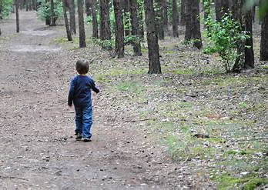
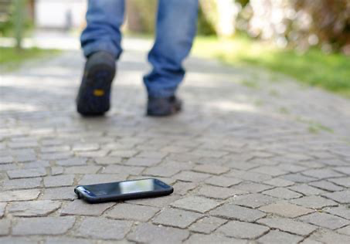
Lose Elicits Panic
Children or elderly people
Phone
Pets
2000
per hour
Millions
per year
1/3 lost
80% unfound
Notes:
Items, people and pets can be lost
It is reported that nearly 2000 phones
are lost or stolen every single hour
Moreover, millions of children or elderly people worldwide
are going missing every year.
One-third of all pets are reported missing in their lifetimes,
and more than 80% are never found

Slide 4
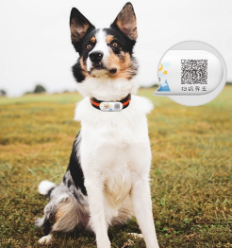
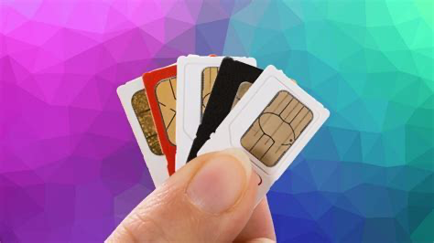
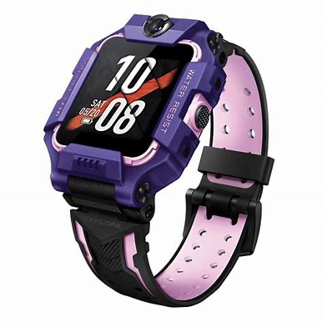
Wearable Devices Are Being Equipped With Position Tracking
GPS
① Get location
② Upload location
Internet
Expensive
Shorter battery life
③ Query
Internet Access
Lost Devices
Owner
Notes:
In this case, some wearable devices are being equipped with
the feature of position tracking
【】These devices apply a positioning module to obtain the location
【】and upload the location to the cloud via a built-in SIM card
【】The owner then can query this location from the cloud
【】However,with the complicated built-in functions of communication and positioning
these devices are usually expensive and are with shorter battery life

Slide 5
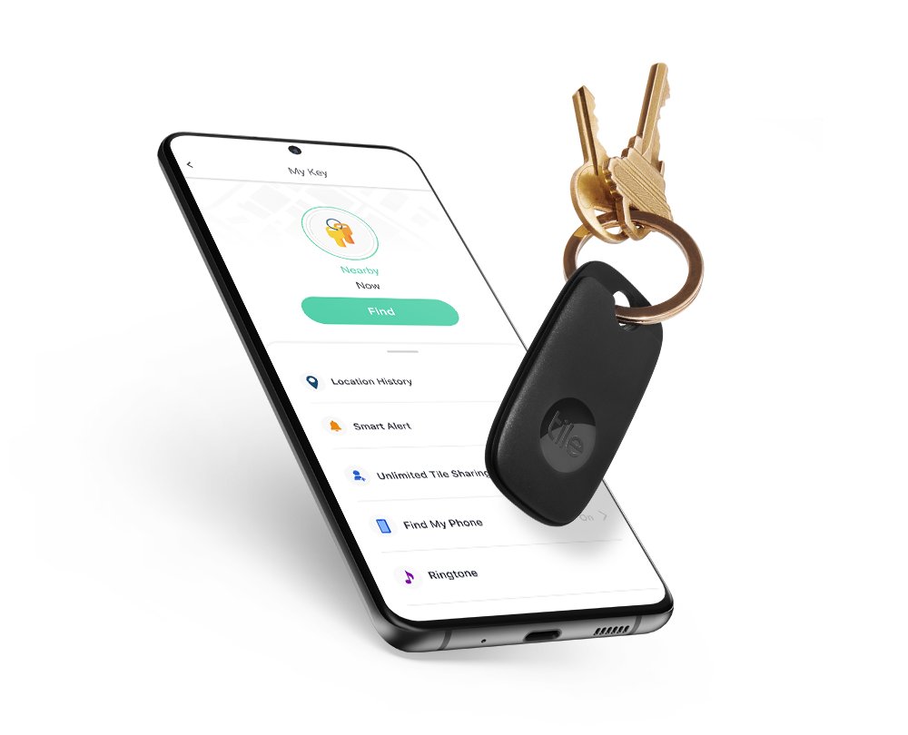
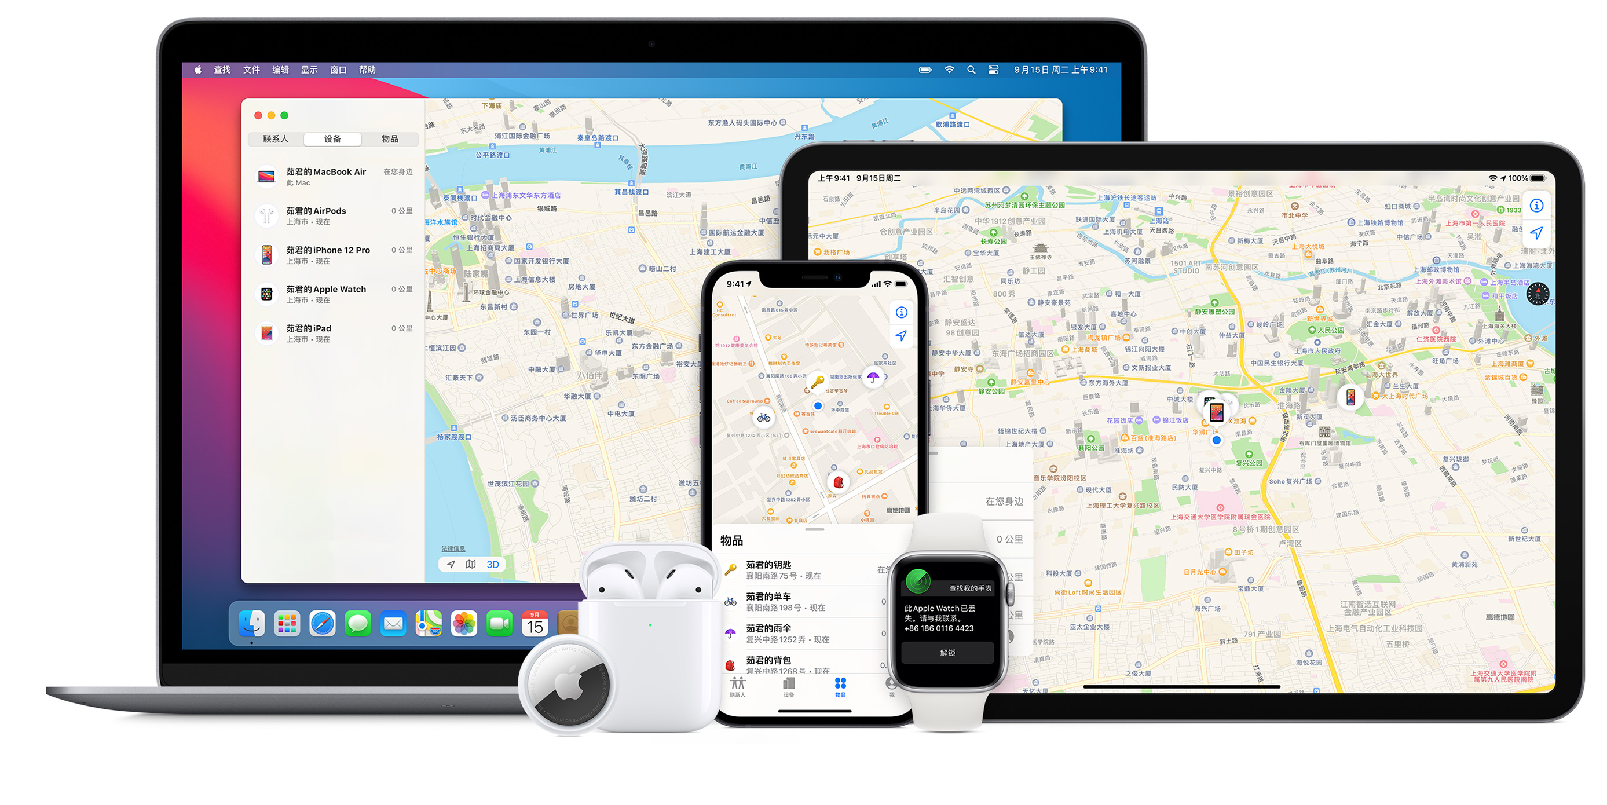
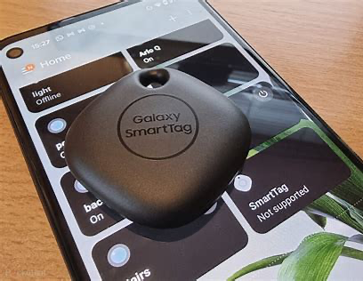
Offline Find Network (OFN)
Tile
Apple
Samsung
Huawei
Notes:
To tackle this issue, industrial pioneers
such as Tile, Apple, Samsung and Huawei
have offered an offline finding network

Slide 6
An Overview of OFN
Notes:
In general, the ecosystem of OFN has four types of roles
As shown in the figure
the Lost Device is usually a thin device
(e.g., watch, headset, tag)
without complicated built-in functions of communication and positioning
While it can also be a rich device
(e.g., phone, tablet) without online access
The Finder Devices are composed of a group of users
that are nearby and under the Bluetooth signal coverage of the lost device
These devices are usually rich devices
with built-in functions of communication and positioning
acting as volunteers to help the offline lost device report its location
The Cloud Server provides the storage service of the reported locations in the cloud
Since the location data is encrypted
the privacy of finder devices is protected
The Owner Client is usually a device with Internet access
that decrypts the location data queried from the cloud server

Slide 7
An Overview of OFN
【e.g., Airtag】
【e.g., iPad】
【e.g., iCloud】
【e.g., crowd-sourced iPhones】
Notes:
To understand how OFNs work in detail
we take Apple’s Find My feature
that works with Apple’s iPhone and AirTag as a case study
Step 1, the owner binds AirTag to the iPhone
and the Find My application generates the key pair
whose public key is stored in the AirTag
When the AirTag is detected and marked as lost (in Step 2)
it generates rolling public keys periodically (in Step 3)
In Step 4, the AirTag broadcasts the public keys periodically
and multiple nearby iPhones get the public key via BLE neighbor discovery
In Step 5, these finder's iPhones retrieve their current location
encrypt the location with the public key
and upload the encrypted location record (in Step 6)
To find the lost AirTag
the paired owner's iPhone generates the list of the rolling public keys
that the AirTag would have used in the last days
and queries the iCloud server (in Step 7)
In Step 8, the server returns the encrypted location records
for the list of requested public keys
and finally in Step 9
the owner's iPhone decrypts the location records with its private key
and obtains an approximate location of the lost AirTag

Slide 8
An Overview of OFN
Enabling crowd search without leaking private data
A first step to highlight OFN’s performance issues
Privacy and Security Issues
Performance Issues
Notes:
To the best of our knowledge
almost all prior works focus on privacy and security analysis of OFN systems
Their goal falls into the category of
enabling crowd search without leaking private data
This paper does not focus on the security and privacy issues of OFNs
Instead
we take a first step to highlight its design challenges
from the perspective of performance.

Slide 9
Neighbor Discovery is the prerequisite stage of OFN
【e.g., Airtag】
【e.g., iPad】
Performance Issues
【e.g., iCloud】
【e.g., crowd-sourced iPhones】
Neighbor Discovery
Notes:
The performance issue of OFN comes from the bottleneck in Step 4
which we call it neighbor discovery
As the prerequisite /ˌpriːˈrekwəzɪt/ stage of OFN
neighbor discovery is a process
where a finder device seeks to first contact the lost device
within the Bluetooth range

Slide 10
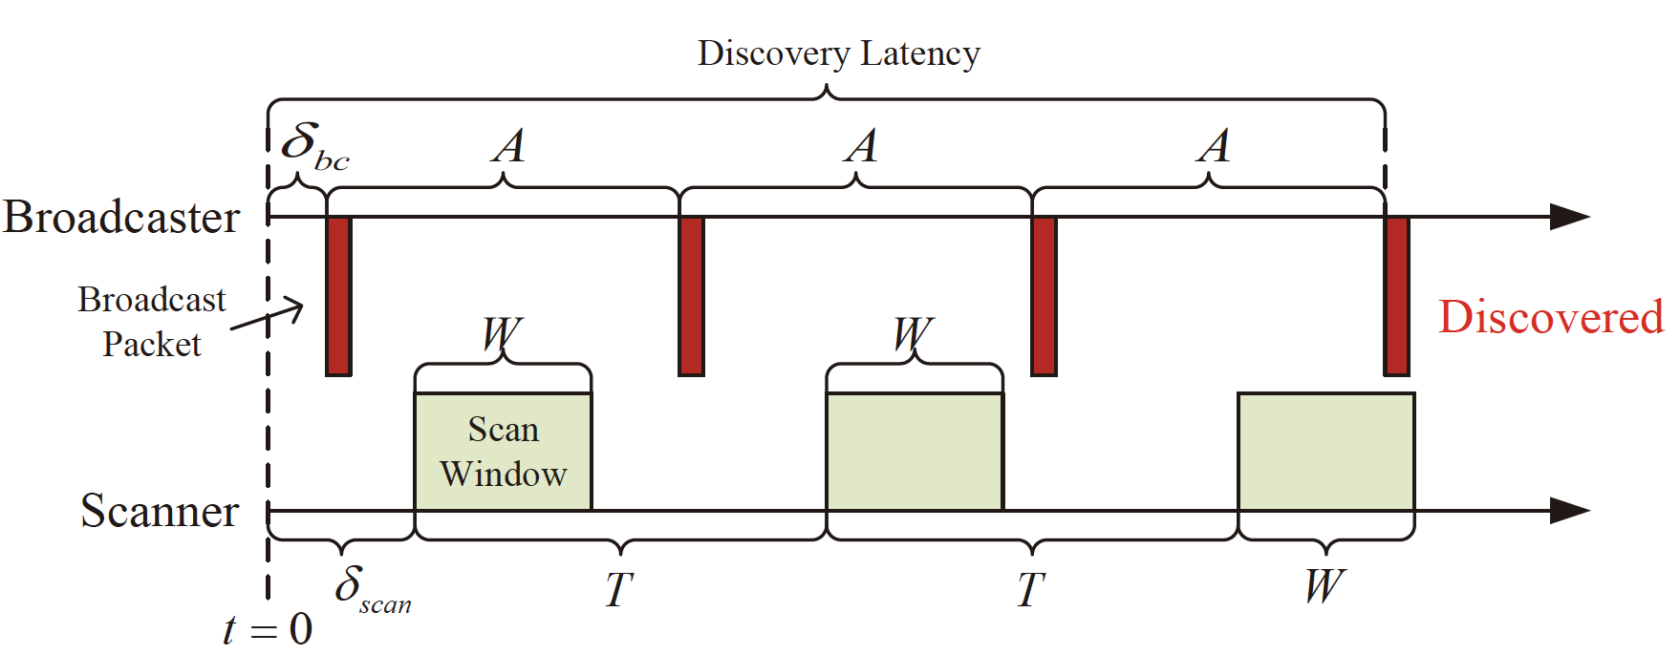
Neighbor Discovery Latency
Notes:
We therefore focus on the performance metric of neighbor discovery latency
It involves interactions between a broadcaster and a scanner
in a duty-cycling paradigm with three parameters
the broadcaster’s broadcast interval (A)
the scanner’s scan window (W)
and the scanner's scan interval (T)

Slide 11
Motivation
Neighbor Discovery Latency Matters in OFN
Discovery Latency is a Non-linear Function of Power Consumption
Finder Devices Vary in Scan Modes
Scan Mode Diversity Results in Local Optima
Notes:
Next, we will motivate our work by offering four insights.
We find that neighbor discovery latency matters in OFN
And this discovery latency is a non-linear function of power consumption
We further find that finder devices vary in scan modes
And this scan mode diversity results in local optima

Slide 12
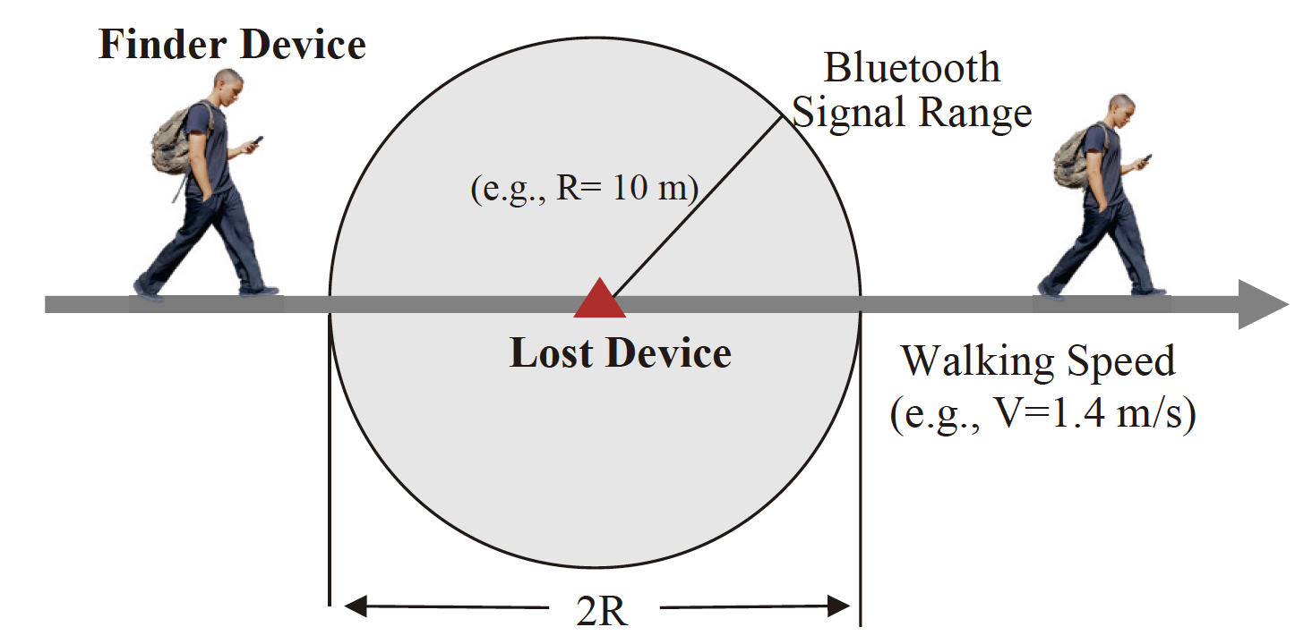
Insight 1: Neighbor Discovery Latency Matters in OFN
Neighbor discovery between finder device and lost device in the walking scenario
Neighbor discovery latency
Success ratio of finding lost device
Neighbor discovery latency should not exceed the time the person spends within the Bluetooth signal range (i.e., T = 2R/V ≈ 14 s)
Notes:
Let’s come to the first insight
neighbor discovery latency matters in OFN
To explain this more clearly
we give an example of how a lost device is found by a finder device
As shown in the figure
a person with a finder device passes the Bluetooth signal range
of a lost device at a walking speed
In this case
the neighbor discovery latency should not exceed
the time the person spends within the Bluetooth signal range (i.e., 14 seconds)
Otherwise, the finder device fails to find the lost device
and the opportunity is wasted
Thus we conclude that
neighbor discovery latency approximates the possibility of finding lost devices

Slide 13
Insight 2: Discovery Latency is a Non-linear Function of Power Consumption
The distribution of the worst-case discovery latency (upper bound).
Scan Window (W) = 1024 ms and Scan Interval (T) = 4096 ms
Worst-Case Latency
7
6
Discovery Latency (s)
5
4
3
2
1
0
1000
2000
3000
4000
5000
6000
Broadcast Interval (ms)
Broadcast interval is inversely proportional to power consumption
Notes:
It has been well-studied that
the trade-off between discovery latency and power consumption
should be carefully handled
to meet the application's required performance under the power constraint
Intuitively
discovery latency is inversely proportional to power consumption
However, we find that in most cases
discovery latency is a non-linear function of power consumption

Slide 14
Insight 2: Discovery Latency is a Non-linear Function of Power Consumption
The distribution of the worst-case discovery latency (upper bound).
W = 1024 ms and T = 4096 ms
Worst-Case Latency
7
6
Discovery Latency (s)
Measured Latency
5
4
3
2
1
0
1000
2000
3000
4000
5000
6000
Broadcast Interval (ms)
Notes:
Since both broadcaster and scanner may randomly come into the range of reception
The measured discovery latencies (plotted as blue stars)
range from zero to the worst-case latency

Slide 15
Insight 2: Discovery Latency is a Non-linear Function of Power Consumption
The distribution of the worst-case discovery latency (upper bound). W = 1024 ms and T = 4096 ms
Worst-Case Latency
7
Local Minimum Worst-Case Latency
6
Discovery Latency (s)
5
4
3
2
1
$$=\left\lceil \frac{T}{W}\right\rceil$$
Slope of line
0
1000
2000
3000
4000
5000
6000
Broadcast Interval (ms)
Notes:
We further find that
there exist multiple local minimum worst-case latencies (plotted as blue cycles)

Slide 16
Insight 2: Discovery Latency is a Non-linear Function of Power Consumption
The distribution of the worst-case discovery latency (upper bound). W = 1024 ms and T = 4096 ms
Peak
Worst-Case Latency
7
Semi-peak
Local Minimum Worst-Case Latency
6
Discovery Latency (s)
5
Semi-valley
4
3
Valley
2
1
$$=\left\lceil \frac{T}{W}\right\rceil$$
Slope of line
0
1000
2000
3000
4000
5000
6000
Broadcast Interval (ms)
Given a scan mode, there exist multiple broadcast intervals within the “Valley Area”
Notes:
We therefore define that a broadcast interval is within the “valley area”
when it achieves the local minimum worst-case latency
And a broadcast interval is within the
“semi-valley area”, the “semi-peak area”, and the “peak area”, respectively
according to the increased latency compared to
the corresponding local minimum worst-case latency
To summarize
the existence of multiple valley areas implies that
we might fail to reduce discovery latency
by simply reducing the broadcast interval
Instead
we need to “smartly” select the broadcast interval within valley areas
while do not violate the power constraint

Slide 17
Insight 3: Finder Devices Vary in Scan Modes
Scan modes
SCAN_MODE_LOW_LATENCY (W=T)
SCAN_MODE_BALANCED (W=1024 ms, T=4096 ms)
SCAN_MODE_LOW_POWER (W=512 ms, T=5120 ms)
HarmonyOS customized mode (W=20ms, T=600ms)
……
Crowd-sourced Finder Devices are uncontrollable
Power-saving mode or high-performance mode
Device screen is on or off
Application in the foreground or background
Notes:
Our third insight is that
The finder devices vary in scan modes
This is because the crowd-sourced finder devices are uncontrollable
For example
An application running in the foreground might use the LOW_LATENCY scan mode
While it may use the LOW_POWER scan mode when running in the background

Slide 18
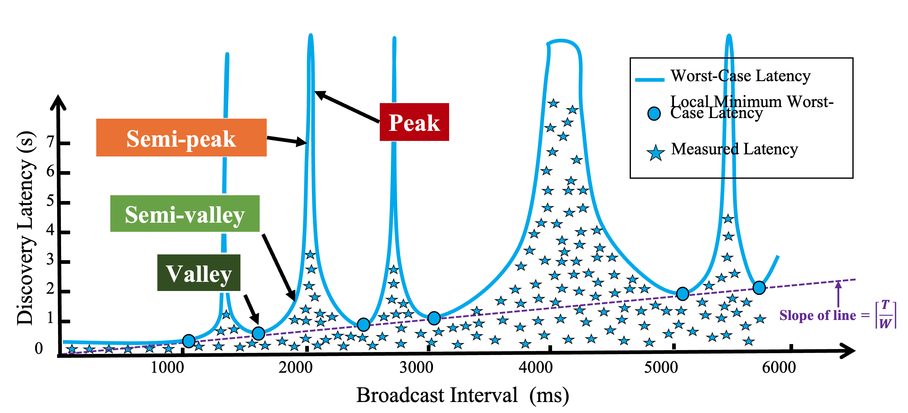
Insight 4: Scan Mode Diversity Results in Local Optima
Local Optimal
Broadcast Interval
A = 2000 ms
Lost Device
…
Scanner 1
Scanner 2
Scanner 3
Valley
Peak
Semi-peak
Scan mode 1
30ms/300ms
Scan mode 2
60ms/600ms
Scan mode 3
60ms/3000ms
(a) Legacy way of neighbor discovery
Notes:
As discussed above
for each scan mode we should carefully search an optimal broadcast interval
to obtain the minimum upper bound of discovery latency
However
the distribution of the worst-case latency varies with the scan mode
As a result
an optimal broadcast interval for a certain scan mode
might not be the optimal broadcast interval for another scan mode
This reveals that the scan mode diversity results in local optima

Slide 19
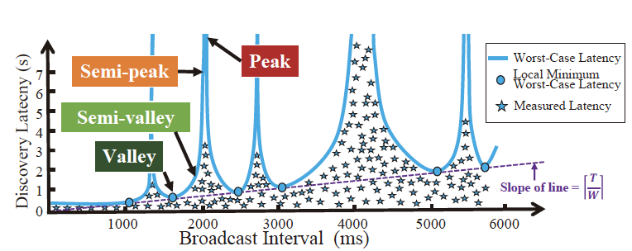
Insight 4: Scan Mode Diversity Results in Local Optima
Local Optimal
Broadcast Interval
A = 2000 ms
Global Optimal
Broadcast Interval
Lost Device
Lost Device
…
…
Scanner 1
Scanner 2
Scanner 3
Scanner 1
Scanner 2
Scanner 3
Valley
Peak
Semi-peak
Valley
Valley
Semi-valley
Scan mode 1
30ms/300ms
Scan mode 2
60ms/600ms
Scan mode 3
60ms/3000ms
Scan mode 1
30ms/300ms
Scan mode 2
60ms/600ms
Scan mode 3
60ms/3000ms
(a) Legacy way of neighbor discovery
(b) Goal of Neighbor discovery
Notes:
In this paper
we aim to search for the global optimal broadcast pattern
that makes the broadcast interval(s) within the valley or semi-valley area
for all types of scan modes

Slide 20
Goal:
Achieving globally optimal neighbor discovery latency by overcoming the challenges induced by scan mode diversity
Notes:
That is
achieving globally optimal neighbor discovery latency
by overcoming the challenges induced by scan mode diversity

Slide 21
ElastiCast
Notes:
Thus we present a brand-new broadcast mode called ElastiCast
ElastiCast deals with the scan mode diversity issues through the following modules:
Local Optima Estimation
Common Interest Extraction
and Interval Multiplexing

Slide 22
Local Optima Estimation
Broadcast Setting
Neighbor Discovery Simulator (Blender^{[1]})
CDF
$$P$$
$$A_{1}$$
$P$-Percentile Latency Distribution
Discovery Latency
CDF
$P$-Percentile Latency
Scan Setting
Broadcast Setting
$$P$$
$$\left(T,W\right)$$
$$A_{2}$$
Discovery Latency
Broadcast Interval
…
…
$$A_{1}$$
$$A_{2}$$
…
$$A_{m}$$
Broadcast Setting
CDF
Output
$$A_{m}$$
$$P$$
Discovery Latency
Input
The work progress of local optima estimation
Reference:
[1] Yukuan Ding, Tong Li, Jiaxin Liang, et al. Blender: Toward Practical Simulation Framework for BLE Neighbor Discovery. ACM MSWiM, pp. 1-8, 2022.10.24.
Notes:
Local Optima Estimation provides Blender
a neighbor discovery simulator
that simulates the behavior of broadcasters and scanners
Its input contains multiple settings of scan modes
among all possible finder devices
and its output is the set of latency distributions
as the functions of the broadcast interval

Slide 23
The basic framework of data flow in ElastiCast
For more design details on the Common Interest Extraction and Interval Multiplexing modules, please refer to the paper
Scan Modes
Latency
$$\left(T_{1},W_{1}\right)$$
Broadcast Interval
Latency
Broadcast Pattern
Local Optima Estimation
Latency
Common Interest Extraction
Interval Multiplexing
Broadcast
Interval
$$\left(T_{2},W_{2}\right)$$
Broadcast Interval
…
…
Latency
$$b_{2}$$
Broadcast Interval
$$\left(T_{n},W_{n}\right)$$
$$b_{1}$$
$$b_{3}$$
Time
Broadcast Interval
Common Broadcast Intervals
Output
Input
$P$-Percentile Latency Distribution
Notes:
Common Interest Extraction makes full use of the non-linear relationship
between discovery latency and power consumption
It picks the common broadcast intervals
that achieve minimized discovery latency among all scan modes
However
simply setting a single optimal broadcast interval
might result in bias due to the random advertising delay
a random value with a range of 0 ms to 10 ms
generated for each broadcast event
Thus we further apply the Interval Multiplexing module
to overcome the hurdles caused by the random advertising delay
It adopts the intermixed use of multiple feasible broadcast intervals
instead of the single one
It steps further toward the global optima in the cases
where the random advertising delay is non-negligible
For more design details on the Common Interest Extraction and Interval Multiplexing modules, please refer to the paper

Slide 24
Evaluation
Inputs:
512ms/5120ms (i.e., LOW POWER) and 1024ms/4096ms (i.e., BALANCED) are two types of default scan modes supported by most Android phones
20ms/600ms and 30ms/300ms are two types of customized scan modes (e.g., HarmonyOS )
Parameters:
We run tests for broadcast intervals that meet A ∈ [A_{left},A_{right}], where we recommend A_{left} ≥ 20 ms and A_{right} < min{10240ms, latency tolerance} according to the whole range of broadcast intervals allowed in BLE
Schemes:
LOP (Local OPtima): the scheme that sets the broadcast interval that achieves the tight duty-cycle-dependent bounds on discovery latency for only one type of scan mode, i.e., LOP locally optimizes latency.
ElastiCast-SBP refers to the Single Broadcast Pattern without applying Interval Multiplexing
ElastiCast-ABP refers to the Alternation Broadcast Pattern with applying Interval Multiplexing
Notes:
For evaluation
We take into account multiple practical scan modes in modern commercial phones
And we compare the proposed ElastiCast with the legacy way of local optima

Slide 25
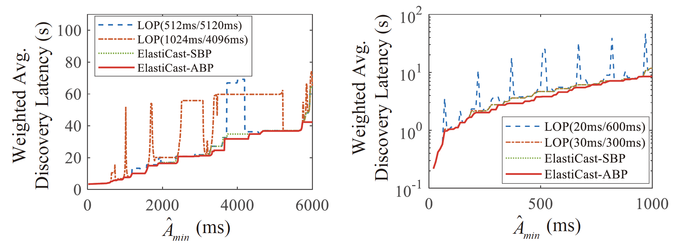
Evaluation
ElastiCast can always bound the neighbor discovery latency in the case of scan mode diversity
We examine the minimized weighted average discovery latency (Y-axis) when applying each scheme within the power budget in the form of (X-axis)
ElastiCast has been deployed in Huawei’s commercial-off-the-shelf (COTS) BLE devices, called HUAWEI Tag
Scan modes: 512ms/5120ms and 1024ms/4096ms
Scan modes: 20ms/600ms and 30ms/300ms
Notes:
Here is the result
Compared to the legacy way of local optima
ElastiCast reduces the discovery latency by 50% to 90%
within the power budget in our case studies
ElastiCast can always bound the neighbor discovery latency in the case of scan mode diversity
This is because that
ElastiCast adapts well to the scan mode diversity
by searching for the best broadcast pattern
that achieves the globally minimized discovery latency
within the power budget

Slide 26
Takeaways
Performance issues also exist in Offline Finding Network (OFN)
We take a first step toward understanding the OFN framework and highlight its design challenges from the perspective of performance
Neighbor discovery latency matters in OFN
Neighbor discovery latency should not exceed the time the person spends within the Bluetooth signal range
Discovery latency is a non-linear function of power consumption
Given a scan mode, there exist multiple broadcast intervals within the “Valley Area”
Finder devices vary in scan modes
The crowd-sourced finder devices show diversity in scan modes due to different power modes or different manufacturers
Scan mode diversity results in local optima
An optimal broadcast interval for a certain scan mode might not be the optimal broadcast interval for another scan mode.
ElastiCast is proposed to achieve global optima by overcoming the challenges induced by scan mode diversity
ElastiCast can always bound the neighbor discovery latency in the case of scan mode diversity
Notes:
We conclude this talk with the following six takeaways
First,
performance issues also exist in offline finding network
We take a first step toward understanding the OFN framework
and highlight its design challenges from the perspective of performance
Second,
neighbor discovery latency matters in OFN
Third,
discovery latency is a non-linear function of power consumption
Forth,
Finder devices vary in scan modes
However,
this scan mode diversity results in local optima
Therefore
ElastiCast is proposed to achieve global optima
by overcoming the challenges induced by scan mode diversity

Slide 27
Thank you!
Email: tong.li@ruc.edu.cn
Q&A
Notes:
That all for my talk
Thank you for your attention
I will be happy to take any questions

