Slide 1
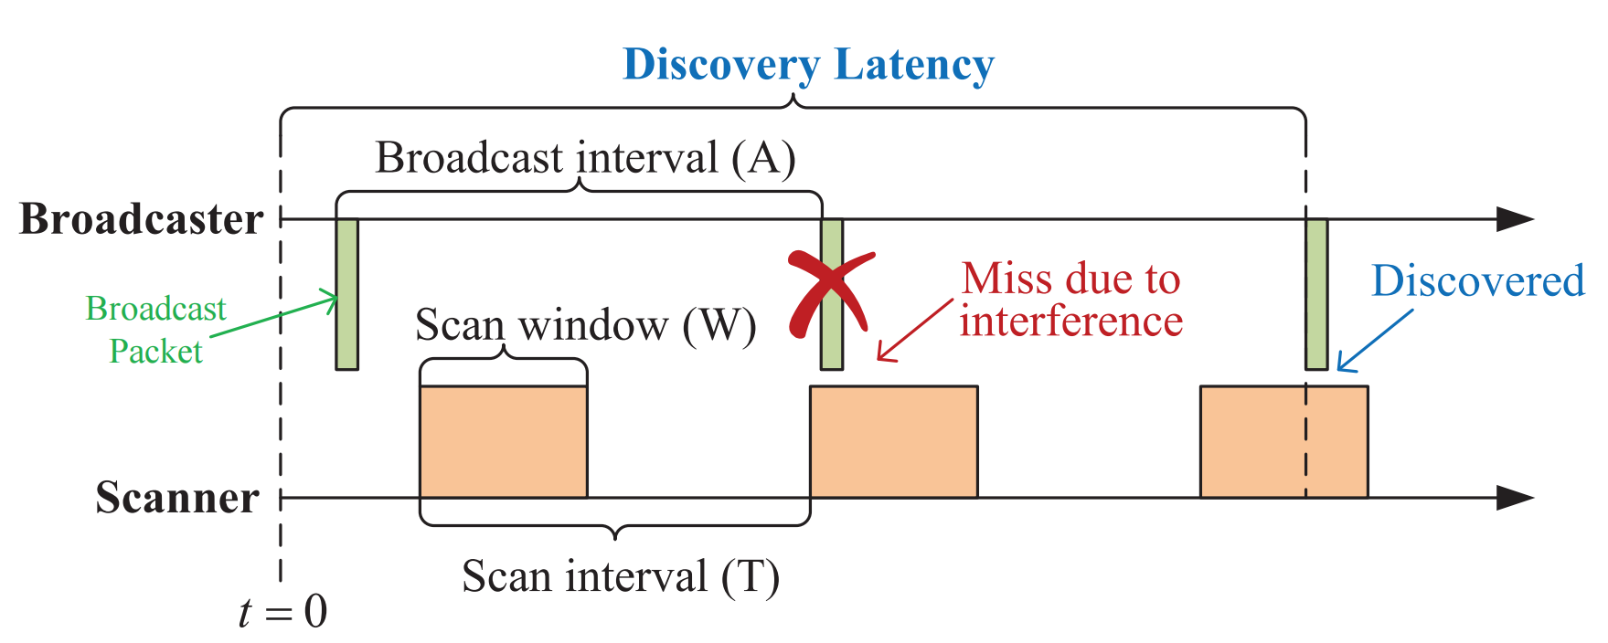
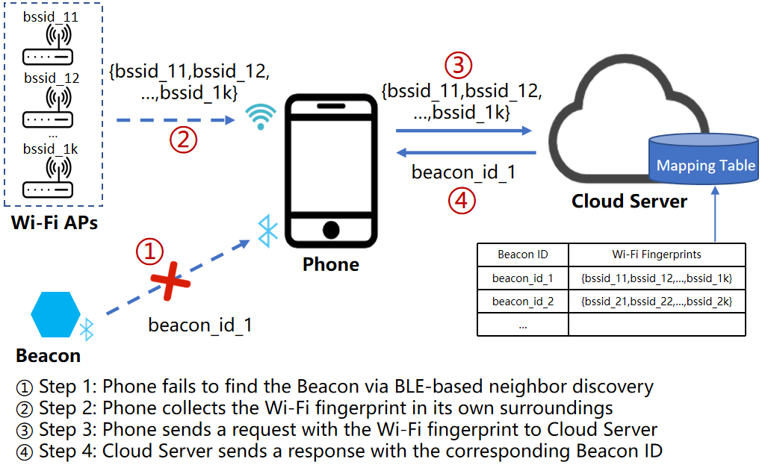
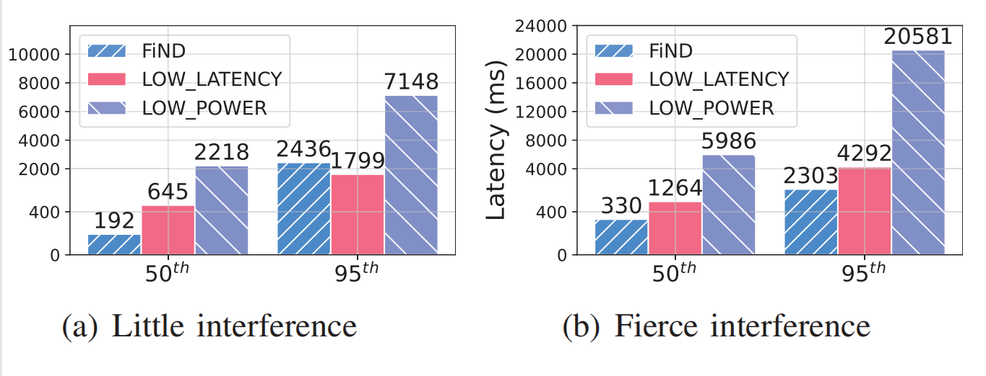
Accelerating BLE Neighbor Discovery via Wi-Fi Fingerprints
Tong Li†‡, Bowen Hu† , Guanjie Tu† , Jinwen Shuai† , Jiaxin Liang‡ , Yukuan Ding§ , Ziwei Li¶ , and Ke Xu¶
Renmin University of China† , Huawei‡ , HKUST§ , Tsinghua University¶
Abstract
We demonstrate the design of FiND, a novel neighbor discovery protocol that accelerates BLE neighbor discovery via Wi-Fi fingerprints without any hardware modifications. The design rationale of FiND is that the two modes of WiFi and BLE show complementarity in both wireless interference and discovery pattern. When abstracting the neighbor discovery problem, this demonstration provides validation for the approach of reasoning-based presence detection in the real world.
1
Background
Bluetooth Low-Energy (BLE) neighbor discovery acts as the prerequisite stage of the widespread Proximity Beacon scenarios such as marketing activities and interactive applications (e.g., seamless access systems, robot navigation). BLE neighbor discovery latency is affected by the following aspects.
BLE neighbor discovery suffers from the trade-off between latency and power consumption (see Figure 1).
BLE neighbor discovery further suffers from wireless interference.
2
Step 1:The Phone starts BLE scanning for a certain period of time, if it fails to find the Beacon, it goes to Step 2.
Step 2: The Phone collects the Wi-Fi fingerprint via Wi-Fi scanning or directly reads the historical records readily available in the cache.
Step 3: The Phone sends a request with the Wi-Fi fingerprint to the Cloud Server.
Step 4: Cloud Server then queries the Beacon ID according to the Wi-Fi fingerprint in the Mapping Table, and sends a response to the phone. The Phone then indirectly discovers the BLE Beacon by applying the FiND system.
4
PART 2
Fig. 1: The duty-cycling of BLE neighbor discovery.
Motivation
Kindt et al. have proposed the tight bounds on latency that no prior neighbor discovery parameter setting approaches can beat, and concluded there is no further potential to improve the relationship between latency and duty cycle.we argue that a huge room still exists for improvement with the auxiliary of ubiquitous Wi-Fi APs in practical scenarios.
Wi-Fi and BLE show complementarity in wireless interference.
Wi-Fi and BLE show complementarity in discovery patterns in two aspects:
Wi-Fi not only supports BLE-like passive scanning but also supports active scanning during which the client radio transmits a probe request and listens for a probe response from an AP.
Wi-Fi always returns discovery results (although might be from a previous scan if the current scan has not been completed or succeeded), while BLE may return nothing.
3
Fig. 2: The basic workflow of FiND.
Demonstration and Evaluation
We implement the proposed protocol FiND into the Android platform with the assistance of a cloud server (see https://github.com/litonglab/find). We further showcase two representative scenarios of different duty cycles and wireless interference:
As shown in Figure 3(a), employing FiND to accelerate BLE neighbor discovery with a limited power budget (i.e., a low-duty cycle);
As shown in Figure 3(b),employing FiND to accelerate BLE neighbor discovery with fierce interference.
For both scenarios, FiND significantly reduces 46.3% to 65.9% of the 95th percentile neighbor discovery latency.
5
Design
We design FiND, a Fingerprint-based Neighbor Discovery protocol that makes full use of the complementarity between Wi-Fi and BLE. In the case of a long BLE neighbor discovery latency, FiND accelerates the discovery by deducing the presence of the BLE Beacons according to the presence of Wi-Fi fingerprints through the historical correlation between them. Figure 2 illustrates an example of the basic workflow of FiND where a Phone uses a Wi-Fi fingerprint to deduce the Beacon ID with the help of a remote Cloud Server.
4
PART 1
Fig. 3: Testbed results.
Conclusion
Using the cloud-assisted deployment with the complementarity between BLE and Wi-Fi signals, testbed results verify that the proposed FiND can achieve stable and low discovery latency regardless of the power budget or wireless interference.
6
REFERENCES
[1] P. H. Kindt and S. Chakraborty, “On optimal neighbor discovery,” in ACM SIGCOMM, 2019, pp. 441–457.
[2] “Proximity beacon,” https://altbeacon.org/, 2022.
[3] T. Li, J. Liang, D. Wang, Y. Ding, K. Zheng, X. Zhang, and K. Xu, “On design and performance of offline finding network,” in IEEE INFOCOM, 2023, pp. 1–10.
[4] “Android wi-fi scan,” https://developer.android.com/guide/topics/connectivity/wifi-scan, 2020.
[5] P. Jaccard, “The distribution of the flora in the alpine zone. 1,” New phytologist, vol. 11, no. 2, pp. 37–50, 1912.
[6] “Android ble scan settings apis,” https://developer.android.com/reference/android/bluetooth/le/ScanSettings.

