Slide 1
Revisiting Loss Recovery for High-Speed Transmission
Hui Xie♥♦, Tong Li♠
♥️
♦
♠
Notes:
Hi, I am Hui Xie from Tsinghua University. Today I am going to introduce our recent work on Revisiting Loss Recovery for High-Speed Transmission.

Slide 2
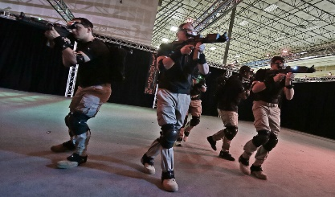
High Speed Rails (HSRs)
Wide area network (WAN) demands ultra-high bandwidth transmission
Cloud AR/VR gaming
Ultra-high-definition
(UHD) streaming
Data Source: Mangiante, Simone , et al. “VR is on the Edge: How to Deliver 360° Videos in Mobile Networks.” VR/AR Network, 2017.
Metaverse
Notes:
The emerging applications such as cloud AR/VR gaming, ultra-high definition streaming, and Metaverse imply the demand for ultra-high bandwidth transmission in the wide area network.

Slide 3
High Speed Rails (HSRs)
Is it possible to achieve as good a performance as the dedicated networks via non-dedicated links?
Dedicated links:
High bandwidth
Low latency (jitters)
Less losses
Large corporations may deploy
Non-dedicated links:
High bandwidth
Large RTT (jitters)
Lossy
Small and medium enterprises may afford
Dedicated links
Non-dedicated links
Notes:
Large corporations may deploy dedicated links to ensure fast and reliable data transmission for part of their services. However, a vast number of other services are transmitted via the public and cheap links with high bandwidth (e.g., 1 or 10 Gbps) but long round-trip time (RTT) and high packet loss ratio (PLR). This proportion is much larger for small and medium enterprises who cannot afford the expensive dedicated links. This raises a question: “Is it possible to achieve as good a performance as the dedicated networks via non-dedicated links?”

Slide 4
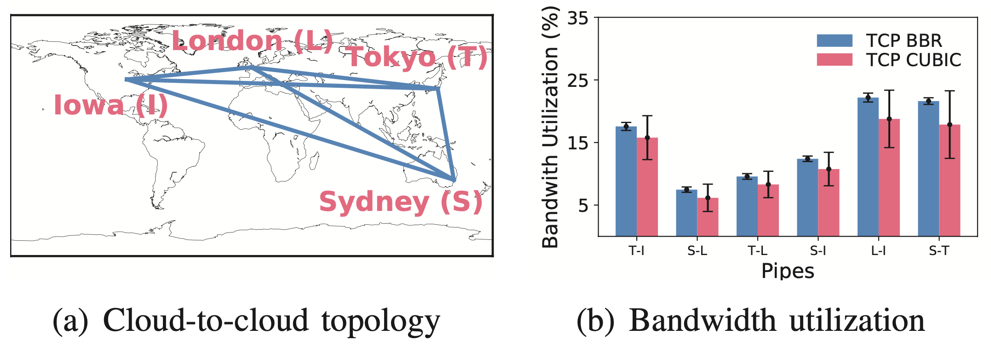
TCP fails to fill up the pipe
Classical loss-based TCP: TCP Reno, TCP CUBIC, etc.
High-speed and non-loss-based TCP variants: FAST TCP, Compound TCP, TCP BBR, etc.
Pipes are verified not full but TCP only achieves bandwidth utilization of less than 25%. Where bw = 1 Gbps, rtt ∈ [100,300] ms. The maximum receive buffer of TCP is 16 MB in the cloud end-hosts.
Notes:
Considering a network with high bandwidth-delay product (BDP) and lossy links, the desire for fast and reliable data transmission in interactive scenarios is far from satisfactory. For example, data transmissions over long distances using TCP-based protocols (including FTP and HTTP) can only utilize a limited amount of bandwidths. It is observed that network infrastructures with multi-Gbps delivery capacity provide only a rate of a few Mbps over cross-country and intercontinental distances. As shown in the Figure, it is observed that both loss-based and non-loss-based TCPs only achieve bandwidth utilization of less than 25% even when there is sufficient available bandwidth.

Slide 5
So, why TCP fails to fill up the pipe?
Insight: TCP’s capability of loss recovery does not match the capability of high-speed TCP advancements such as non-loss-based congestion control .
Loss recovery
Loss recovery
TCP CUBIC
TCP BBR
Notes:
So why TCP fails to fill up the pipe? Our insight in this paper is that the current capability of loss recovery does not match the capability of high-speed TCP advancements such as non-loss-based congestion control.

Slide 6
Takeaways
Loss-based TCP improperly decreases window
Recovery capability does not match high-speed TCP
Application-level optimization do not generalize
Notes:
To explain this insight more clearly, we conduct a measurement study on loss recovery for high-speed transmission and we get three takeaways:
First, loss-based TCP improperly decreases window. Second, recovery capability does not match high-speed TCP. Third, application-level optimization do not generalize.

Slide 7
Takeaways
Loss-based TCP improperly decreases window
Recovery capability does not match high-speed TCP
Application-level optimization do not generalize
Notes:
Let’s start from the first one.

Slide 8
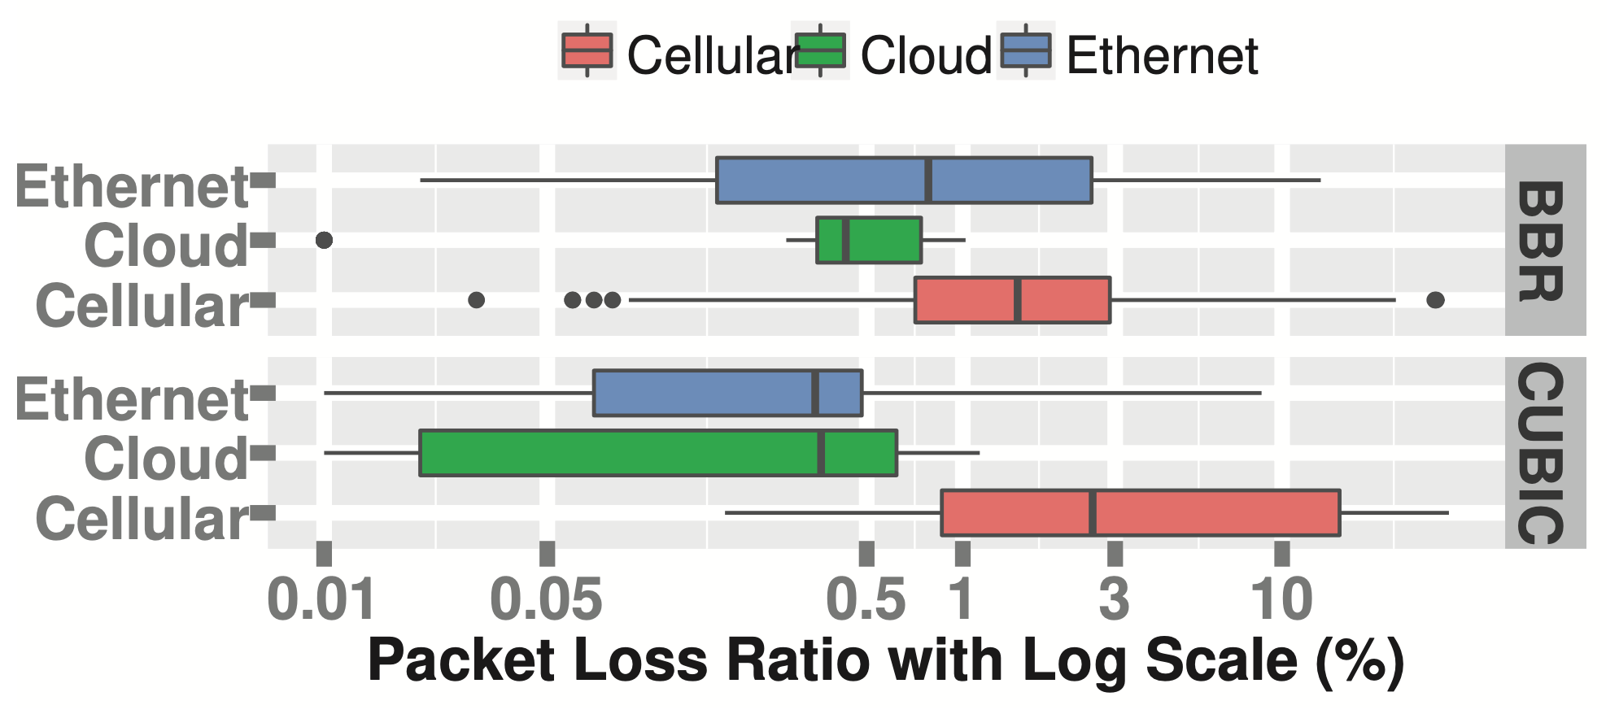
Packet loss is ubiquitous
Data is collected from Pantheon, a global- scale testbed contains measurement nodes on wired/cellular networks and in cloud datacenters across nine countries such as the UK, USA, Japan and Australia. See http://pantheon.stanford.edu.
Notes:
This figure illustrates a 10-month measurement study of average packet loss of single-stream TCP on real paths through the Pantheon, a global- scale testbed contains measurement nodes on wired/cellular networks and in cloud datacenters across nine countries such as the UK, USA, Japan and Australia. We explore two TCP variants, TCP CUBIC (loss-based) and TCP BBR (non-loss- based), within Linux Kernel 4.10. The reason why we also investigate TCP BBR is to demonstrated that packet loss is ubiquitous in the wide-area scenarios, no matter whether the TCP variant is loss-based or non-loss-based. Specifically, the typical values of loss rate are 0.5%, 1%, and 3% in the scenarios of cloud to cloud, end to cloud via ethernet links, and end to cloud via cellular links, respectively.

Slide 9
Packet loss unnecessarily results in window drops
Congestion and non-congestion loss
State-of-the-art works rarely differentiate explicitly
Non-congestion loss
physical media errors
middlebox’s drop policies
normal routing routines
packet drop attacks
Loss-based congestion controller regards packet loss as a congestion signal
For example, CUBIC unnecessarily drops the window when non-congestion loss occurs
Notes:
The state-of-the-art works rarely differentiate congestion and non-congestion loss explicitly. Take the loss-based congestion controller CUBIC as an example, it regards packet loss as a congestion signal. Considering other causes such as physical media errors, middlebox’s drop policies, normal routing routines and packet drop attacks, decreasing the congestion window upon every packet loss has a deadly impact on TCP performance.

Slide 10
Takeaways
Loss-based TCP improperly decreases window
Recovery capability does not match high-speed TCP
Application-level optimization do not generalize
Notes:
To conclude, the reason why loss-based TCP fails to fill up the pipe is that it react wrongly in the case of non-congestion loss which is ubiquitous over the public Internet.
A number of high-speed TCP variants that are non-loss-based have improved throughput for wide-area transmissions. However, they suffer from new issues as discussed next.

Slide 11
Takeaways
Loss-based TCP improperly decreases window
Recovery capability does not match high-speed TCP
Application-level optimization do not generalize
Notes:
Then we give the second takeaway: The current recovery capability does not match high-speed TCP.

Slide 12
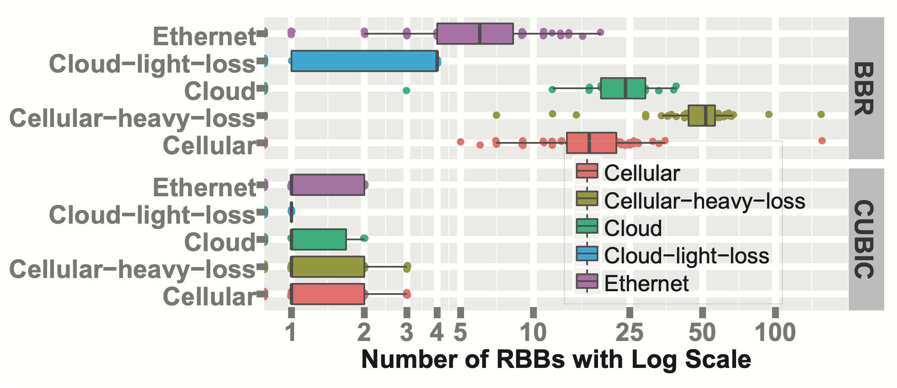
BBR results in more RBBs than CUBIC
1
2
3
Receive-buffer-bubble (RBB)
4
5
6
Receive-buffer-bubble (RBB)
7
8
9
Receiver
Notes:
We define receive-buffer-bubble (RBB) as the gap in sequence space between non-contiguous blocks of data that have been received and queued at the receiver. An RBB can be caused by packet loss or out-of-order delivery. It is observed that the number of RBBs in TCP CUBIC does not exceed three in all scenarios, while the number of RBBs in TCP BBR is much larger. In the worse case, BBR can cause up to 150 RBBs in the receiver’s queue.

Slide 13
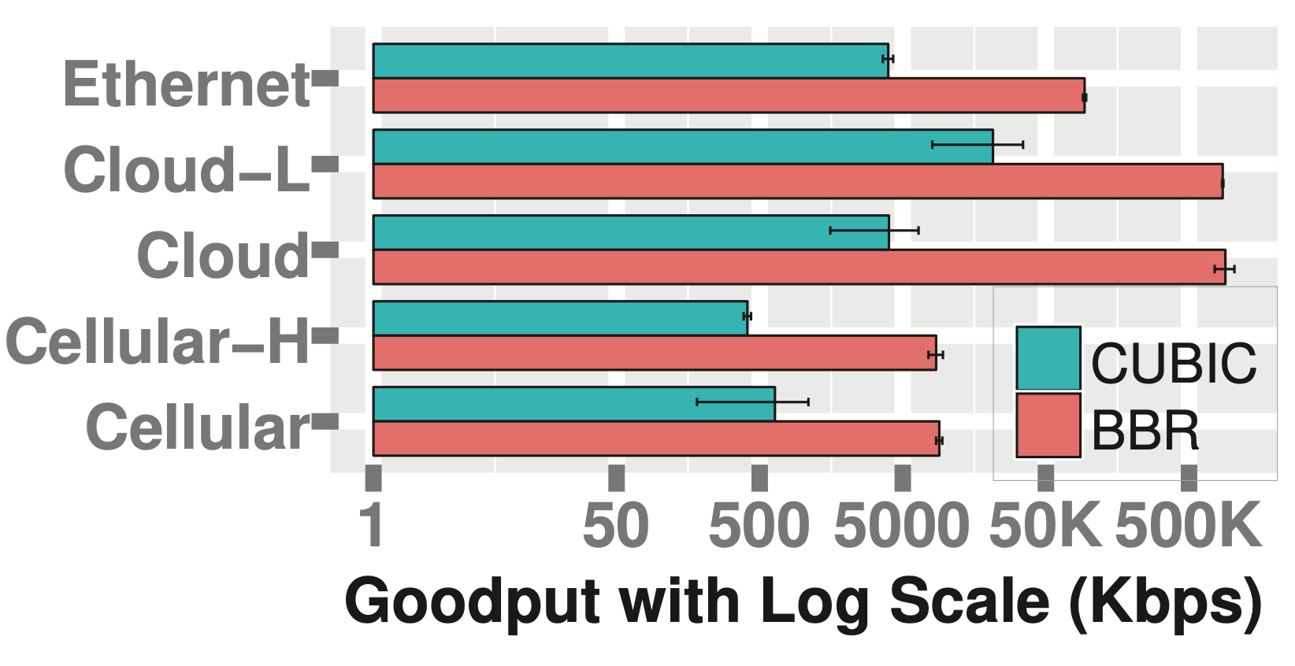
Higher speed results in more RBBs
Loss recovery
Larger number of RBBs
TCP BBR
Mismatch
Loss-based TCP (e.g., TCP CUBIC) :
This mismatch issue is unremarkable when both throughput and number of RBBs are low
Non-loss-based TCP (e.g., TCP BBR) :
Large number of RBBs requires more efficient loss recovery capability!
Goodput over large-BDP and lossy links
Number of RBBs $∝$ Throughput
Notes:
Why BBR results in more RBBs than CUBIC? The answer is relevant with the higher throughput. As shown in the left figure, TCP BBR is a high-speed TCP variant that does not regard loss as back-off signal directly, its throughput is much higher than that of loss-based CUBIC over large-BDP and lossy links. In general, the number of RBBs has its positive correlation with throughput. Large number of RBBs results in the mismatch between recovery capability and high-speed TCP. This mismatch issue is unremarkable for the loss-based TCP when both throughput and number of RBBs are low. However, large number of RBBs requires more efficient loss recovery capability!

Slide 14
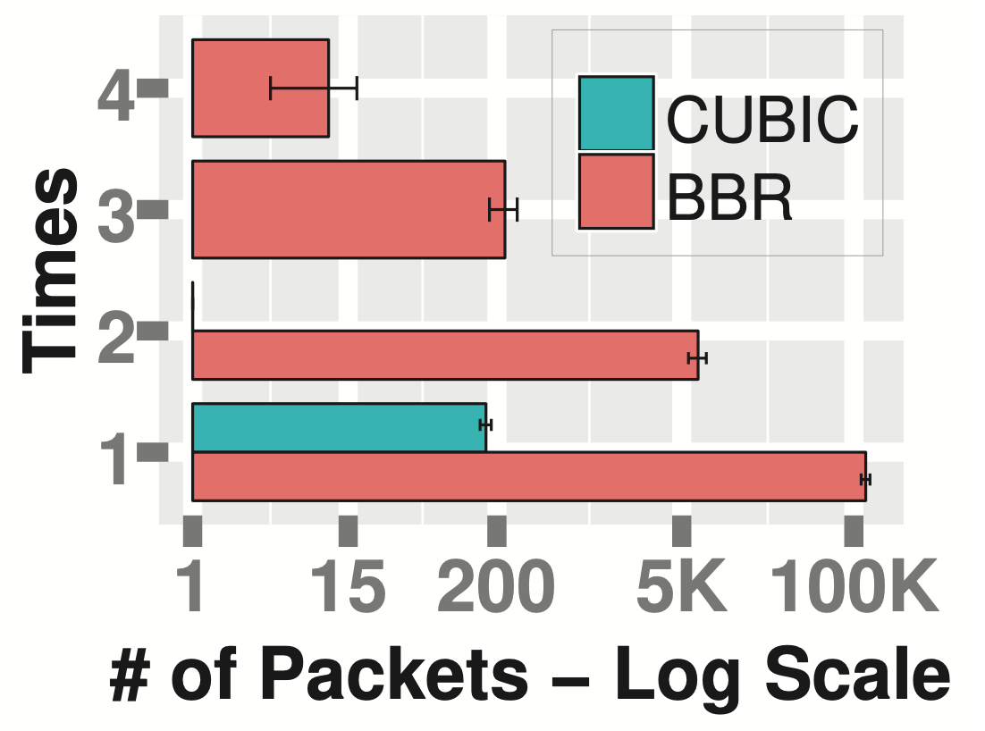
Higher speed results in more times of retransmissions
$k$: retransmission times of a specific packet
$k_{max}$: maximum value of k among all packets
Packet 1
$$k_{max}^{BBR}=4$$
Packet 2
Retransmission
Packet 3
Packet 4
$$k_{max}^{CUBIC}=2$$
Packet 5
Packet 2
$$k=1$$
Packet 4
Packet 6
Packet 7
$$k=2$$
Packet 2
$k_{max} ∝$ Throughput
$$k_{max}=2$$
Notes:
We use k to denote the retransmission times of a specific packet, k_max, the maximum value of k among all packets in a connection.
As shown in the right figure, TCP BBR suffers more serious lost retransmissions than TCP CUBIC. Specifically, for TCP BBR, 132 “unlucky” packets have been retransmitted 3 times, and 14 “unlucky” packets being retransmitted 4 times. We infer that higher speed results in more times of retransmissions.

Slide 15
High-speed wide-area transmission is buffer starving
$k_{max}^{CUBIC}=2$ requires 2x BDP receive buffer
$k_{max}^{BBR}=4$ requires 4x BDP receive buffer
≈143 MB
Retransmission
(c5.xlarge instances of Amazon EC2 usually sets 16 MB receive buffer)
$k_{max} ∝$ Throughput
Receive buffer required$∝$ $k_{max}$
Notes:
The more times for a specific packet is retransmitted, the more receive buffer the connection occupies. Therefore, when running under large-BDP and lossy network conditions to optimize the TCP throughput, high-speed TCP might bottleneck its receive buffer which is usually small (for example, 16 MB) in modern wide-area Linux servers. This bottleneck can be verified by our measurement study through the Pantheon. As shown in the right figure, it is observed that buffer limitation makes TCP only achieve bandwidth utilization of less than 25% even when there is sufficient available bandwidth. This reveals that high-speed wide-area transmission is buffer starving.

Slide 16
Takeaways
Loss-based TCP improperly decreases window
Recovery capability does not match high-speed TCP
Application-level optimization do not generalize
Notes:
To mitigate the capability mismatch between loss recovery and throughput improvement of high-speed TCP, network operators usually raise the end-host buffer by TCP tuning. However, the issue is never solved in the case that operators only owning one side. Some application-level optimization such as parallel TCP tries to improve transmission efficiency at the sender side when the end-host’s buffer is insufficient, however, they face with problems as we will discuss next.

Slide 17
Takeaways
Loss-based TCP improperly decreases window
Recovery capability does not match high-speed TCP
Application-level optimization do not generalize
Notes:
That is, our third takeaway.

Slide 18
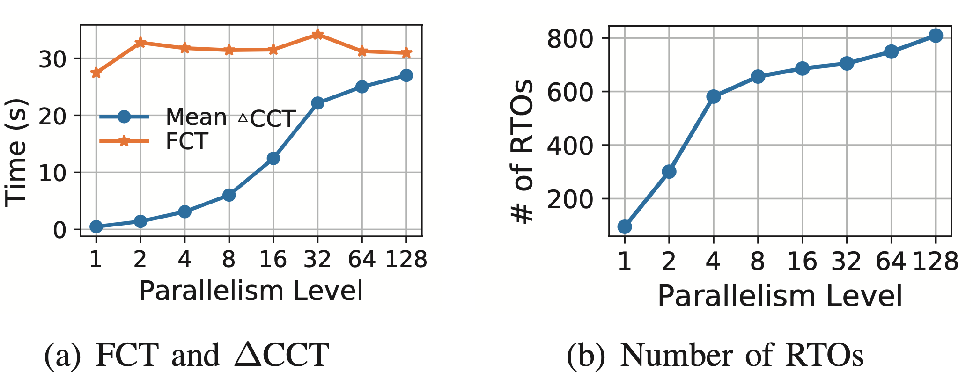
Application-level optimization do not generalize
Parallel TCP requires tuning repeatedly
Network conditions such as RTT, PLR, bottleneck link capacity are always dynamically changing, and cross traffic is also unpredictable
Characteristics of datasets (e.g., file size and number of files) and end-hosts (e.g., file system and transmission protocol type) impact the optimal parallelism level
Parallel TCP introduces negative effect due to a greater risk of tail loss
Notes:
How many connections is sufficient to yield good through- put performance? The answer might be very hard to find. First, the network conditions such as RTT, PLR, bottleneck link capacity are always dynamically changing, and cross traffic is also unpredictable which impact the available bandwidth significantly. Second, the characteristics of datasets (e.g., file size and number of files) and end-hosts (e.g., file system and transmission protocol type) may also impact the optimal parallelism level. Furthermore, parallel TCP sockets introduce negative effect even if it runs with an optimal number of connections. As shown in the figure, when a single stream can achieve the same throughput as the parallel TCP, parallel TCP may have negative effect due to a greater risk of tail loss which usually cause time out.

Slide 19
Our work:
Eliminating the bottleneck of receive buffer during the loss recovery phases
Notes:
As discussed above, high-speed transmission usually encounter a problem that a retransmitted packet is lost repeatedly under large-BDP and lossy network. In this paper, we propose try to eliminate the bottleneck of receive buffer during the loss recovery phases.

Slide 20
Opportunistic Random Redundant Retransmission (OR3)
Opportunism
Redundancy
Randomization
Retransmit packets beyond congestion window and receive window
Allow sending multiple replicas of the lost packets when a loss event is detected
Make the redundant retransmitted packets to be sent out in a random number of sending cycles
This assures that OR3 adaptively retransmits the lost packets as fast as possible
This is useful especially in networks where there are burst losses
Receive buffer might be released once opportunism retransmission succeeds, overbooking the receiving buffer in advance can improve bandwidth utilization
Notes:
we propose an opportunistic random redundant retransmission algorithm, called OR3. OR3 follows three design principles, i.e., opportunism, redundancy, and randomization, to minimize the maximum number of retransmissions.
First, opportunism tackles the flow control bottleneck by allowing the sender to retransmit packets beyond congestion window and receive window. The design rationale is that the receive buffer is the bottleneck of high-speed transmission in 80% of cases during loss recovery. During the packet loss recovery phase, the sender is allowed to send more data than the limit of receive buffer. Since a large volume of receive buffer might be released once the opportunism retransmission succeeds, overbooking the receiving buffer in advance can improve bandwidth utilization.
Second, redundancy allows sending multiple replicas of the lost packets when a loss event is detected. OR3 applies two simple rules: (1) A packet is retransmitted with no replica if lost for the first time. (2) The more times that a packet have been lost, the more replicas are sent. The first rule is based on the fact that most of the lost packets can be successfully delivered after retransmitted once. This avoids unnecessary redundancy overhead. The second rule assures that OR3 adaptively retransmits the lost packets as fast as possible.
Finally, a loss event usually contains multiple consecutive lost packets, the redundant replicas might be lost together again when burst losses occur. To improve the robustness under various packet loss pattern, randomization enables the redundant retransmitted packets to be sent out in a random number of sending cycles. This is useful especially in networks such as wireless networks and policy-based networks where there are burst losses.

Slide 21
Evaluation
TCP-OR3 implementation
TCP-OR3: a TCP implementation that applies OR3 and chooses the non-loss-based BBR as its default congestion controller
Experiment setup
For testbed simulations, we set up a testbed in which RTT, PLR and bandwidth are adjustable for performance estimation and behavior analysis under different parameter settings
The sender and receiver are connected by a Spirent Attero-X network emulator and a switch with 24 Ethernet 10/100/1000 ports, 4 x 10 Gbps NICs
Both end-hosts are with Intel Xeon CPU E5-2620, 16 GB memory, Gigabit Ethernet cards and a 10Gbps NIC
The emulator allows to set filters on both ingress and egress ports, enabling estimation on the effect of impairments to particular packets or particular types of traffic
The link between the two switches is set as bottleneck whose bottleneck buffer is 6 MB.
Notes:
We implement TCP-OR3, a TCP implementation
that applies OR3 and chooses the non-loss-based BBR as its default congestion controller.

Slide 22
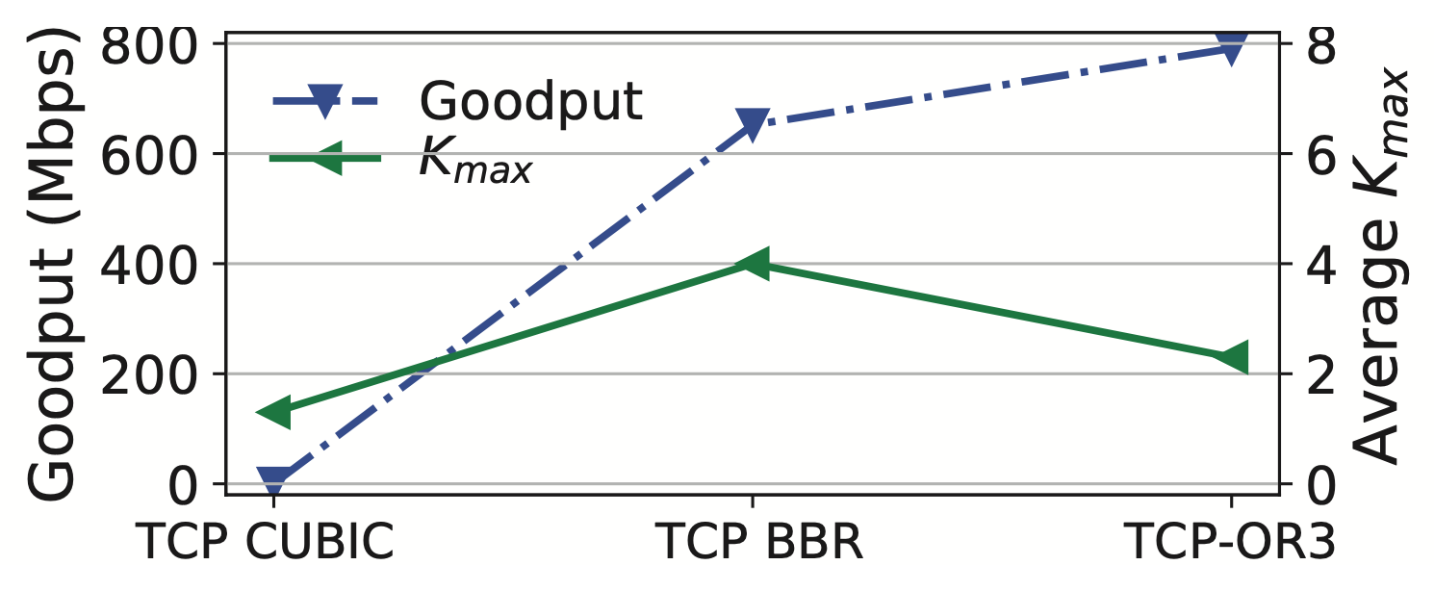
OR3 minimizes the maximum times of lost retransmissions
rtt = 300 ms, plr = 3%, link capacity is 1 Gbps
Notes:
Here is the result.
It is demonstrated that OR3 greatly increases the goodput (blue dashed line) by decreasing the k_max (green line).

Slide 23
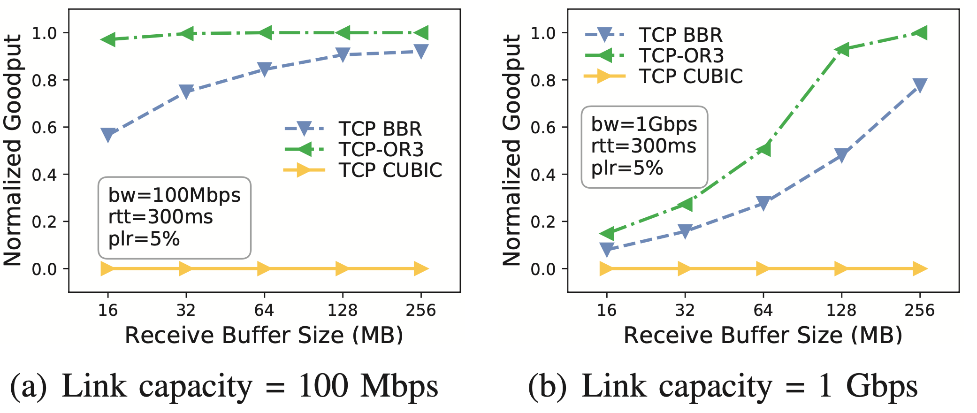
OR3 alleviates receive buffer starvation
Notes:
The left figure further shows the case of long-delay and lossy links with capacity of 100 Mbps. It is observed that TCP-OR3 still fills up the pipe when the end-host’s buffer size is insufficient for TCP. This can be attributed to TCP-OR3’s efficient loss recovery. When the link capacity increases to 1 Gbps, as shown in the right figure, the bandwidth utilization of all schemes decreases significantly in the case of receive buffer starvation. Nevertheless, TCP-OR3 achieves a significant advantage over TCP in goodput.

Slide 24
Takeaways
Loss-based TCP improperly decreases window
Recovery capability does not match high-speed TCP
Application-level optimization do not generalize
Following principles such as opportunism, redundancy, and randomization, TCP-OR3 minimizes the maximum number of retransmissions to alleviate receive buffer starvation
Discussion:
It is also recommended to deploy OR3 for low-latency applications
Applying OR3 accelerates tail loss recovery, which is one of the most challenging issue for tiny flow transmission in real-time applications
Notes:
I would like to conclude today’s talk by summarizing the takeaways.
First, loss-based TCP improperly decreases window.
Second, legacy recovery capability does not match high-speed TCP.
Third, application-level optimization do not generalize.
Following three design principles: opportunism, redundancy, and randomization, we propose TCP-OR3 to minimize the maximum number of retransmissions, so that alleviate receive buffer starvation.
We also note that although OR3 is originally designed for high-throughput applications, it is also recommended to deploy OR3 for low-latency applications. This is because that applying OR3 accelerates tail loss recovery, which is one of the most challenging issue for tiny flow transmission in real-time applications.

Slide 25
Thank You! Q & A
Notes:
That’s all for my talk. Thank you for your attention!

