Slide 1
ICDCS 2017
On efficient offloading control in cloud radio access network with mobile edge computing
Tong Li*, Chathura S. M. ‡, Kezhi Wang‡, Ke Xu*,
Kun Yang‡, Haiyang Wang †
Presented by Tong Li
*
†
‡

Slide 2
Case Study
Smart City Online Monitoring
Cloud Gaming systems:
- Onlive
- Gaikai
Computation
Offloading
Notes:
User equipment is playing an important role in new application scenarios. For example, the digital cameras in a smart city online monitoring system. Problem here is that senor nodes usually have limited power and resource, so they need task offloading. Another case can be cloud gaming. Onlive and Gaikai have provide service for users, whose actions are transmitted to the cloud proxy. During being processed in the cloud, the actions are rendered, encoded and compressed. Thereafter, the video will be streamed back to the player.

Slide 3
From Cloud to Edge
MCC: Mobile cloud computing
Users offload computation to the remote resourceful cloud (e.g. EC2), thereby saving processing power and energy
However, suffering from high latency via the Internet (WAN)
CDN: Content Delivery Network
Akamai, Limelight and Level3 Networks
Essentially the precursor to the evolution to the new edge cloud architecture
Remote cloud
From MCC to MEC
Edge
cloud
Notes:
For Mobile cloud computing-based offloading, users offload computation to the remote resourceful cloud, thereby saving processing power and energy. However, it is difficult to control delay and jitter at WAN scale. If we learn from the CDN solution, we can easily come up with the new edge cloud architecture.

Slide 4
From MCC to MEC
MEC: Mobile Edge Computing
Smart Base Station
Offloading
Offloading
Task Offloading
Computation offloading other than traffic offloading
Notes:
From cloud to edge, means from mobile cloud computing to mobile edge computing.
%MEC is proposed to be a 5G technology in 2015. MEC handles distributed task offloading by shifting computation capacity from the public cloud to the edge cloud, which can significantly reduce offloading latency. The edge cloud is formed by smart and resource-rich base station.

Slide 5
On the other hand…
Mobile traffic growth
x7
40 Billion TB
x6
2020
# of Users
Data Volume
x22
+37Billion
1.8 Billion TB
2015
Smart
phones
Wearable
devices
WiFi
APs
2011
2020
Explosive growth users
Explosive growth bandwidth
Cellular infrastructure must be flexible and reconfigurable
Notes:
On the other hand, with the explosive growth of users and bandwidth requirements, the Radio Access Network must be flexible and re configurable.

Slide 6
Base Station Evolution
The Evolution of Radio Access Network (RAN) Architecture
Notes:
The radio access network is now evolved to the Cloud-based one, we call it C-RAN.

Slide 7
Cloud Radio Access Network
C-RAN: proposed by CMCC in 2009
BBU
RRH
The revolutionary evolution of RAN: An essential element of 5G
Notes:
C-RAN is also a 5G technique proposed in 2009. It moves the BBU from traditional base station to the cloud and leaves the remote radio heads (RRH) distributed. The RRHs are connected to the BBU pool via high bandwidth and low-latency fronthaul. The BBU pool can be realized by the virtual machines in data centers, and the centralized baseband processing enables BBU to be dynamically configured and shared on demand.

Slide 8
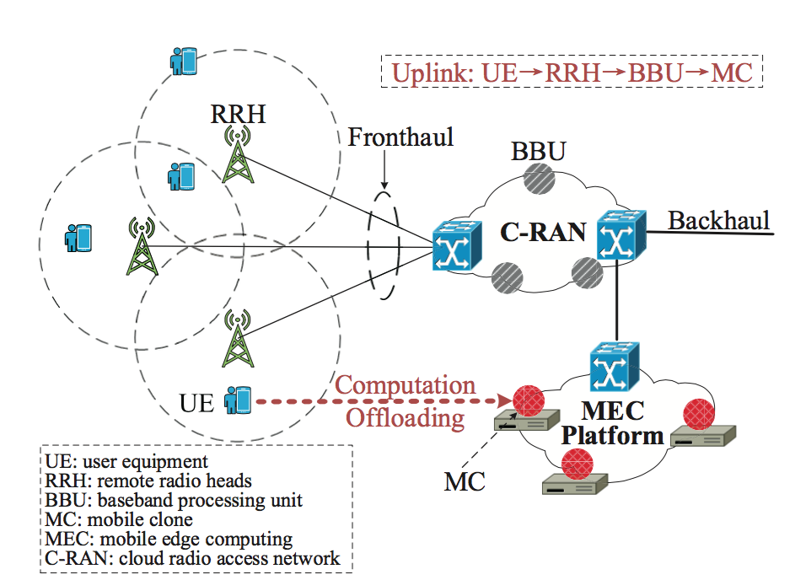
When C-RAN meets MEC
Hybrid deployment of C-RAN with MEC
Notes:
Here we show the hybrid deployment of C-RAN with MEC for computation offloading.
【】Connected with distributed RRHs and centralized BBUs, UEs get access to VMs. These VMs are called mobile clones (MC) which are in a mobile cloud. For computation offloading requests, data is transmitted to MCs by base stations via uplinks. Once processed by an MC in the mobile cloud, the results will be returned to UEs via downlinks.

Slide 9
Motivation
Prior work
Handling offloading control falls in the general category of resource allocation optimization
Our work
Focuses on the perspective of matching problem
UE: user equipment
RRH: remote radio heads
BBU: baseband processing unit
MC: mobile clone
RRH
UE
BBU
MC
Notes:
Most previous work doing offloading control falls in resource allocation. However here now, we focus on the perspective of matching.

Slide 10
Challenges
Different matching among UEs, RRHs, BBUs and MCs results in different task offloading efficiency
Communication Efficiency
Computation Efficiency
Notes:
Different matching among UEs, RRHs, BBUs and MCs results in different task offloading efficiency. In particular, data transmission latency depends on the assignment of both RRHs and BBUs, and task processing time depends on the MC assignment. However, the UE interaction makes it challenging to directly assign the UE’s most satisfied RRH, BBU or MC to them.
%This interaction may affect the task offloading efficiency in two aspects: (1) the wireless transmission data rate will decrease with poor channel quality between UEs and RRHs, (2) while the baseband processing speed of BBU and task processing speed of MC will be slowed down when overloaded. The former is called communication efficiency, and the latter is called computation efficiency.

Slide 11
Multi-stage Duplex Matching
Tri-level heuristic: UE-to-RRH stage, UE-to-BBU stage, and UE-to-MC stage
A1
A2
A3
Notes:
Our objective is maximizing the amount of UEs whose completion time meet their deadlines. We propose a tri-level heuristic for multi-stage duplex matching, which divides the optimization problem into three stages: the UE-to-RRH stage, the UE-to-BBU stage, and the UE-to-MC stage. It is worth mentioning that separately handling all stages is hard to close to the optimal assignment, and these three stages are correlative during multi-stage matching.
%In particular, A2 is obtained according to A1, and A3 is obtained according to A1 and A2.

Slide 12
Testbed Implementation
Notes:
Before performing the algorithm evaluation, we implement an LTE-based MEC testbed.
%Currently the mobile edge cloud is implemented in the RAN environment, with further extension of the base station (e.g., OpenAirInterface), our testbed can be evolved in a C-RAN environment in the future (our ongoing work). So far, the testbed is mainly used to capture traces of the required parameters for evaluation.

Slide 13
Evaluation
Parameters and Scenarios
Matlab-based implementation of the related algorithms
Note:
Notes:
Based on the captured traces of the testbed, we conduct the trace-based simulation to estimate the algorithm.

Slide 14
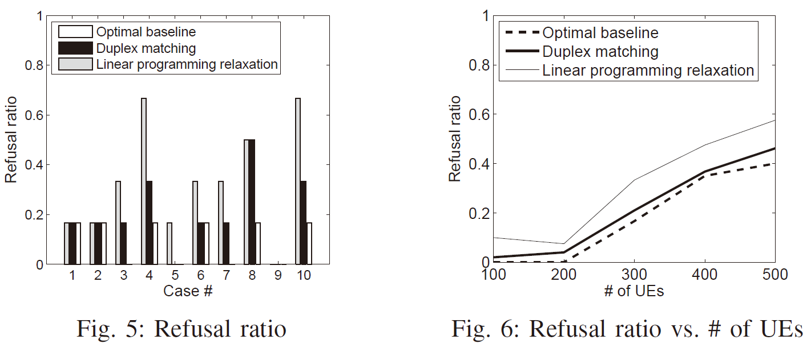
Evaluation
Refusal ratio: Proportion of UEs that will miss their deadlines
Refusal ratio
Notes:
We start with a small offloading scenario , we find our approach can achieve the near-optimal performance in 90% of cases. The reason is our duplex matching framework can adapt to the dynamics of computation and communication efficiency. Larger scenarios also show the same conclusion, and our solution can always bound the optimal assignment.

Slide 15
Open issues
Conclusion
Latency can be optimized by smartly solving a matching problem, improving offloading efficiency.
On going work
From the Amarisoft LTE 100 to OpenAirInterface (OAI)
Testbed for mobile edge computing in the C-RAN environment.
Future work
For users, which one to choose, cloud or edge?
For ISPs, how to assignment resources with a budget?
A game among users, ISPs, cloud providers.
Notes:
Our on going work is to change the commercial Amarisoft to OpenAirInterface to deploy the testbed for MEC in the C-RAN environment.
The future work focuses on the tradeoff between cloud and edge. Delay-sensitive applications such as automatic drive and industrial control should be processed in the edge, however, video streaming can be put in the cloud. The problem can be how to maximize the utility of all entities such as users, ISPs, and cloud service providers.

Slide 16
Notes:
That’s all for my presentation.
Thank you very much.

Slide 17
Back up

Slide 18
When C-RAN meets MEC
C-RAN: Cloud-based radio access network
C-RAN uses centralized BBU to do baseband processing
MEC: Mobile edge computing
MEC handles distributed task offloading by shifting computation capacity from the public cloud to the edge cloud
MEC mobile offloading
C-RAN environment
Still work in
Notes:
It is worth mentioning that C-RAN uses centralized BBU to do baseband processing, while MEC handles distributed task offloading by shifting computation capacity from the public cloud to the edge cloud. Since MEC usually works with distributed base stations in conventional radio access network, it is quite interesting to see if MEC mobile offloading still works in the C-RAN environment.

Slide 19
Cloud Radio Access Network
C-RAN trial and deployment in CMCC
Notes:
Currently, C-RAN has been widely deployed in China.

Slide 20
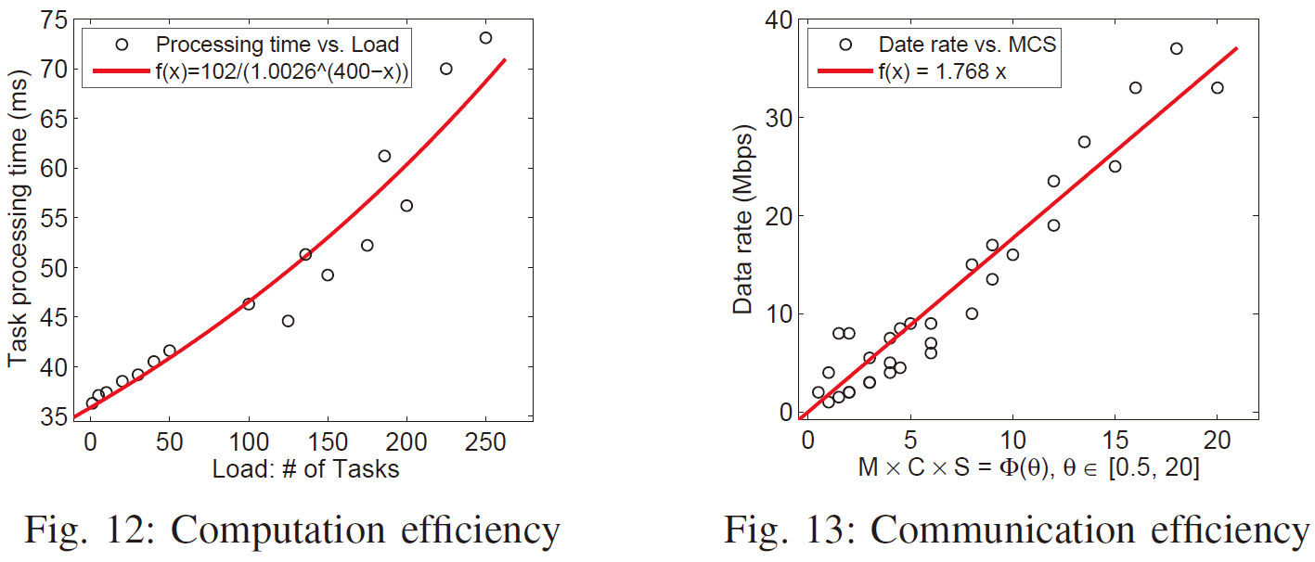
Back Up
Testbed measurements to estimate computation efficiency and communication efficiency

Slide 21
Motivation
Not only communication efficiency but also computation efficiency should be considered in C-RAN with MEC
Wireless data transmission
Wireless channel quality will be influenced by user interaction
Cloud task processing
Multiple tasks will compete for CPU time slices, which may lead to queuing delay
BBU baseband processing during wireless communication can be regarded as computation intensive workload, multiple UEs will also compete for computing resource in the BBU
Synergy of communication efficiency and computation efficiency
Notes:
Here we argue that not only communication efficiency but also computation efficiency should be considered in C-RAN with MEC scenarios, i.e., there is interference among UEs both in wireless data transmission and cloud task processing.

Slide 22
Offloading control framework
Offloading control framework
To maximize the number of tasks that meet their deadlines
Notes:
The deadline-aware offloading control framework is shown in the Figure. By estimating whether a task may exceed its deadline, we decide to accept or reject UE’s offloading request.

Slide 23
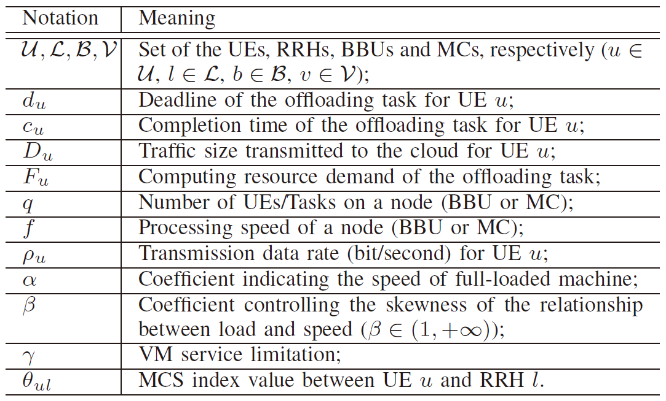
Problem Formulation
Task Processing Time
Processing speed
vs.
task load
Net Present Value (NPV) Function: different VMs may have different α, β and γ
Wireless Transmission Latency
Uplink Completion Time
g(θ) is defined as a function of MCS index (varies from 0 to 31)
Notes:
We also use the 【】NPV function to calculate the task processing time，and the wireless transmission latency is obtained according to 【】 the channel quality and BBU processing speed. The task completion time is the sum of both.

Slide 24
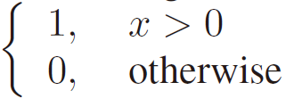
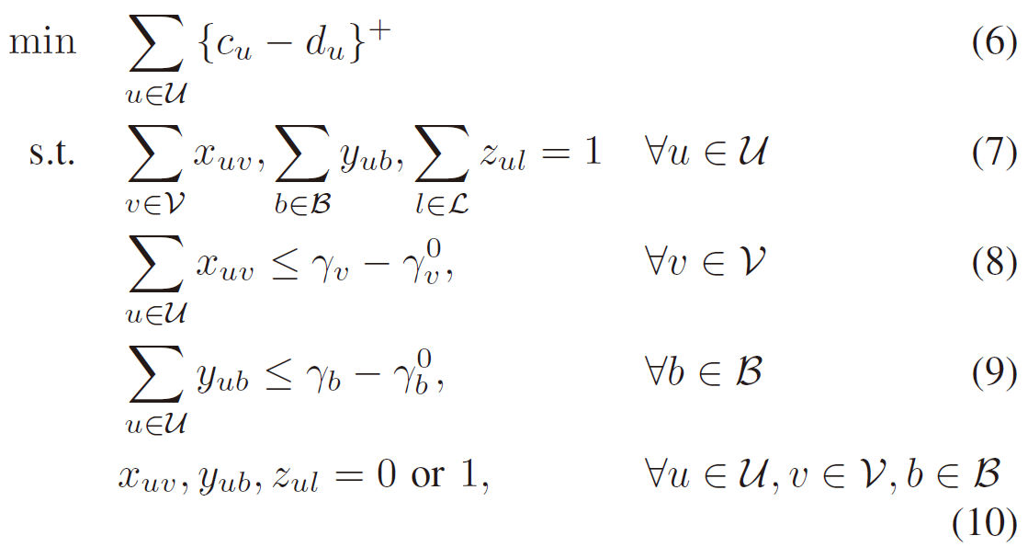
Problem Formulation
Joint assignment optimization model
Define
Refusal ratio: # of UEs that will miss their deadlines
Then we have
Service limitation
constraints
Non-linear integer programming problem: NP-Hard !
Notes:
We propose the joint assignment optimization model, 【】to minimize the refusal ratio for the UE’s offloading requests, i.e., maximizing the amount of UEs whose completion time is less than their deadlines. (8) and (9) refer to the service limitation constraints.

Slide 25
Multi-stage Duplex Matching
UE-to-RRH Stage
We assume that all the BBUs are the same and fully loaded
Expected transmission latency
Based on the MCS index, each UE
just selects the RRH with the minimal
expected transmission latency
Assignment A1 between UEs and RRHs
Notes:
First stage, we assume that all the BBUs are the same and fully loaded, then the expected transmission latency only depends on the channel qualities, In this case, each UE just selects the RRH with the best channel quality.

Slide 26
Multi-stage Duplex Matching
UE-to-BBU Stage
Different UEs have the different deadlines. Meanwhile, different BBUs have the different loads and service limitations
Gale-Shapley Matching
Theory: college admission
problem (CAP)
UEs as students,
BBUs as colleges
A1
Assignment A2 between UEs and BBUs
Notes:
Second stage, different UEs have different deadlines, different BBUs have different loads and service limitations. We abstract a duplex matching framework which is inspired by the Gale-Shapley Matching Theory, they discussed the real-life college admission problem. Particularly, we regard UEs as students and BBUs as colleges.

Slide 27
Multi-stage Duplex Matching
UE-to-BBU Duplex Matching Algorithm
Iteration 1
Every UE applies to its first choice of BBU, every BBU puts top UEs (within its quota) into its prospective admission list Y, then rejects the other applicants, if one BBU is full loaded, add 1 to its quota.
Iteration i
All UEs eliminated in the last step continue to apply to its first choice of BBU, then each BBU takes both the new applicants and the ones already in Y into account, then rejects the other applicants , if one BBU is full loaded, add 1 to its quota.
Repeat Iteration i until every UE is in a prospective admission list of a certain BBU, or all the BBUs are no longer available
Notes:
Our duplex matching framework is a bit different from the conventional Gale-shapley matching algorithm. We have modified it to fit our problem and improve the efficiency.

Slide 28
Multi-stage Duplex Matching
UE-to-MC Stage
Similar to the UE-to-BBU stage, it is also feasible to apply the duplex matching framework in this stage
A1
Assignment A3 between UEs and MCs
A2
Notes:
After wireless transmission through base stations, offloading tasks are processed in the edge cloud. Similar to the UE-to-BBU stage, it is also feasible to apply the duplex matching framework in the last stage, however, to achieve better performance we have to modify some steps.
Finally, the matchings among UEs, RRHs, BBUs, and MCs are obtained.

Slide 29
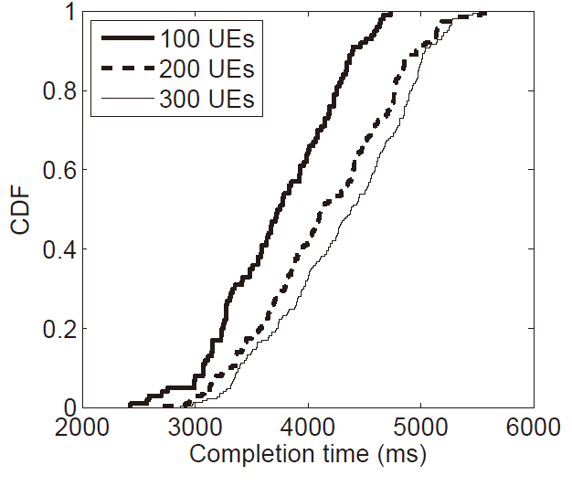
Evaluation
Completion Time
Notes:
We further explores the task completion time for the UEs that can meet their deadlines. It is easy to see that the completion time increases with the growing number of UEs, due to the increased load affects the computation efficiency.

Slide 30
Evaluation
Refusal ratio with different inputs of the parameters
Insights:
Notes:
To better understand the computation efficiency in different types of VMs, we investigate different parameter of the NPV function. We find that a good VM should have a smaller α and larger β and γ.

