Slide 1
Towards Minimal Tardiness of Data-intensive Applications in Heterogeneous Networks
T. Li*, K. Xu*, M. Sheng@, H. Wang †, K. Yang‡, Y. Zhang*
Presented by Meng Sheng
*
@
†
‡
Notes:
我的题目是异构网络中数据密集型应用的延迟最优化研究。

Slide 2
Outline
Why this work
  Background and Motivations
Analytical Model and Lower Bound
Routing and Scheduling duplex MATching (RSMAT) framework
Evaluation
Conclusion and the future work
Notes:
报告分为五个部分。首先来看问题的背景和动机。

Slide 3
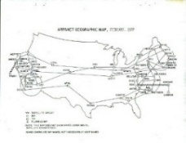
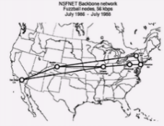
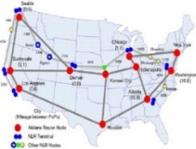
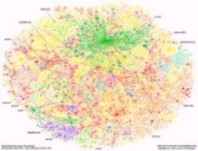

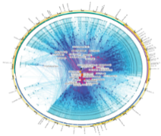
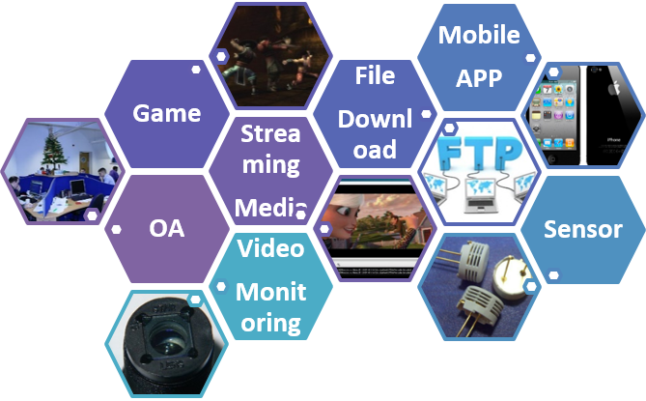
Background
# of Users
<0.1mil.
1mil.
14mil.
147mil.
817mil.
2.93bil.
1978
1984
1993
1997
2004
2014
Heterogeneous Network
Data-intensive Workloads
New Programming Paradigms
Notes:
The increasing data requirement of Internet applications has driven a dramatic surge in developing new programming paradigms and complex scheduling algorithms to handle data-intensive workloads.

Slide 4
Background
Data-intensive Workloads with Intermediate Processing Constraints
Big-node
cost-inefficient
Intermediate Processing Constraints
Capability Anisotropy
Stage
Treatment
Load
Balancing
Notes:
Whereas it is cost-inefficient to indiscriminately send all raw data to the server, a solution towards effective processing of data-intensive workloads is enabling the networked nodes with processing capacity. However, capability
anisotropy, stage treatment, and load balancing promote an increasing number of special data-intensive workloads, requiring being processed (such as size changing, format conversion, and noise handling) at intermediate nodes on its route to destination, which is called intermediate processing constraint. An intermediate processing node is usually a dedicated high performance machine with sufficient resources (e.g., CPU cores, memory). For simplicity, we call it big-node in this paper.

Slide 5
Background
An example: Handling data-intensive workloads with intermediate processing constraints
Notes:
Take the smart city as an example, cameras distributed in each district aggregate to a monitoring network of intelligent transportation system (ITS). A typical application is that when capturing all the peccant vehicles (traffic violations) at some point, distributed cameras transmit their snapshots to the control center. Due to limited processing ability of the camera embedded system, image processing needs to be migrated to one of the capable big-nodes (e.g., graphic workstations).

Slide 6
Background
Flows of a soft real-time application
Flow expected completion time varies due to the interdependence of flows, i.e., deadline of each flow might be discrepant [5].
Meanwhile, the flow is still meaningful and contributes to the application even if it misses the deadline [6].
Components of flow completion time
Notes:
On the other hand, for the flows of a soft real-time application, their expected completion time varies due to the interdependence of flows, i.e., deadline of each flow might be discrepant. Flow completion time is the sum of
handling time and routing delay. Handling time is composed of the queueing time and the processing time for a flow to be processed on a big-node.

Slide 7
Objective
Optimizing the application tardiness means minimizing
the total tardiness of all distributed flows
Notes:
Assume big-nodes are heterogeneous with different processing speed, then routing delay depends on the selection of big-nodes, and the queueing time depends on the scheduling scheme on big-nodes.

Slide 8
Challenge
Interaction of routing and scheduling
Makes it challenging to simultaneously reduce the queueing time, processing time, and routing delay
  As to a flow, being processed at a high-performance big-node gains smaller processing time. However, the path length might be long.
  Achieving the minimal routing delay is to select the big-node on its shortest path. However, the queueing time might be extremely long on an overloaded big-node.
Flow scheduling should take into account the collaborative routing strategies!
Notes:
However, the interaction of routing and scheduling makes it challenging to simultaneously reduce the queueing time, processing time, and routing delay. For instance, as to a flow, being processed at a high-performance big-node gains smaller processing time. However, the path length might be long. Besides, achieving the minimal routing delay is to select the big-node on its shortest path. However, the queueing time might be extremely long on an overloaded big-node. Under these circumstances, to minimize the total completion time, flow scheduling should take into account the collaborative routing strategies

Slide 9
Problems
How to assign big-nodes to flows
Which flow should be preferentially processed
To minimize the total tardiness of all flows?
Notes:
This paper is devoted to addressing the following question: how to assign big-nodes to flows, and which flow should be preferentially processed, to minimize the total tardiness of all flows?

Slide 10
Motivation
Individual routing
  Multi-Constrained Path (MCP) problems [9]–[11]
Individual scheduling
  packet-level scheduling [12] [13]
  flow-level scheduling [14] [15]
  application-level scheduling [16]
  Job packing [17] [18]
Integration of Routing and Scheduling
  RAPIER [19], RUSH [23]
  energy-efficient DCN [20]–[22]
Seldom focuses on the intermediate processing constraints
Notes:
In addition to much work on individual routing and individual scheduling, the joint optimization of routing and scheduling is attracting more attention currently. Different from the prior solutions integrating routing and scheduling, we focus on the intermediate processing constraints, which are new and challenging in achieving the minimal tardiness of data-intensive applications in heterogenous networks.

Slide 11
Outline
Why this work
  Background and Motivations
Analytical Model and Lower Bound
Routing and Scheduling duplex MATching (RSMAT) framework
Evaluation
Conclusion and the future work
Notes:
Next we model the joint optimization for routing and scheduling with intermediate processing constraints

Slide 12
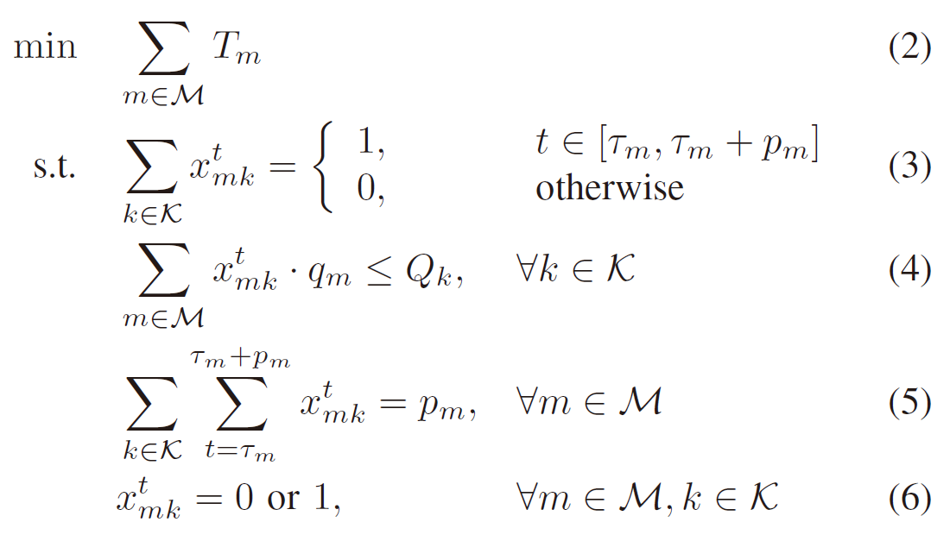
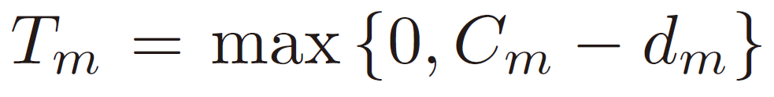
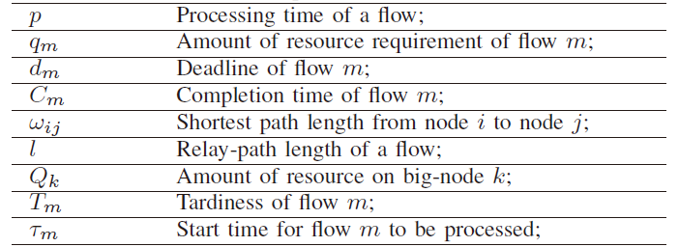
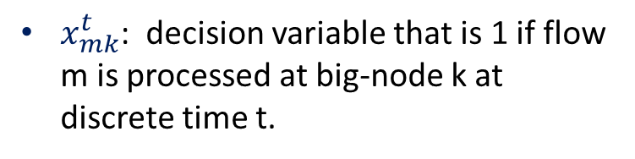
Analytical Model
Tardiness-aware Flow Scheduling with Processing constraints (TFS-P)
$x_{mk}^{t}$: decision variable that is 1 if flow m is processed at big-node k at discrete time t.
TFS-P is a non-linear integer programming Problem, NP-Hard.
Notes:
We model the problem as a nonlinear integer programming problem, and it essentially turns out to be a combinational optimization of the routing with intermediate processing constraints and multi-processer scheduling with capability constraints. Since the problem owns higher complexity than multi-processer scheduling, we focus on the lower bound instead of the optimal value.

Slide 13
Outline
Why this work
  Background and Motivations
Analytical Model and Lower Bound
Routing and Scheduling duplex MATching (RSMAT) framework
Evaluation
Conclusion and the future work
Notes:
第三部分，路由和调度双向匹配框架。

Slide 14
Duplex Matching
College Admission Problem (CAP)
RSMAT : Routing and Scheduling duplex MATching framework
D. Gale and L. S. Shapley, “College admissions and the stability of marriage,” American Mathematical Monthly, pp. 9–15, 1962.
Notes:
we apply the Gale-Shapley Matching Theory in the cooperativity between scheduling and routing. we map our problem into the College Admission Problem (CAP) . As a result, the framework of Routing and Scheduling duplex MATching (RSMAT) is designed.

Slide 15
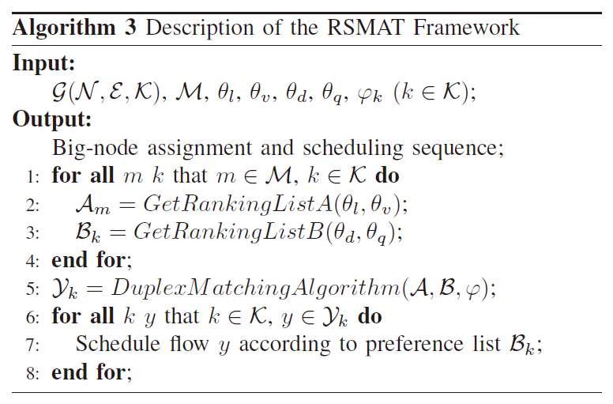
Duplex Matching
RSMAT : Routing and Scheduling duplex MATching framework
Step 5 is a certain duplex matching algorithm
Notes:
In RSMAT, By heuristically generating the preference lists and applying duplex matching algorithm, we get big-node assignment and flow scheduling sequence.

Slide 16
Duplex Matching
DA: Gale-Shapley Deferred Acceptance Algorithm
Iteration 1
  Every flow applies to its first choice of big-node, every big-node puts top flows (within its quota) into its prospective admission list Y, then rejects the other applicants.
Iteration i
  All flows eliminated in the last step continue to apply to its i th choice, then each big-node takes both the new applicants and the ones already in Y into account, then rejects the other applicants.
  Repeat Iteration i until every flow is either in a prospective admission list of a certain big-node, or rejected by all big-nodes in its preference list
DA results in stable and the Pareto efficient match [24]
Notes:
RSMAT framework can further be implemented by the classic Gale-Shapley Deferred Acceptance (DA) algorithm, which has already been proved to result in stable and the Pareto efficient match .

Slide 17
Duplex Matching
Inefficient Stability
Assume both f₁ and f₂ prefer K₂, meanwhile K₂ prefer f₁
DA is inefficient with regard to the RSMAT framework
Notes:
However, this Pareto efficiency is inapplicable for the RSMAT framework, in which the optimization objective is minimizing the total tardiness of all flows. Tardiness is tightly coupled with the handling time on the big-nodes. Since the handling time of a flow is composed of the queueing and processing time, considering the processing speed of a big-node can only contribute to the processing time. Without taking the queueing time into consideration, DA can hardly achieve approximately minimal tardiness.
For example in the Figure, assume both 𝑓1 and 𝑓2
prefer 𝐾2, meanwhile, 𝐾2 prefers 𝑓1. In this case, DA assigns
𝐾2 to both 𝑓1 and 𝑓2. However, 𝑓2 has to be suspended when
𝑓1 is being processed, which results in the tardiness of 𝑓2.
Therefore, although the Pareto efficient, the stable match of
DA is inefficient with regard to the RSMAT framework, which
is called inefficient stability.

Slide 18
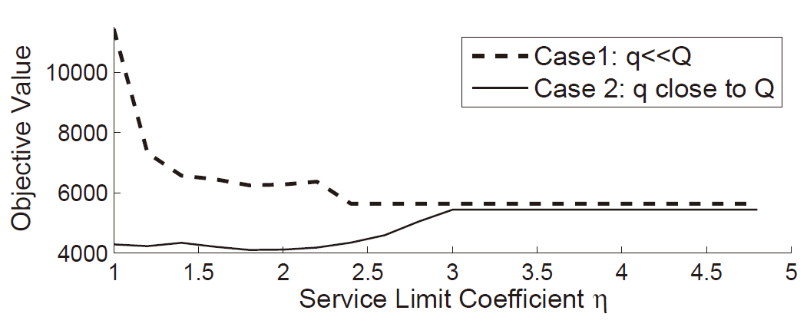
Duplex Matching
Quota Dependency
Two random-generated networks with 10 big-nodes and 50 flows are scheduled using DA
The match in DA and TDA has severe dependence on quota
Notes:
On the other hand, the objective value decreases with the increase of 𝜂. However, the objective value increases with 𝜂 in the case that one bignode can only serve one or two flows at a time (𝑞𝑚 close to 𝑄𝑘). Thus, the performance of DA depends on the quota setting, called quota dependency.

Slide 19
Duplex Matching
TDA-DQ: TDA with Dynamical Quota
TDA-DQ gradually increases the quota of the preferred big-nodes.
Applicants just apply to their first choice during each iteration of TDA.
TDA-DQ also tends to result in unstable matches, as we do not care whether flows have ever been rejected by big-nodes.
NOTE: Both DA-DQ and TDA-DQ result in unstable matches, however, they are more efficient for the RSMAT framework, which will be evaluated next.
Notes:
To simultaneously mitigate inefficient stability and quota dependency, we finally propose the Tardiness-aware Deferred Acceptance algorithm with Dynamical Quota (TDA-DQ). In terms of inefficient stability, we break the stability by taking into account the flow’s expected handling time on the big-node. On the other hand, to mitigate the challenge of quota dependency, we propose a technical solution that gives a dynamical quota to each big-node, i.e., gradually increase the quota of the preferred big-node in each iteration.

Slide 20
Outline
Why this work
  Background and Motivations
Analytical Model and Lower Bound
Routing and Scheduling duplex MATching (RSMAT) framework
Evaluation
Conclusion and the future work
Notes:
第四部分，性能评估。

Slide 21
Evaluation
Parameters and Scenarios
Matlab-based implementation of the related algorithms
Scenario of the ITS in a smart city.
A random network with 500 nodes act as the cameras, and then randomly choose 2% of nodes acting as the big-nodes (workstations distributed randomly across different districts).
500 flows in each applicaton from cameras to the control center, i.e., M = 500,K = 10.
Finally, we generate 100 applications to evaluate the proposed algorithms.
Notes:
We consider a scenario of the ITS in a smart city. A random network with 500 nodes acting as the cameras, and then randomly choose 2% of nodes acting as the big-nodes

Slide 22
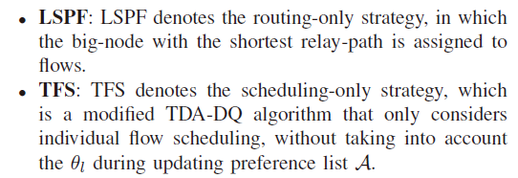
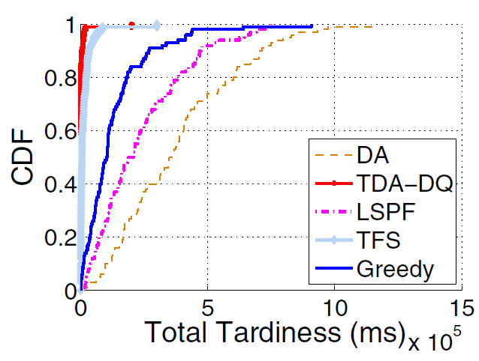
Evaluation
Total Tardiness
Due to quota dependency, DA perform even worse than the routing-only or greedy strategies.
Notes:
by applying TDA-DQ, the total tardiness in 60% cases is 0. This reveals that 60% applications are finished without tardiness. We can see that due to inefficient stability and quota dependency, DA performs even worse than the routing-only or greedy strategy.

Slide 23
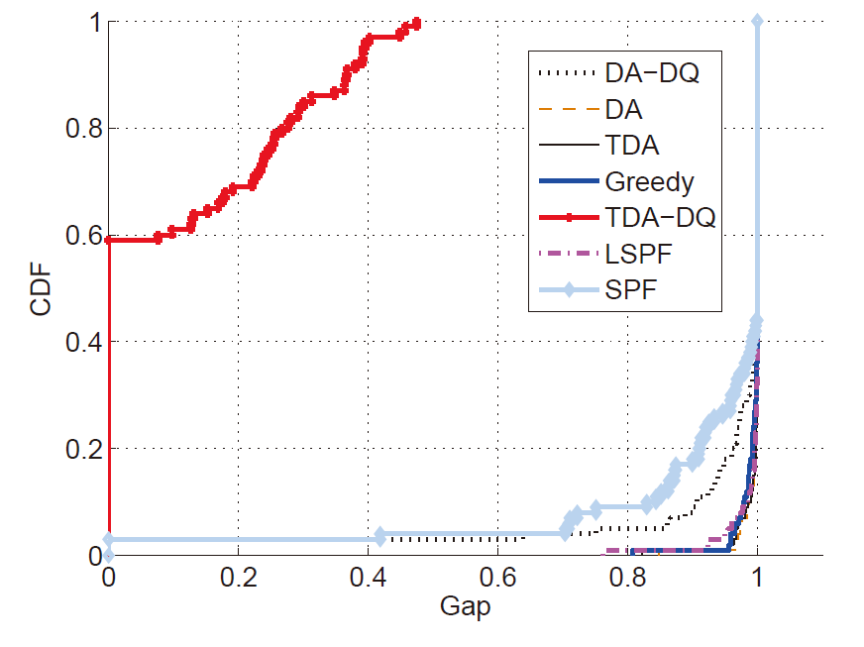
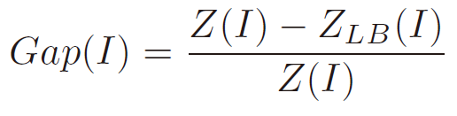
Evaluation
Total Tardiness
Gap(I): To quantitatively analyze the algorithm optimality
Z(I): Objective value in case I
ZLB(I): Lower bound
Notes:
We further estimate the gap on the total tardiness between the proposed algorithms and the lower bound. More than 90% of the gaps in TDA-DQ are less than 0.4, however, only 5% of the gaps in the other algorithms are less than 0.4. This indicates TDA-DQ outperforms any other proposed algorithms in optimality and approximates the lower bound well.

Slide 24
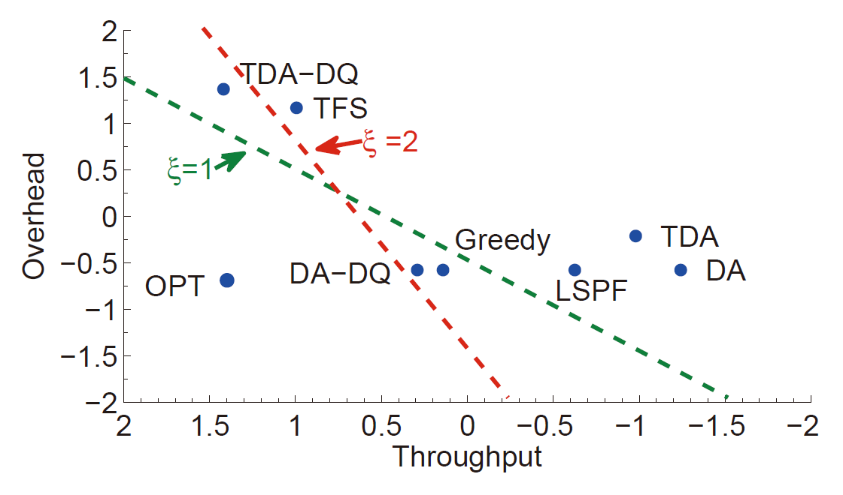
Evaluation
Applicability Evaluation
Notes:
Figure 13 shows the applicability of the proposed algorithms, of which axes denote the zero-mean nomalization value. The green dashed reference line is drawn for the case that overhead and throughput get the same weight, i.e., 𝜉 = 1, while the red one is drawn for the case that 𝜉 = 2. In terms of applicability, points below the line are always better than those above the line. As a result, we find that Greedy are superior to TDA-DQ when 𝜉 = 1. However, TDA-DQ outperforms all the others when 𝜉 = 2. More generally, for operators the optimal choice is TDA-DQ when 𝜉 > 1.72, while just Greedy when 0 ≤ 𝜉 ≤ 1.72. Whereas most flows in real-time systems are tardinesssensitive, we usually have 𝜉 ≫ 2 in fact [5]. This reveals that TDA-DQ is more applicative in real-time scenarios.

Slide 25
Outline
Why this work
  Background and motivations
The Application Adaptation Capacity based evolvability evaluation model (2ACT)
The 2ACT Model-based Evaluation for in-network Caching
Conclusion and the future work
Notes:
最后是总结。

Slide 26
Conclusion
For the first time apply the Gale-Shapley Matching Theory in the cooperativity between routing and scheduling
  Duplex matching algorithm is proposed for our RSMAT framework
  Evaluation shows that TDA-DQ achieves the near-optimal performance in handling data-intensive workloads
  Future work
  Extension to environments with multi-resource management and strategies on intermediate processing node placement
Notes:
We for the first time apply the Gale-Shapley Matching Theory in the cooperativity between routing and scheduling. As a result, the duplex matching algorithm is proposed for our RSMAT framework. Evaluation shows TDA-DQ achieves the near-optimal performance in handling data-intensive workloads. Applicability analysis reveals that TDADQ gains better applicability than the others in real-time cases, and different algorithms can adapt to different scenarios. Future work includes the extension to environments with multi-resource management and strategies on intermediate processing node placement.

Slide 27

Notes:
汇报到此结束，请老师批评指正。

Slide 28
Back up

Slide 29
Motivation
Case study
Tardiness:
Notes:
图a所示，f1和f2两个流，f1和f2的deadline分别为4和6,资源需求为2和4。大节点K1和K2上的资源分别为6和5。边上的数字为端到端的路径延时。F1和f2在K2上的处理时间分别为2和4，K1处理速度是K2的两倍。
如图b,单一的流调度，目的在于最小化流处理时间，由于K1速度比K2快，所以将K1同时分配给两个流，f1和f2的完成时间分别为7和6，总时延为3.
如图c,单一的路由策略，目的在于寻找最短路径上的大节点。所以，将K2分配给f1，完成时间为4；再将K2分配给f2，由于排队时间为2，所以f2完成时间为8.总时延为2.
然而，全局最优的分配策略，则是同时考虑调度和路由两个角度，如图d, 将k1分配f2，将k2分配给f1。f1和f2的完成时间分别为4和6，总时延为0.

Slide 30
Duplex Matching
Mapping Challenge
Quota Setting
How to set an appropriate quota for each big-node
Preference List Generation
How to define the preference lists reasonably and efficiently
Notes:
然而，流申请的大节点与学生申请的大学的不同点，在于学校有名额，而理论上节点处理流是没有名额的。【】因此，映射问题第一个挑战是如何为每个大节点设定一个合理的名额？另一方面，流和节点的属性呈现多样化，【】如何根据优化目标，合理高效地生成偏好列表，则是映射问题的另一个挑战。

Slide 31

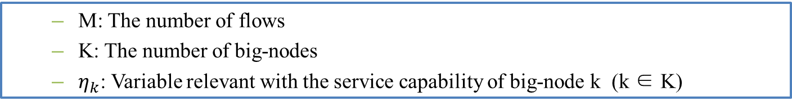
Mapping Challenge
Quota Setting
Quota
  Service limit as an additive attribute of big-nodes. This service limit is reasonable since we seldom process all flows on the same big-node.
Quota of each big-node can be denoted as
  M: The number of flows
  K: The number of big-nodes
  $η_{k}$: Variable relevant with the service capability of big-node k (k ∈ K)
Notes:
首先，为每个大节点附加一个服务限制属性。这个服务限制是合理的，因为我们很少将所有流集中放到同一个大节点上处理。

Slide 32
Mapping Challenge
Preference List Generation
Flow preference list A
  For a flow to select a big-node, the list is generated by a weighted sum of path length and processing speed.
Big-node preference list B
  For a big-node to select a flow, the list is generated by a weighted sum of flow deadline and the amount of resource requirement.
Notes:
当流选择大节点时，偏好列表取决于大节点所在的路径长度和处理速度；
当大节点选择流时，偏好列表取决于流的deadline和流的资源需求量。

Slide 33
Duplex Matching
Expected handling time
Notes:
流在节点上期望的处理时间，取决于流在节点上的调度次序。具体来说，就是将流临时地加入到节点的录取名单中，然后按偏好列表进行顺序调度。这里给出了一个计算期望处理时间的例子。
For example in Fig. 5, f1, f2, and f3 are flows already in Y before f4 is added. Q =18, q1 = 10, q2 = 5, q3 = 8, q4 = 6, pm = qm(m = 1, 2, 3, 4). Assuming the preference in B is f1 > f2 > f3 > f4, and scheduling with capacity constraints, the expected handling time of f4 is 16. Since the flow’s expected handling time depends on the interaction of all flows in the queue, A changes dynamically during each iteration in this case.

Slide 34
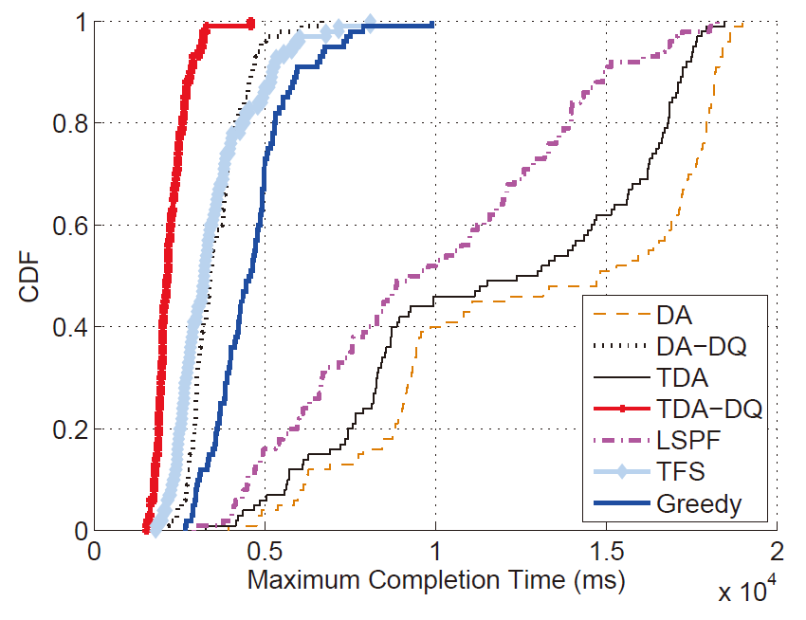
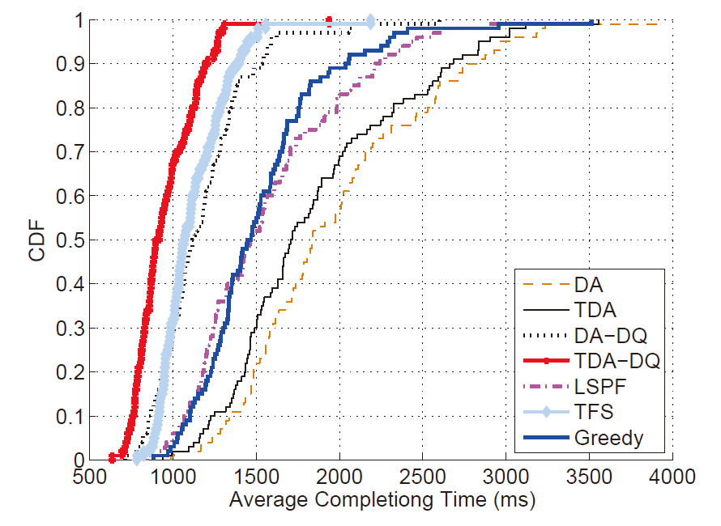
Evaluation
Completion Time
Notes:
从完成时间上，也可以得出类似的结论。
Figures 9 & 10 show the maximum
completion time and the average completion time, respectively.
We can find that TDA-DQ gains the min-max completion
times, of which 94% are less than 3300 ms. Meanwhile,
applying algorithms of DA-DQ, TFS, and Greedy, the system
can also gain good performance with regard to the maximum
completion time. Whereas more than 80% applications can be
completed within 5000 ms. However, assume the due date of
the soft real-time applications is 5000 ms, systems applying LSPF, DA, and TDA have to suffer from high application
tardiness.

Slide 35
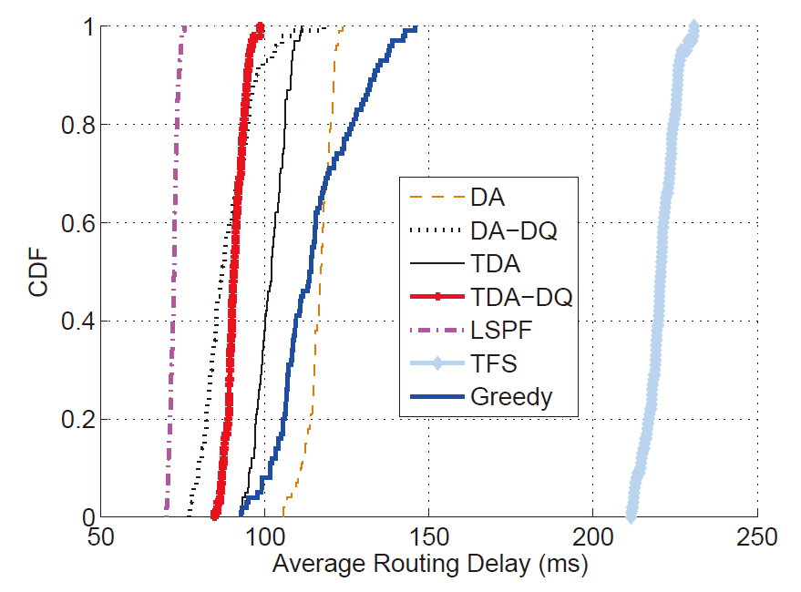
Evaluation
Routing Delay
Notes:
路由延迟方面，单一的路由优化由于将最短路径上的大节点分配给各个流，实现了最短路由延迟。而单一的流调度，由于不考虑路由优化，导致了最大的路由延迟。
Figures 11 shows the average routing delay.
The routing-only strategy LSPF gains the lowest propagation
delay, as it assigns the big-nodes with the shortest relaypath
to flows. However, the scheduling-only strategy TFS
results in the highest propagation delay. Assume an identical
propagation delay exists on each link, higher propagation delay
means using more links to complete an application. Hence,
systems applying TFS may suffer from bandwidth waste and
higher risk of link failure. This further enhances the necessity
of integrating routing and scheduling even in the cases that
routing delay is much less than handling time.

Slide 36
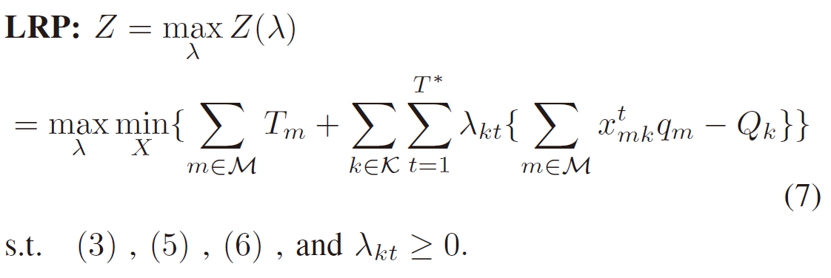
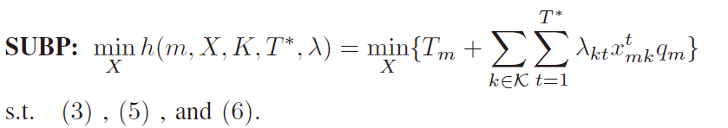
Lower Bound
Lagrangian Relaxation Problem (LRP)
Subproblem (SUBP)
Notes:
求解优化问题下界的方法很多。这里采用拉格朗日松弛的方法。将原问题的难约束松弛后，转变成容易求解的子问题。

Slide 37

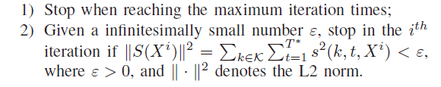
Lower Bound
Subgradient Optimization Algorithm
Solve SUBP
Subgradient of LRP:
Calculate subgradient
Stop conditions:
Stop conditions
NO
YES
lower bound
Notes:
进一步，设计次梯度优化算法，通过迭代的方式，求得问题的下界。本质上，次梯度优化算法是一种启发式的算法。

