Slide 1
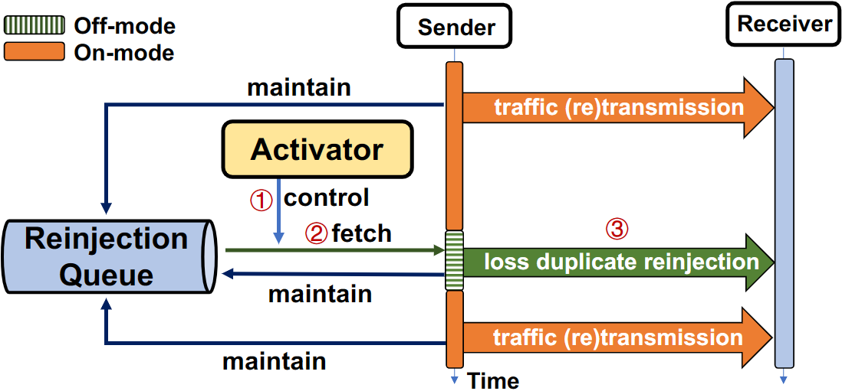
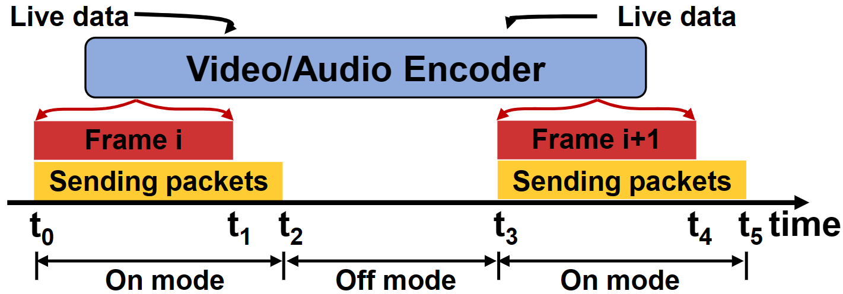
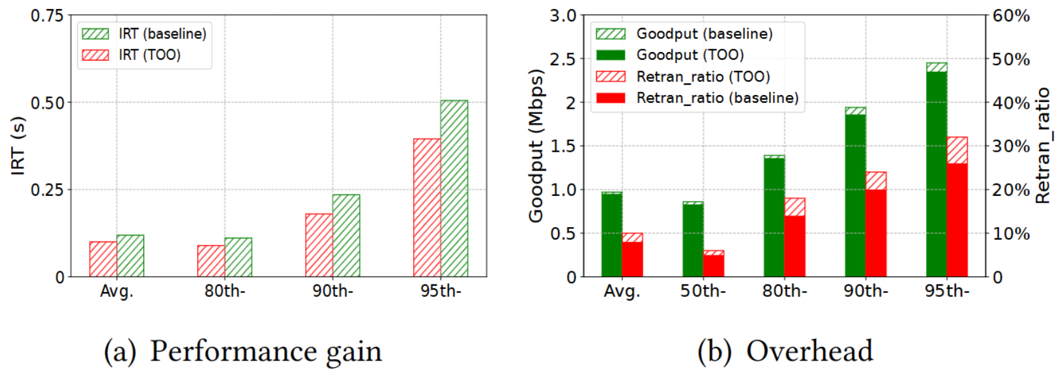
TOO: Accelerating Loss Recovery by Taming On-Off Traffic Patterns
Xu Yan† , Tong Li† , Bo Wu‡ , Cheng Luo‡ , Fuyu Wang‡ , Haiyang Wang§ , and Ke Xu¶
Renmin University of China† , Tencent‡ , University of Minnesota Duluth§ , Tsinghua University¶
Abstract
As the ubiquitous phenomenon occurs in applications such as live streaming and video conferencing, the on-off traffic pattern is regarded as a disadvantage for congestion control. However, we argue that it can be transformed as an advantage for accelerating loss recovery. We demonstrate the design of TOO, a loss recovery acceleration mechanism that tames on-off patterns for loss duplicate reinjection without incurring non-trivial traffic overhead.
1
Background
The ubiquitous packet loss is an essential factor affecting client-side quality-of-experience (QoE) in live-streaming services, in which the introduced head-of-line (HOL) blocking might result in long-time video freezing.
Most modern CDN vendors employ the automatic-repeat-request (ARQ) paradigm to control loss tolerance as the commercial solution. However, from the deployment experience of real product networks, we find that legacy ARQ-based loss recovery is far from satisfactory.
Most loss recovery schemes fall into the category of dual-side solutions that require modification or upgrade on both the server side and the client side. Unfortunately, they all suffer from deployment issues, especially under Multi-Supplier Strategy that is applied by application providers (e.g., Tiktok Live) to select better-performed CDN vendors.
2
To further mitigate the additional traffic overhead, TOO enables the proposed duplicate reinjection on demand, which is based on the designed activator that depicts client-side waiting time for loss recovery. TOO can identify the poor-performed live streaming, and then activate the proposed
recovery optimizations for these selected streams. As a result, only the packet losses under worse-performed connections will be reinjected.
4
PART 2
Motivation
The performed measurements show that on-off switching ubiquitously occurs in current live streams. Note that it is well-studied that the on-off traffic pattern is not conducive to transmission control. For example, as shown in Figure 1, during the off-mode, the sender stops pushing data into the network, and the delivery rate might be underestimated. However, we argue that the "wasted" off-mode can be regarded as an essential opportunity for accelerating loss recoveries.
3
Fig. 2: The TOO Framework.
Demonstration and Evaluation
We implement the TOO prototype based on the user-space QUIC protocol(with the version of LSQUIC Q043). The experimental evaluation is performed on commercial live-streaming services, where the CDN proxy server that has deployed TOO prototype can pull and transmit the requested live streaming from our live CDN to real-network users.
To better depict the quality of loss recovery, we introduce a metric called invalid-response-time (IRT), which is defined as the duration from when any data is detected lost to when resending a recovery packet that will be successfully received.
As shown in Figure 3(a), we can learn the average IRT can be lowered by the ratio of 16.0%;
As shown in Figure 3(b), TOO makes the average goodput to deteriorate only with a ratio of 2.4% (from 974.3Kbps to 951.1Kbps).
5
Fig. 1: The sketch of on-off mode in live streams.
Design
As a sender-side extension, TOO enables traffic senders to reinject loss duplicates once entering the off-streaming mode, as Figure 2 shows.
In particular, each TOO sender establishes and maintains a reinjection queue (Qrein) for each live stream, which only records retransmitted packets that has been resent but unacknowledged yet by its receiver. In TOO, Qrein will be updated if any retransmitted packet has been resent or acknowledged. Concretely, retransmitted packet will be inserted to the end of Qrein if it has been retransmitted while being removed if the retransmitted packet is successfully received by its receiver. Besides, the TOO sender will move retransmitted packet from the head to the end of Qrein when the proposed off-mode reinjection is performed
4
PART 1
Fig. 3: The performance of TOO.
Conclusion
The real-world experiments demonstrate that TOO can effectively accelerate loss recovery of live streaming without incurring unbearable overhead.
6
REFERENCES
[1] Zhilong Zheng, Yunfei Ma, Yanmei Liu, Furong Yang, Zhenyu Li, Yuanbo Zhang, Jiuhai Zhang, Wei Shi, Wentao Chen, Ding Li, et al. Xlink: Qoe-driven multi-path quic transport in large-scale video services. In ACM SIGCOMM, 2021.
[2] Tong Li, Kai Zheng, Ke Xu, Rahul Arvind Jadhav, Tao Xiong, Keith Winstein, and Kun Tan. Tack: Improving wireless transport performance by taming acknowledgments. In ACM SIGCOMM, pages 15–30, 2020.
[3] Yasemin Arda and Jean-Claude Hennet. Inventory control in a multi-supplier system. International Journal of Production Economics, 104(2):249–259, 2006.
[4] D BertsekasandR. Gallager, data networks. Prentice-Hall, 1(99):2, 1992.
[5] Theophilus Benson, Ashok Anand, Aditya Akella, and Ming Zhang. Understanding data center traffic characteristics. ACM SIGCOMM Computer Communication Review, 40(1):92–99, 2010.
[6] LiteSpeed Tech. LiteSpeed QUIC and HTTP/3 Library. https://github.com/litespeedtech/lsquic.

