Slide 1
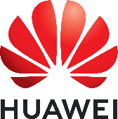
WIP: When RDMA Meets Wireless
Tong Li^{1,2}, Ke Xu^{3,4,5}, Hanlin Huang³, Xinle Du³,Kai Zheng¹
¹Hua Wei, ²Renmin University of China, ³Tsinghua University,
⁴BNRist, ⁵PCL,
Notes:
hello everyone i’m hanlin huang from tsinghua university. Today i'm glad to present our work When RDMA Meets wireless. This is a joint work with people at Huawei, RENMIN UNIVERSITY OF CHINA and tsinghua university.

Slide 2
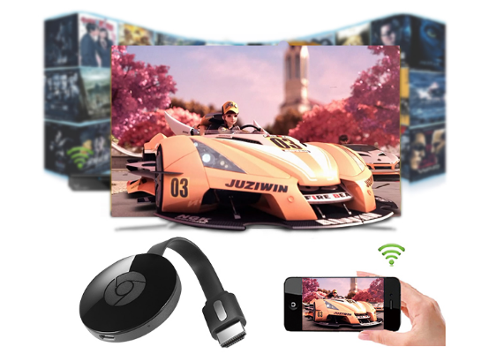
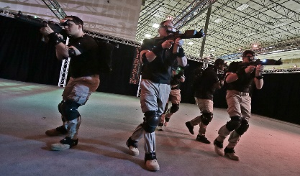
Wireless local area network (WLAN) demands high throughput
100
Mbps
200
Mbps
500
Mbps
30
Mbps
92
Mbps
Average
Peek
UHD VR
2018
2023
Ultra-high-definition
(UHD) wireless projection
Application Requirements | UHD Cameras (Security) | UHD Streaming | VR Streaming | Self Driving Vehicle Diagnostics | Cloud Gaming | UHD IP Video | 8K Wall TV | HD VR | UHD VR
Average (Mbps) | 16 | 16 | 17 | 20 | 30 | 51 | 100 | 167 | 500
Source: Cisco Annual Internet Report, 2018–2023
VR interactive gaming
8K Videos from Youtube | Asteroid Discovery | NORWAY | The Las Vegas Strip | TOKYO HDR Time Lapse | Angel Falls, Venezuela | Tigers Go For A Swim | Henosis(8K Short Film)
Average (Mbps) | 81.0 | 81.1 | 129.1 | 62.8 | 57.7 | 72.0 | 40.6
Peek (Mbps) | 206.9 | 196.9 | 134.2 | 83.2 | 81.3 | 72.1 | 71.1
Open Metaverse
Source: Huawei iLab, 2017
Notes:
High-throughput transport over WLAN becomes a demanding requirement
with the emergence of applications such as UHD wireless projection, VR-based interactive gaming, Metaverse and so on. It is reported that the average WLAN connection speed in 2018 was 30 Mbps and will be more than triple by 2023.

Slide 3
Legacy kernel TCP stack is not fully satisfactory
CPU bottleneck restricts performance of high-bandwidth technologies
System kernel operations
New wireless transmission technology
A gap exists between the actual transmission and target value
Ultra-low latency of wireless applications requires ultra-high bandwidth
High-resolution and video-based interactive applications
Encoding, transmitting, and decoding for each frame
CPU-intensive codec is becoming the bottleneck of high-resolution and interactive applications
Notes:
However, the legacy kernel TCP stack is not fully satisfactory.
On one hand, CPU bottleneck restricts performance of high-bandwidth technologies
With the development of new communication technologies such as 5G, WiFi 6, and WiFi 7, when transferring a large volume of traffic via the legacy kernel TCP stack, the system kernel has to handle operations such as context switching and memory copies
On the other hand, Ultra-low latency of wireless applications requires ultrahigh
bandwidth. Each video frame handling process including encoding, transmitting, and decoding has to be completed within 60 ms
In summary, the CPU bottleneck on hosts is becoming the
hurdle for wireless transmission to achieve ultra-low latency
and ultra-high bandwidth

Slide 4
Fortunately, RDMA high performance in datacenter inspires us
Remote Direct Memory Access
Access memory remotely and directly
Bypass the system kernel
Parse packet in hardware
[1]reveals RDMA reduces over 95% of the CPU utilization on hosts
Considering the great potential of RDMA in tackling the CPU bottleneck issue, enable RDMA for wireless transmission.
[1]Y. Zhu, H. Eran, D. Firestone, C. Guo, M. Lipshteyn, Y. Liron, J. Padhye,S. Raindel, M. H. Yahia, and M. Zhang, “Congestion control for large scale rdma deployments,” ACM SIGCOMM CCR, 2015.
Notes:
RDMA (Remote Direct Memory Access), a technique to access memory
remotely and directly, can bypass the system kernel and perform packet parsing in hardware without software involvement. While RDMA-based applications are currently in the wired domain. Considering the great potential of RDMA
in tackling the CPU bottleneck issue, enabling RDMA for wireless transmission would be a relevant contribution.。

Slide 5
We propose W-RDMA
Notes:
In this paper, we for the first time propose the concept of Wireless-RDMA (W-RDMA). W-RDMA enables RDMA for wireless transmission and tackles the CPU bottleneck issue on wireless hosts.

Slide 6
W-RDMA modules
W-RDMA host
For TCP:
Send data through Socket APIs
System process
Transmitting through wireless MAC
Buffer
Buffer
App
Buffer
Buffer
App
Interface Adapter
Interface Adapter
OS
OS
TCP/IP
TCP/IP
W-RDMA
Engine
W-RDMA
Engine
Buffer
Buffer
For W-RDMA:
Send data through W-RDMA Engine
Hardware process
Transmitting through wireless MAC
Transport
Base on
UDP
Transport
Base on
UDP
MAC
MAC
Wireless Link
Notes:
This Figure shows the module interactions of two protocols, i.e, TCP/IP and W-RDMA, respectively over wireless links. For TCP/IP, data in the application buffer are sent through Socket APIs, passed into the operating system for processing, and then transmitted to the receiver through wireless MAC. For W-RDMA, data at the application layer does not pass through the operating system, but directly enters the cache of the WRDMA engine and is transmitted to the other receiving host.

Slide 7
The W-RDMA protocol stack
User Space
Hardware space
Link layer based 802.11 standards
Host Channel Adapter for transmission medium
Transport layer reuse UDP
Kernel Space
Capturing, forwarding, encapsulating
User Space
W-RDMA Interface Adapter
Unified north APIs
Wireless channel selection APIs
W-RDMA Application
W-RDMA Interface Adapter
Kernel Space
W-RDMA Kernel Mode
W-RDMA Transport Protocol
Hardware Space
Conflict Avoidance
Rate Control
802.11 Link Layer
Notes:
the W-RDMA protocol stack obeys a hierarchical design, including hardware space, kernel space, and user space. the W-RDMA transport protocol should be implemented in the hardware space. Different from the RDMA protocol stack in the wired domain,
the link layer is based on IEEE 802.11 standards. In addition, the WRDMA transport protocol should include a Host Channel Adapter， running on the right channel helps to speed up connection speed。W-RDMA’s kernel space performs fewer operations including capturing and forwarding packets, ect。The unified north APIs provide original interfaces for data transmission, such as SEND, RECEIVE, WRITE, READ

Slide 8
However, three challenges exist for applying W-RDMA
Notes:
However, there are three challenges exist for applying W-RDMA

Slide 9
Challenge1: Lossless transmission guarantee
a prerequisite to guarantee the performance benefits of RDMA like RoCEv2
Poor wireless signal strength, unpredictable network conditions
Recover as quickly as possible in the case of packet loss
Notes:
First challenge is .. It is well-known that ensuring lossless transmission is a prerequisite to guarantee the performance benefits of RoCEv2. wireless transmission suffers from more unpredictable network conditions than wired one. ,W-RDMA
should avoid packet loss as much as possible. On the other hand, W-RDMA should recover as quickly as possible in the case of packet loss.

Slide 10
Challenge2: Interface adapter design
Unified north APIs
Reuse fundamental functions of legacy RDMA verbs
Supporting wireless platform like ARM-based Andriod
Notes:
For the unified north APIs, W-RDMA should basically reuse as many as possible the functions of legacy RDMA verbs APIs, including SEND, RECEIVE,
WRITE, READ, etc. Besides, (2)
the RDMA verbs APIs are relatively complicated for some
applications of other platforms such as ARM-based Android.

Slide 11
Challenge3: Dedicated hardware support
Key functions: kernel bypass, packet processing
Mainly supported by dedicated hardware, i.e., NICs
Notes:
Kernel bypass capability of
RDMA hosts is mainly supported by dedicated hardware, i.e.,
Smart NICs. Although nowadays the Wi-Fi 6 and 5G communication
modules have been widely equipped, no dedicated W-RDMA
enabled chips exist for mobile terminals such as smartphones.

Slide 12
A demo is designed for exploring the feasibility of W-RDMA

Slide 13
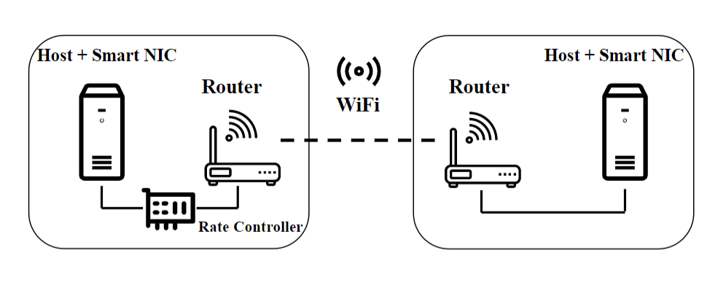
Demo settings
Two hosts equipped with RDMA-enable smart NICs
NICs with a bandwidth 10Gbps, support RoCEv2
Each host connects a 10-GbE router
Rate Controller based DPDK, with two 82599ES NICs
Demo topology
Notes:
The topology of the W-RDMA testbed is illustrated in Figure 3. Two hosts are equipped with RDMA-enabled smart NICs with a high bandwidth capability of 10 Gbps, and each host is connected to a 10-GbE router through a wired link
to form a logic wireless terminal, and the communication
between the two logic wireless terminal is still over Wi-Fi
links (e.g., Wireless Distribution System (WDS)). In order to control the sending rate of RDMA hosts, as shown in Figure, the W-RDMA testbed
requires a Rate Controller implemented between the host and
the router.

Slide 14
Why it can evaluate the feasibility of W-RDMA
The proto verbs operations of RDMA are still used in this testbed, the evaluation of feasibility for W-RDMA remains constant.
To ensure lossless transmission, we control the sending speed of the host by adding a rate controller, proving the feasibility of W-RDMA to be utilized by wireless applications
Notes:
There are some notable points that are important
for reasoning why this testbed can evaluate of the feasibility
of W-RDMA.
First, the proto verbs operations of RDMA are still used
without unified north APIs in this testbed. Since it does not
affect the performance of W-RDMA wireless transmission, the
evaluation of feasibility for W-RDMA remains constant.
In addition, to ensure lossless transmission, we control
the sending speed of the host by adding a rate controller
between it and the router. Although it does not provide a
perfect set of congestion control protocols, it proves the
feasibility of W-RDMA to be utilized by wireless applications
through adequate experiments

Slide 15
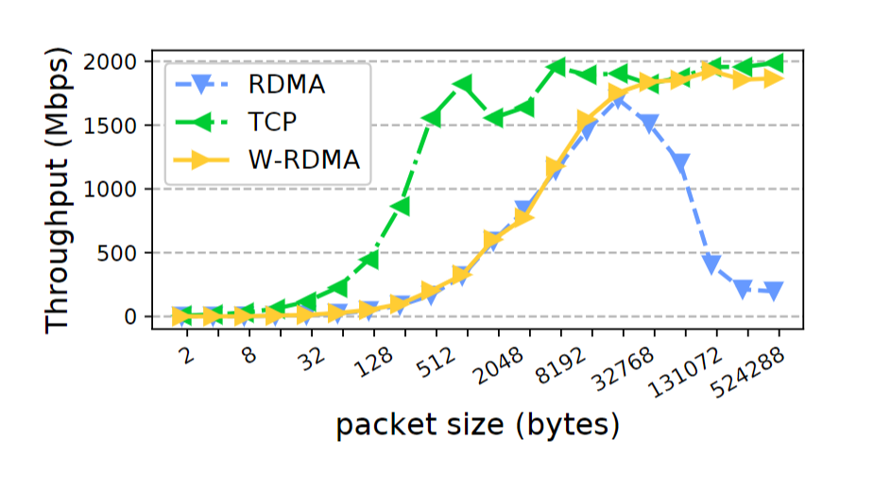
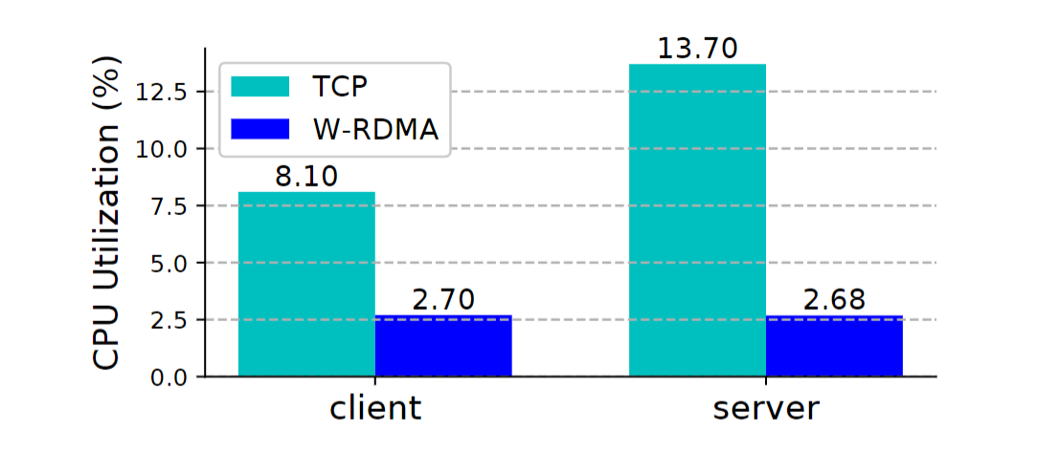
Evaluation
Throughput trend with packet size
CPU utilization
Notes:
We first explore the throughput trend of WRDMA
when packet size varies.
When packet size is large enough (e.g., over
32768 bytes), RDMA’s sending rate exceeds the wireless
bandwidth, which induces packet losses and retransmissions.
This seriously affects the performance of RDMA. W-RDMA
outperforms RDMA because an extra Rate Controller is introduced
to avoid losses. Figure 4 also demonstrates that WRDMA
approximates TCP in throughput when transmitting
large-size packets.
We then compare the CPU utilization of
kernel TCP and W-RDMA with the same packet size. In
particular, we set packet size as 30000 bytes to ensure that
they achieve a similar throughput.
It is obvious that W-RDMA is able to significantly reduce CPU
overhead on hosts. Specifically, W-RDMA saves 66.67% and
80.44% of CPU resources on the client host and the server
host, respectively.

Slide 16
Conclusion
Contributions:
Propose W-RDMA
Analyze difference from legacy TCP/IP
Investigate its feasibility
Future work:
Minimalist device-to-device transport protocols
A complete set of congestion algorithms
Notes:
This paper proposes W-RDMA for the first time, analyzes its difference form legacy TCP/IP and investigates its feasibility
of enabling RDMA in wireless transmission.
The future work includes overcoming the above mentioned challenges
as well as the design of minimalist device-to-device transport
Protocols and a complete set of cc.

Slide 17
Tanks for your listening

