Slide 1
A Measurement Study on Multi-path TCP with Multiple Cellular Carriers on High Speed Rails
ACM SIGCOMM ‘18, Budapest, Hungary
Li Li*, Ke Xu*, Tong Li$†$, Kai Zheng$†$, Chunyi Peng$ℾ$,
Dan Wang$┴$, Xiangxiang Wang*, Meng Shen$║$, Rashid Mijumbi$‡$
August 20–25, 2018
$$∗$$
$$†$$
$$ℾ$$
$$┴$$
║
$$‡$$

Slide 2
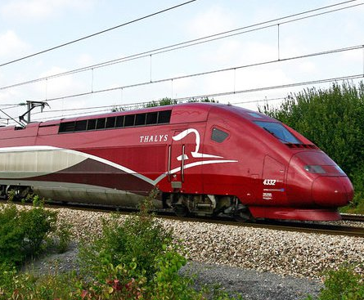
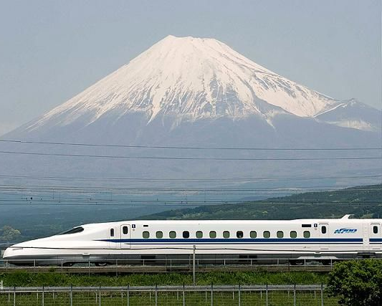
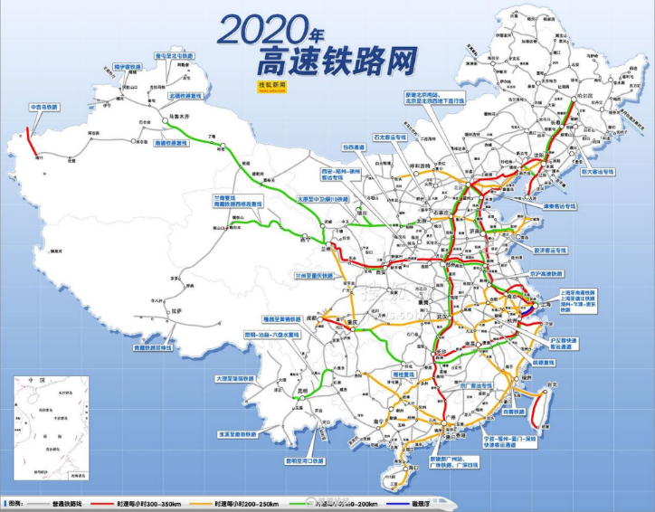
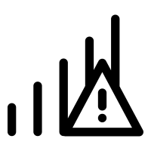
High Speed Rails (HSRs)
38,000
km
66%
310
km/h
1.7
billion
30%
30,000
km
Length
China
Speed
Passenger
Growing
2020
Europe: Thalys
Japan: Shinkansen
China
High speed
mobility
Increasing need for acceptable quality of network services
Notes:
In the last few years, there has been a significant worldwide increase in the deployment of high speed rails, reaching about 38,000 kilometers. In this regard, China contributes 66% of the world’s HSR network in length. The peek speed is over 300 kilometers per hour. The passenger volume in China was 1.7 Billion last year and is growing at an annual rate of 30%. China is planning to provide 30,000 kilometers HSR service in 2020. Therefore, like never before, there is an increasing need for acceptable quality of network services in high speed mobility scenarios.

Slide 3
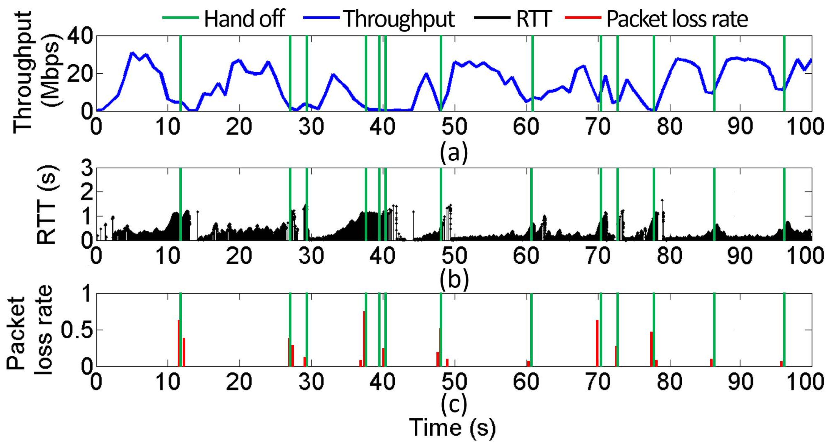
Single-Path Degradation on HSRs
Frequent handoff is the main cause of performance degradation [Li, INFOCOM15] [Li, TON17]
Notes:
Our previous studies indicate that performance of single-path transmission declines significantly on high speed rails. It has been found that frequent handoff is the main cause of performance decline. This figure shows an example of a TCP flow measured in 4G networks on high speed rails. The flow suffers 13 handoffs during 100 seconds marked by green stems. We find that the throughput of TCP decreases sharply, and RTT and packet loss rate increase significantly when suffering a handoff.

Slide 4
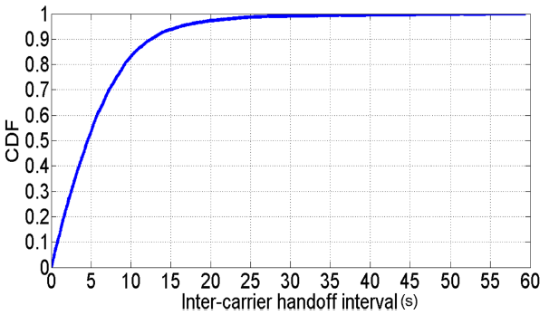
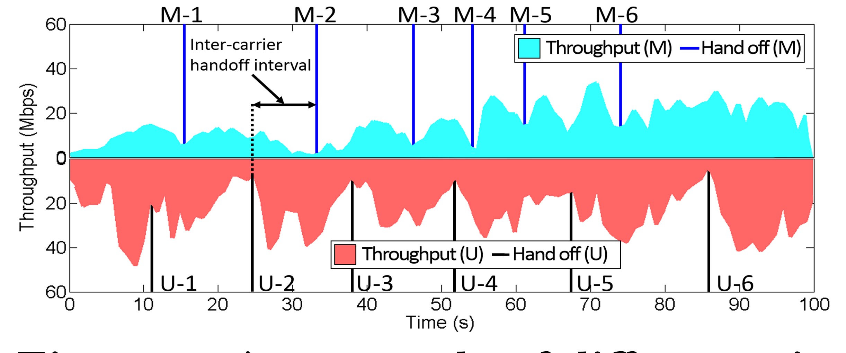
Benefit from Carrier Complementarity
Making use of the difference in handoff time between carriers
Rarely happens at the same time
CDF of inter-carrier handoff interval
An example of two complementary carriers
To explore potential benefits of using Multi-path TCP (MPTCP)
Notes:
Fortunately, we find that handoff of two carriers rarely happens at the same time. This complementarity can be attributed to the differences in base station locations and handoff technologies between carriers. Making use of the diﬀerence in handoﬀ time between carriers, multi-path transmission has the potential to improve performance. The right figure shows an example: two single-path TCP flows using diﬀerent carrier networks are measured simultaneously. When one flow suﬀers a handoﬀ and throughput declines, the other does not suﬀer a handoﬀ at the same time and throughput is much higher. As a result, the total throughput rarely drops to a very low level even when either carrier suﬀers a handoﬀ. This paper is to explore potential benefits of using Multi-path TCP.

Slide 5
Measurement Challenges
Many intertwined factors
External: terrain, speed, handoff and network type, etc.
Internal: flow size and algorithms (congestion controller or scheduler), etc.
Location and time bias
Same location vs high speed mobility
Same time vs flow interference
Effort and time intensive
Many people and much money
Massive data traces on various HSR routes
Notes:
Our measurement study faces several challenges. First of all, performance is influenced by many intertwined factors. It is diﬃcult to evaluate the impact of a single one. It is also diﬃcult to collect information on so many factors without dedicated tools. Second, network conditions vary significantly, and results may be biased by specific time and location during the high-speed rail traveling. Last but not the least, the measurement is eﬀort and time intensive. It requires to recruit many people to put in considerable eﬀort to collect massive data traces on various HSR routes.

Slide 6
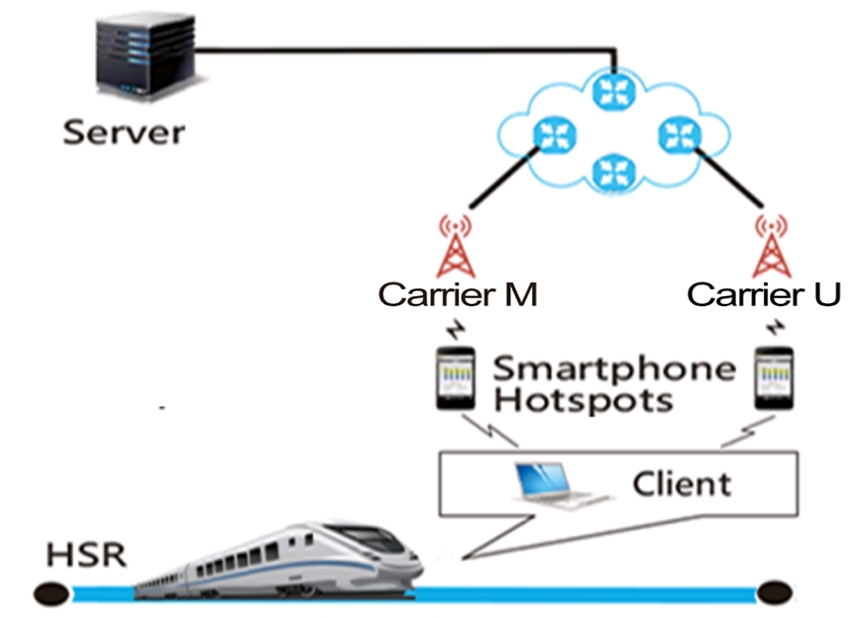
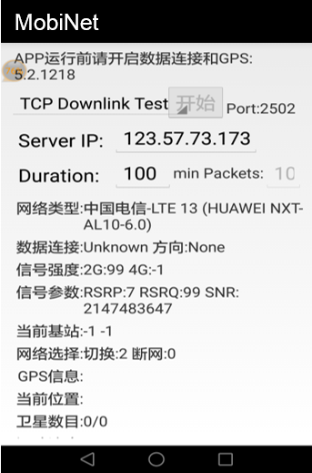
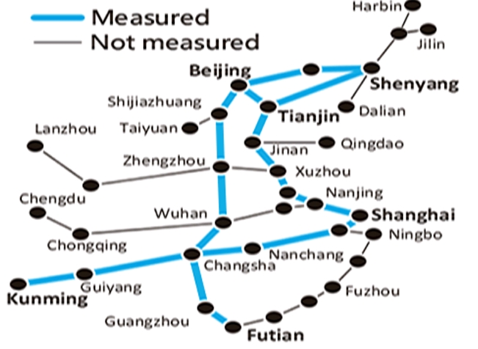
Measurement Methodology
Measurement setup
MobiNet
Footprints
USB cellular modems, USB WiFi
modems accessing smartphone hotspots
Geographical location, train
speed, network type and handoffs
Accumulated 82,266 km:
2x Earth Equatorial Circumference
Notes:
We took laptops as the clients on high speed trains and deployed servers in the cloud. Each laptop can access multiple cellular networks at the same time by using USB cellular modems, or USB WiFi modems accessing smartphone hotspots. The reason for also using smartphone hotspots is that we developed an Android application, MobiNet, to collect real-time cellular conditions such as geographical location and speed of the train, network type and handoffs. During 22 months, we covered six popular HSR routes in China, and took dozens of trips on each route. The total mileage of our measurement equals to twice the circumference of the Earth.

Slide 7
Analysis Method
Filtering data—terrain, speed, handoff and network type
Comparison between MPTCP and TCP
Decision Making
Only consider data in 4G LTE networks in areas of open plains
Same flow size/duration, at the same train speed, with similar handoff frequency, in the same carrier network
Robustness: If MPTCP outperforms either of the two single TCPs
Only consider two cases: static and high speed (280-310km/h)
Efficiency: If MPTCP outperforms both single TCPs
Stable MPTCP kernel implementation v0.91: www.multipath-tcp.org
Notes:
Factors such as terrain, speed, handoff and network type are all changing. To make the analysis feasible, we only focus on speed and handoff, and fix the other factors. Specifically, we only consider data in 4G LTE networks in areas of open plains, and only consider static and high speed cases.
After this, we compare MPTCP and TCP flows with the same size and duration, measured at the same train speed, and suffering the similar number
of handoffs in the same carrier network. We evaluate the advantage of MPTCP over TCP on both robustness and efficiency. If MPTCP outperforms either of the two single-TCPs, MPTCP is considered more robust than TCP. If MPTCP outperforms both single-TCPs, MPTCP is considered more efficient than TCP.

Slide 8
Results
Mice Flows
Notes:
We first study the performance of mice flows.

Slide 9
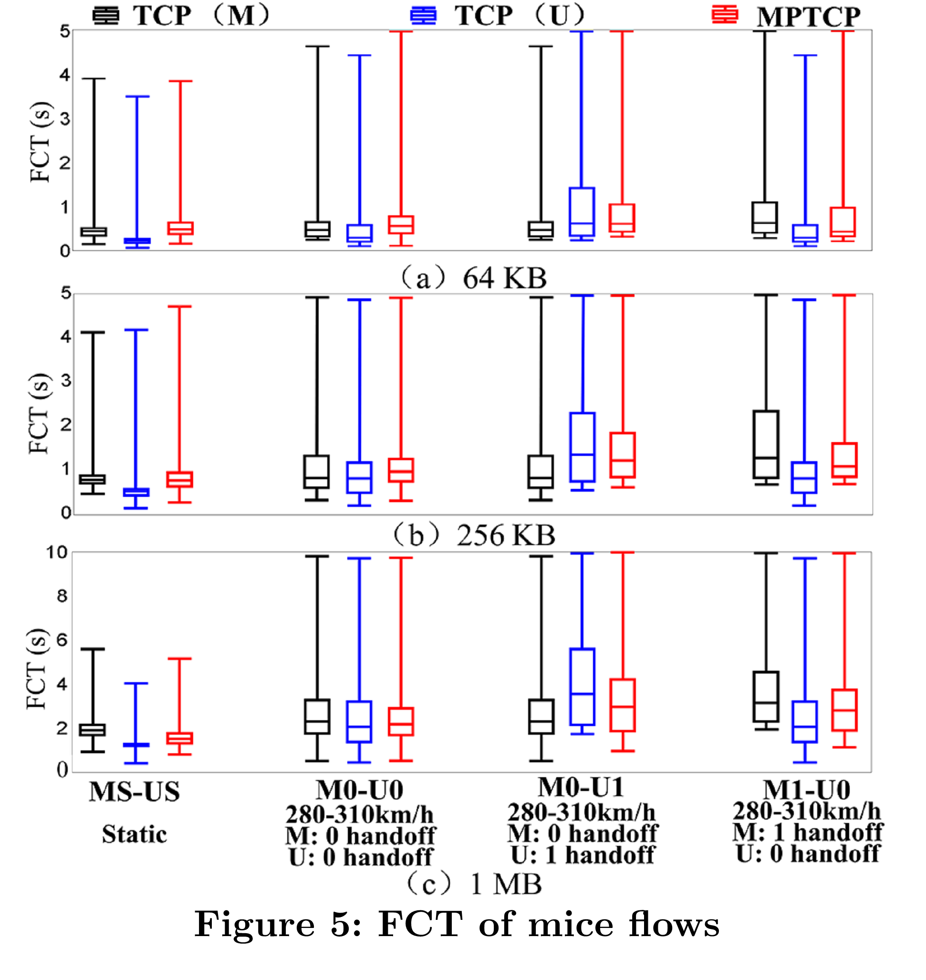
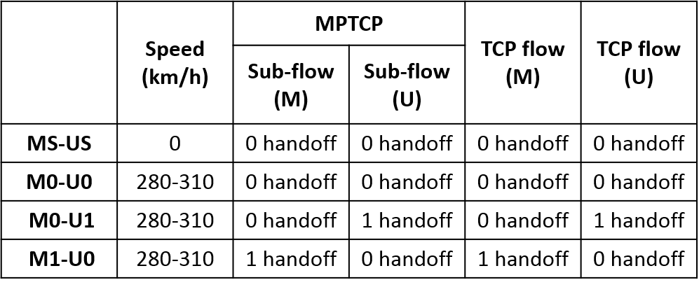
File Completion Time (FCT)
M: Carrier M U: Carrier U
TCP (M): single-path TCP using Carrier M
TCP (U): single-path TCP using Carrier U
MPTCP: dual-path MPTCP using Carrier M and Carrier U, simultaneously
FCT of mice flows (<1 MB)
Notes:
File completion time (FCT) is the key metric for mice flows. We compare single-path TCP using Carrier M, single-path TCP using Carrier U, and dual-path MPTCP using Carrier M and Carrier U, simultaneously

Slide 10
Performance of Mice Flows
Decision Making
Robust: If MPTCP outperforms either of the two single TCPs
Efficient: If MPTCP outperforms both single TCPs
Handoff path
MPTCP
Better path
Cannot achieve advantage over TCP in efficiency
FCT of mice flows (<1 MB)
Notes:
For robustness, when either path suffers a handoff, MPTCP’s file completion time is shorter than that of TCP in the path suffering a handoff, indicating that MPTCP is more robust to handoff than TCP.【】For efficiency, MPTCP’s file completion time is longer than that of TCP in the better path most of the time, indicating that MPTCP cannot achieve a significant advantage over TCP in efficiency.

Slide 11
Performance of Mice Flows
Decision Making
Robust: If MPTCP outperforms either of the two single TCPs
Efficient: If MPTCP outperforms both single TCPs
Large gap
Handoff leads to efficiency reduction
Small gap
Inefficient sub-flow establishment
FCT of mice flows (<1 MB)
Notes:
Worse still, handoff leads to an efficiency reduction. When the train speed is over 280km/h, compared with the case that neither path suffers a handoff, the efficiency gap between MPTCP and TCP increases in the case that either path suffers a handoff.【】Since subflow establishment time of mice flow takes a considerable portion of file completion time. We find that the efficiency reduction is mainly caused by the in-efficient sub-flow establishment, we make an analysis as follows.

Slide 12
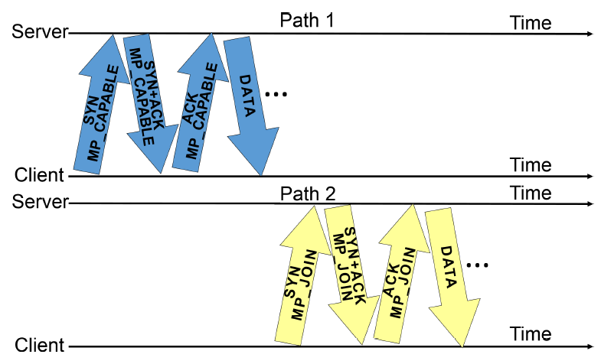
Sub-flow Establishment: Normal Case
Neither of two paths suffers a handoff
Sub-flow 1
3 handshakes
Sub-flow 2
3 handshakes
Notes:
In the case that neither path suffers a handoff, MPTCP does not establish two sub-flows in parallel, but orderly. It first establishes a sub-flow by three handshakes with a flag of “MP_CAPABLE”. After the first sub-flow is established successfully, the second sub-flow is also established by three handshakes with a flag of “MP_JOIN”. MPTCP uses six handshakes in total.

Slide 13
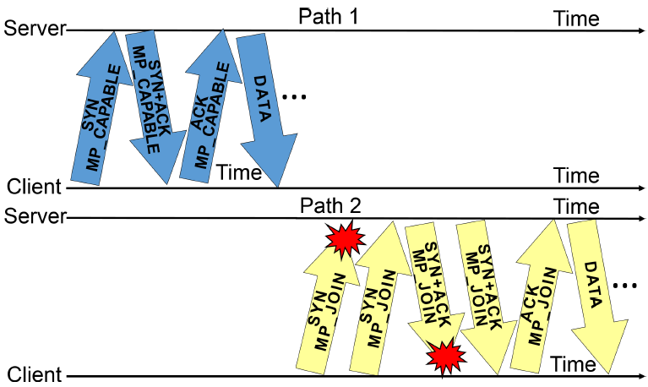
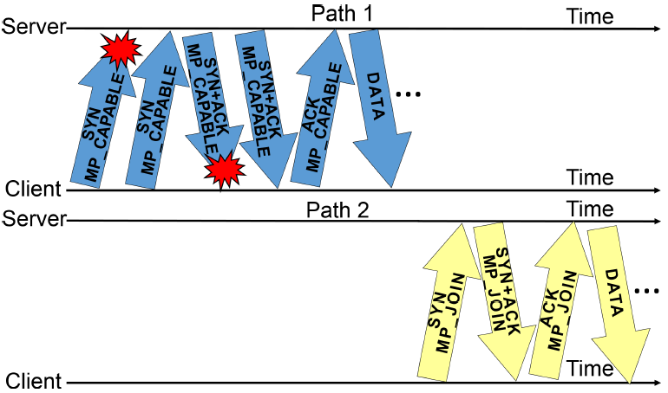
Sub-flow Establishment: Handoff Case
Either of two paths suffers a handoff
Handoff path
3 handshakes
5 handshakes
Handoff path
5 handshakes
3 handshakes
Lucky Case
Unlucky Case
Notes:
While in the case that either path suffers a handoff. If MPTCP luckily establishes the first sub-flow in the better path, it can begin data transmission timely, but spend long time to establish the second sub-flow. On other hand, if MPTCP unluckily establishes the first sub-flow in the handoff path, it takes longer time to establish the first sub-flow. Although the other path is much better, MPTCP can not begin data transmission until the first sub-flow is established successfully.

Slide 14
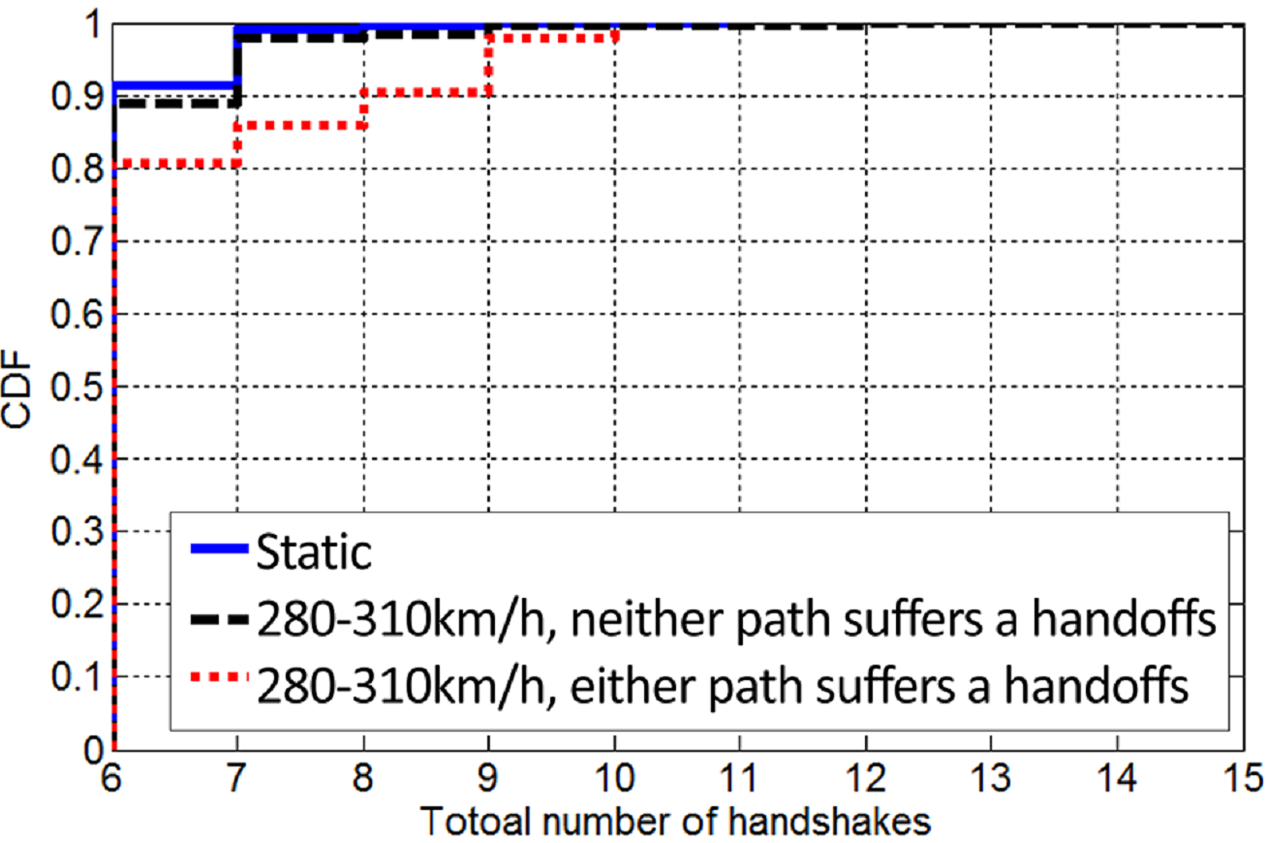
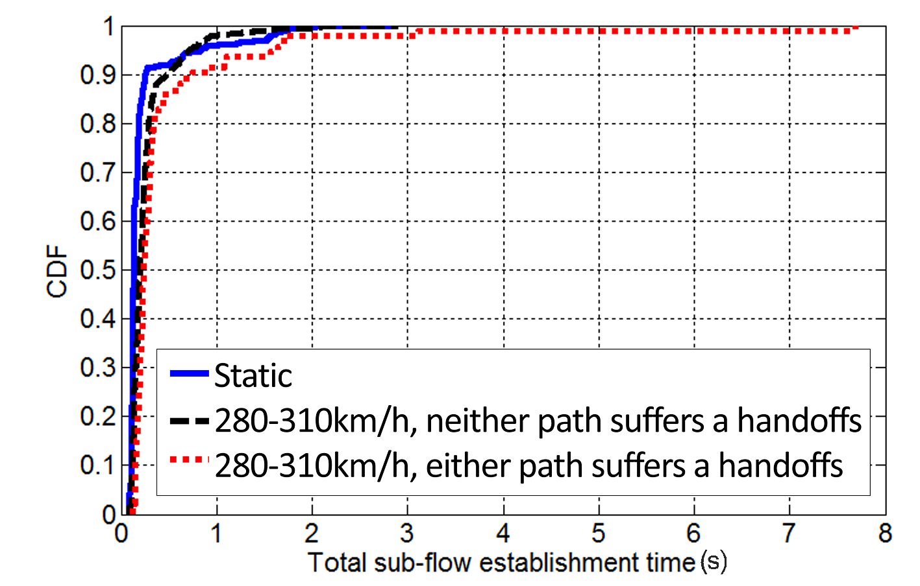
Sub-flow Establishment Time
Long tail
10% > 8 handshakes
CDF of total number of handshakes
CDF of Sub-flow establishment time
MPTCP’s efficiency of sub-flow establishment is low on HSRs
Notes:
These two figures further verify that packet loss caused by handoffs poses big challenges to sub-flow establishment.
10% of the MPTCP flows spend more than 8 handshakes to establish connections. It takes much longer time to establish two sub-flows, when either path suffers a handoff.
To summarize, MPTCP’s efficiency of sub-flow establishment is low in high speed mobility scenarios.

Slide 15
Results
Elephant Flows
Notes:
Next, we study the performance of elephant flows.

Slide 16
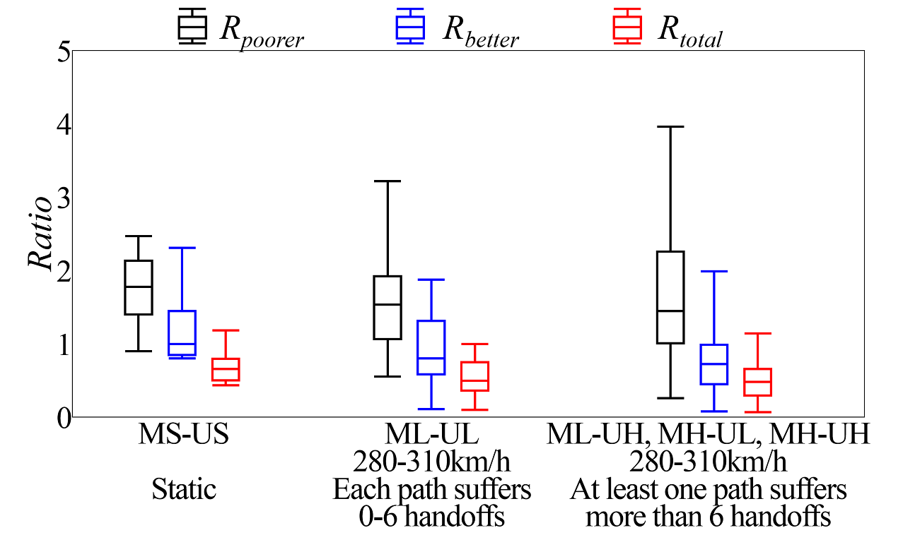
Performance of Elephant Flows
Metric: average rate during 100 seconds
Variable: train speed and number of handoffs suffered
$R_{poorer}=\frac{MPTCP}{min⁡({TCP}_{i})}$ > 1
Robustness
$R_{better}=\frac{MPTCP}{max⁡({TCP}_{i})}$ < 1
Efficiency
$R_{total}=\frac{MPTCP}{sum⁡({TCP}_{i})}$ < 1
Aggregation
Results remain constant, but reasons are different!
Poor adaptability of congestion control and scheduling to frequent handoffs
Notes:
We define three ratios to evaluate the advantage of MPTCP over TCP based on average rate during 100 seconds.
R_poorer indicates the robustness of MPTCP, which is the rate ratio of MPTCP flow to the minimum of single TCP flows.
R_better indicates the efficiency of MPTCP, which is the rate ratio of MPTCP flow to the maximum of single TCP flows.
R_total indicates the bandwidth aggregation capability of MPTCP, which is the rate ratio of MPTCP flow to the total of all single TCP flows.【】We find R_poorer is over 1 most of the time in all cases, however, R_better and R_total decrease significantly with the increase of train speed and handoff number. This indicates that MPTCP is also more robust, and less efficient than TCP. The interesting thing here is that the results remain constant no matter whether the flow is mice or elephant, but reasons are quite different! For elephant flows, the low efficiency can be attributed to the poor adaptability of congestion control and scheduling to frequent handoffs, lets come to the analysis.

Slide 17
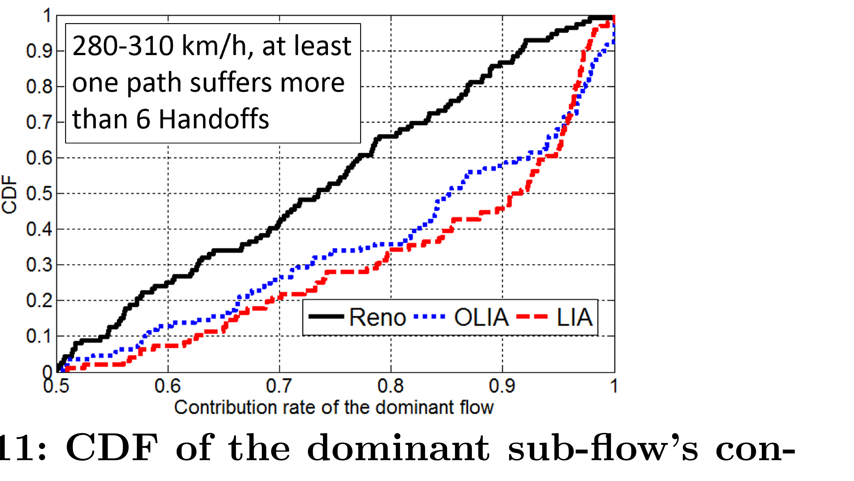
Congestion Control: Traffic Distribution
Contribution rate of dominant sub-flow to quantify degree of traffic distribution balance
$D_{balance}=\frac{max⁡({TCP}_{i})}{sum⁡({TCP}_{i})}$ ≈ 1
Balance
Packet loss causes window drops
Window distribution imbalance leads to traffic distribution imbalance
Coupled congestion controllers
LIA [Raiciu et.al, RFC 6356]
OLIA [Khalili et.al, IETF draft]
Transfer traffic from a congested path to a less congested one
*More details please refer to the paper.
Notes:
We use the contribution rate of the dominant sub-flow to quantify the degree of traffic distribution balance. We explored three MPTCP congestion controllers, Reno, LIA, OLIA, which are all loss-based. MPTCP’s window might drops to a very low level after suffering multiple handoffs. Window distribution imbalance leads to traffic distribution imbalance if network conditions are different between two carriers. 【】it is observed that traffic distribution are quite imbalanced most of the time.
【】Moreover, coupled congestion control algorithms lead to more significant traffic distribution imbalance, because they are designed to transfer traffic from a congested path to a less congested one. More details please refer to the paper.

Slide 18
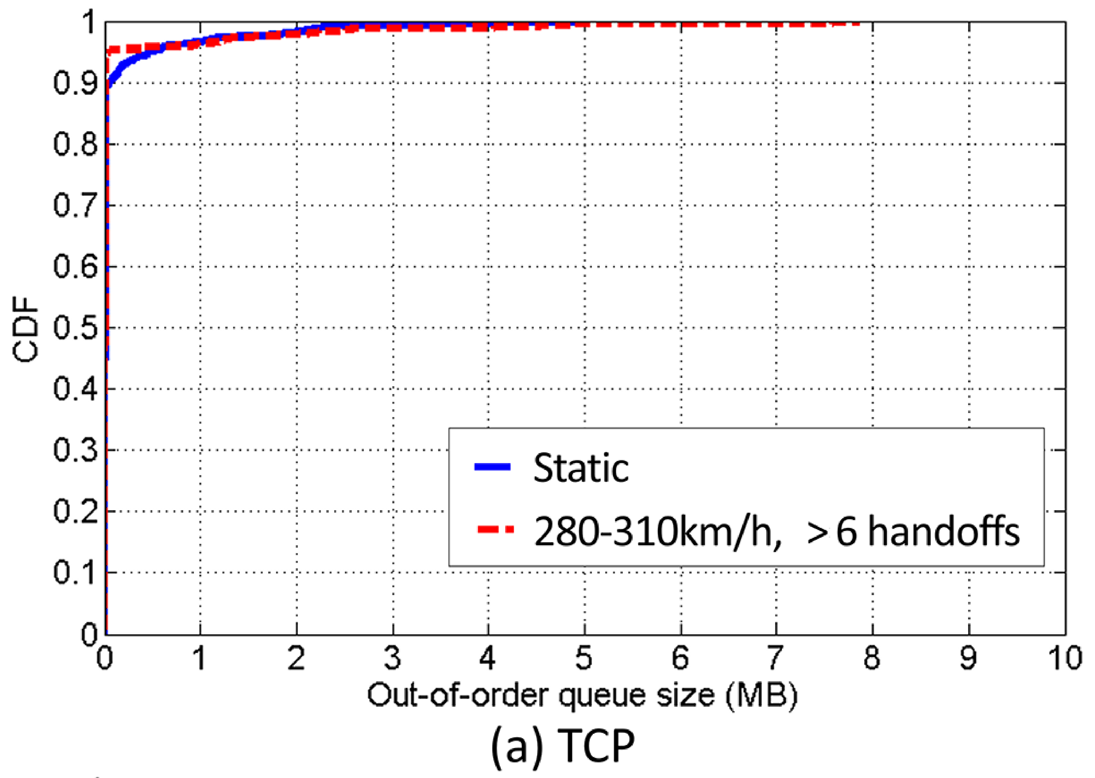
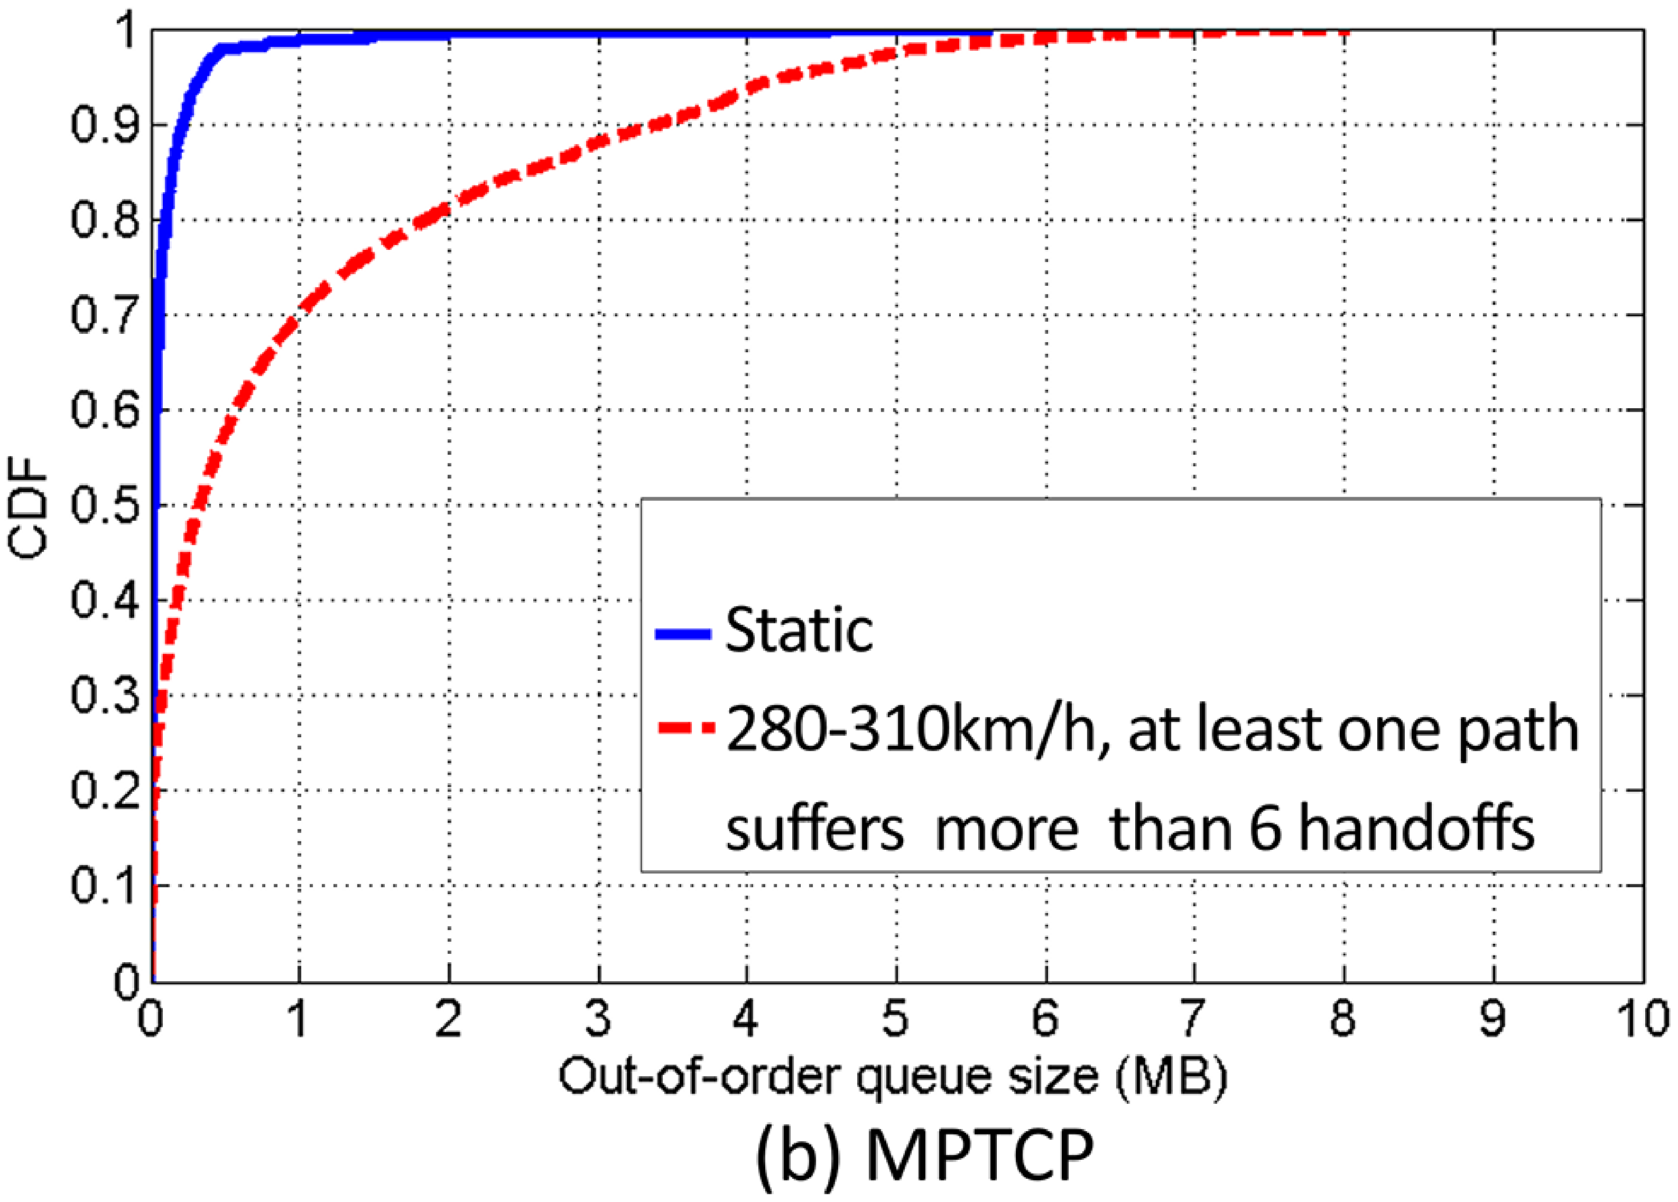
Scheduling: Out of Order Problem
Out-of-order queue size rises
Notes:
In addition to the inefficient congestion control, a significant out-of-order problem is another important cause for MPTCP’s low efficiency. It can be observed that MPTCP’s out-of-order queue size rises significantly in high speed mobility cases, especially when suffering frequent handoffs.

Slide 19
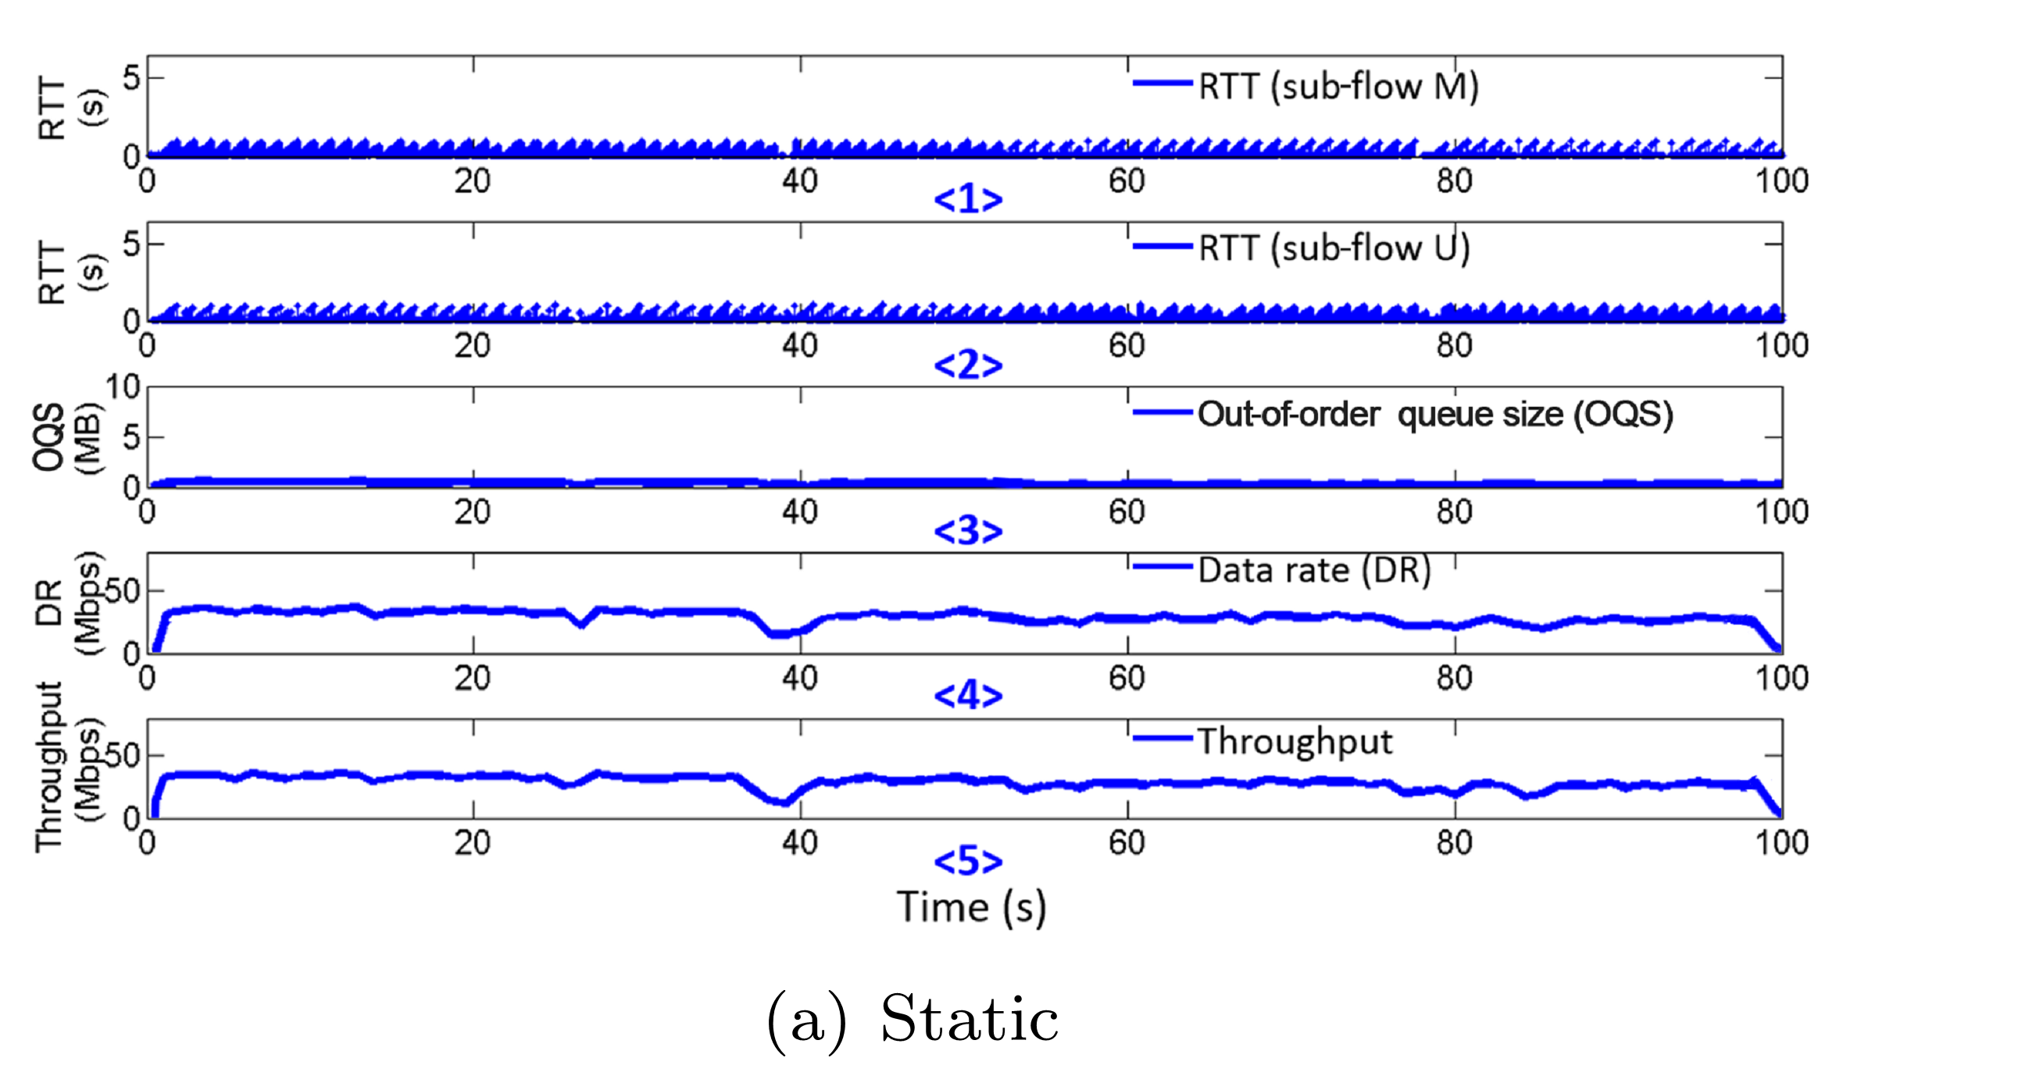
Static Cases
Out-of-order problem is not serious in static cases
Goodput
Goodput
Notes:
To explain the issue clearly, we first give examples in static cases. 【】We can see that RTT is stable relatively, 【】out-of-order queue size is small, 【】and goodput is roughly equal to the throughput in a high and stable level.

Slide 20
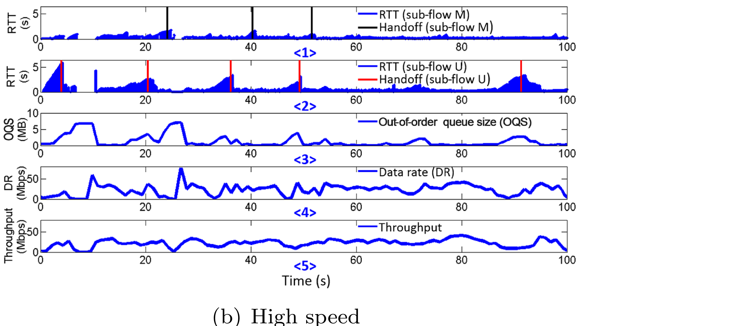
High Speed Mobility Cases
Goodput
Goodput
MPTCP’s efficiency of congestion control and scheduling is low on HSRs
Notes:
While in high speed mobility cases, the out-of-order problem is mainly caused by significant RTT spikes . 【】We can see that the out-of-order queue size increases significantly around moments of handoff. 【】Since only ordered packets can be used to calculate the goodput, the gap between throughput and goodput is enlarged. To summarize, MPTCP’s efficiency of congestion control and scheduling is low in high speed mobility scenarios.

Slide 21
Key Takeaways
Insights: reliability enhancement rather than bandwidth aggregation
Significant advantage in robustness
Efficiency of MPTCP is far from satisfactory
Cause: poor adaptability to frequent handoffs
Mice: sub-flow establishment
Elephant: scheduling and congestion control
Suggestions: handoff pattern detection and prediction
Notes:
To conclude, we performed a large scale MPTCP measurement with two carriers on high speed rails. Our key insight is that MPTCP’s value is proven mostly in reliability enhancement rather than bandwidth aggregation. We find that, as expected, MPTCP gains a significant advantage in robustness. However, unexpectedly, the efficiency of MPTCP is far from being satisfactory. It is the poor adaptability to frequent handoffs by MPTCP’s key operations in sub-flow establishment, scheduling and congestion control prevents MPTCP from showing enough advantage of using two carriers simultaneously. Apart from some state-of-the-art works that may help MPTCP better fit the high speed mobility cases. It is also suggested handoff pattern detection and prediction along high speed rails. In this case, we can establish new sub-flows outside a predicted handoff, retransmit lost packet of the handoff path via other path that is not suffering a handoff. Furthermore, we can differentiate handoff and congestion. We suggest new coupled congestion control that is not loss-based. If you do not care much about fairness in this case. Just apply uncoupled!

Slide 22
Thank You! Email: li.tong@huawei.com Homepage: https://leetong.weebly.com Data traces are available at http://www.thucsnet.org/hsrmptcp.html

Slide 23
backup
Notes:
Users is likely to use multiple carriers in the following three ways. First of all, it is quite normal for business people to have more than one phone. A user creates a Wi-Fi access point via one phone, and then another phone connected to this access point is able to achieve two-carrier access. Secondly, in China, free Wi-Fi access based on the carrier network is already available on the Shanghai-Beijing line on Fuxing run, and Wi-Fi is going to be available on all high-speed trains in the future. Finally, Huawei is actively driving the growth of dual-LTE phones with two SIM cards that provide data access simultaneously. MediaTek is also advancing the dual 4G technology which provides a high data throughput performance and more reliable coverage.

Slide 24
MobiNet
http://www.wandoujia.com/apps/thu.kejiafan.mobinet

Slide 25
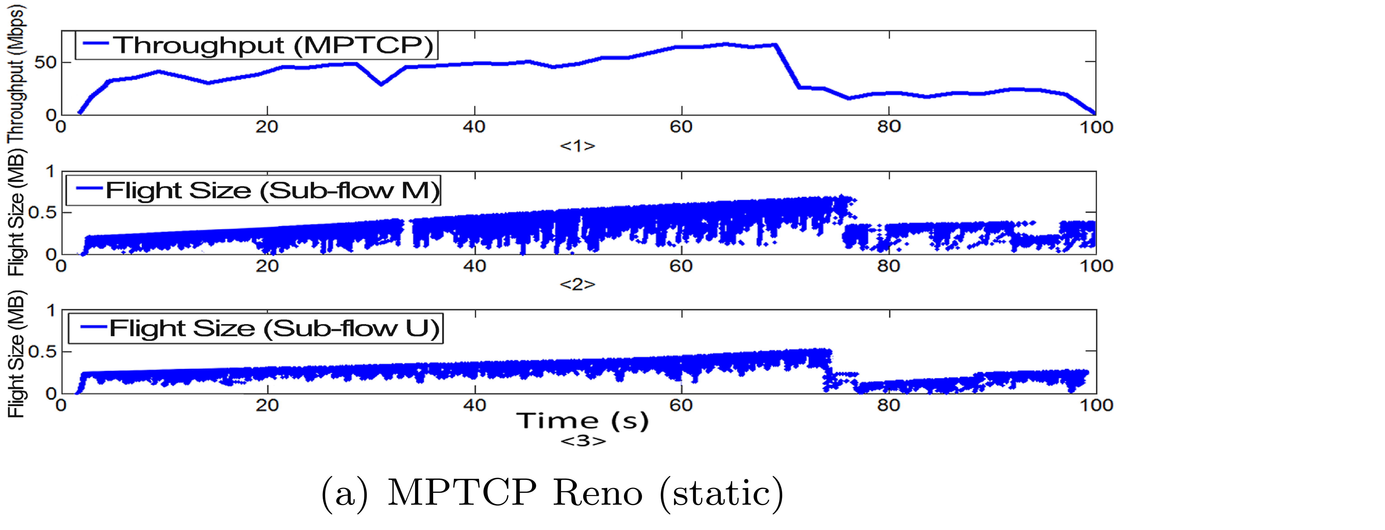
Congestion Control
(a) MPTCP Reno (static)
Notes:
To explain this issue clearly, we show three examples: first, in static cases, only a few multiplicative decreases occur due to light packet losses in two paths, and the distribution of CWND between two paths is quite balanced.

Slide 26
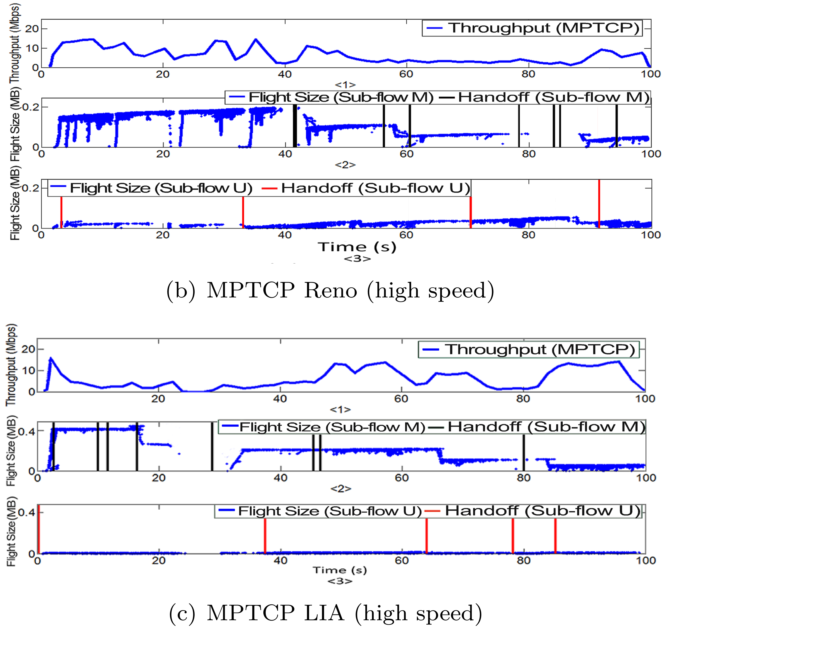
Congestion Control
Notes:
Due to frequent packet loss bursts, CWND of sub-flows suffers multiplicative decreases repeatedly and CWND distribution is extremely imbalanced in high speed mobility cases. Network conditions of two paths are quite different, leading to CWND distribution imbalance.
LIA shows the most significant CWND distribution imbalance, OLIA follows, and Reno shows the lowest. MPTCP cannot distinguish between congestion and handoff, coupled congestion control algorithms cannot transfer traffic among sub-flows timely and accurately on HSRs, leading to unnecessary traffic convergence to one of the two paths.

