Slide 1
词向量研究心得
Nov. 11, 2018 @Weekly Meetup
李博放

Slide 2
About me
Bofang Li 李 博放 libofang@ruc.edu.cn
http://bofang.stat-nba.com
Renmin University of China 中国人民大学
09/2014-present
Ph.D. candidate
Research Interests
Word and text embeddings (Natural Language Processing)

Slide 3
Outline
Introduction
Overview
Objective function
Context definition
Attention
Subword-level word embeddings
English
Japanese
Evaluation
Scaling
Conclusion

Slide 4
What is embedding in NLP
https://towardsdatascience.com/build-your-own-convolution-neural-network-in-5-mins-4217c2cf964f

Slide 5
What is embedding in NLP
https://blog.csdn.net/zchang81/article/details/61918577

Slide 6
What is embedding in NLP
I See A Boat On The River
https://towardsdatascience.com/build-your-own-convolution-neural-network-in-5-mins-4217c2cf964f

Slide 7
What is embedding in NLP
I See A Boat On The River
[0.1, 0.4, -0.3, 0.6, 0.2, -0.9]

Slide 8
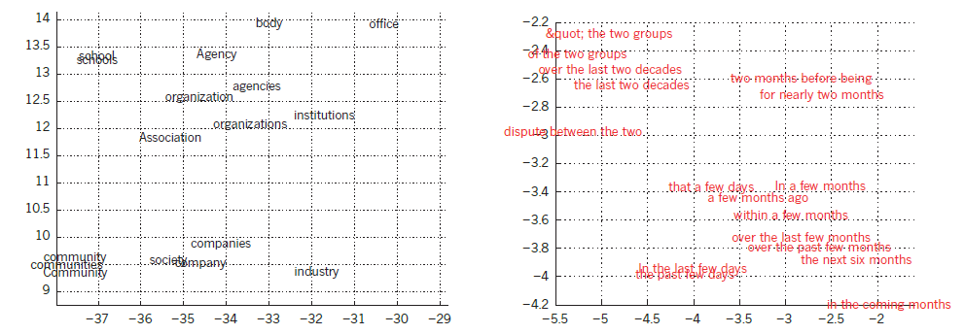
What is embedding in NLP
https://blog.csdn.net/zchang81/article/details/61918577

Slide 9
What is embedding in NLP
https://blog.csdn.net/zchang81/article/details/61918577

Slide 10
What is embedding in NLP
Embedding transforms human language meaningfully into a numerical form
text -> vector (text embedding)
word -> vector (word embedding)

Slide 11
How to train word embedding model
fruit
tool
sweet
apple -> [0.96, 0.56, …, 0.85]
orange -> [0.96, 0.12, …, 0.69]
car -> [0.09, 0.84, …, 0.15]
http://text-machine.cs.uml.edu/lrec2018_t4/index.html
Notes:
Now we know
Here i would like to give a very brief introduction of how to train word embedding.
Since training word embedding is easier than training text embedding, and the rest of my talk
The input of word embedding model
We often call this training scheme as unsupervised learning,

Slide 12
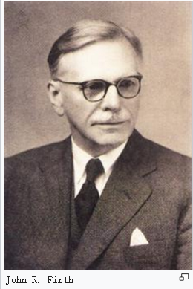
How to train word embedding model
Distributional Hypothesis
words that are used and occur in the same contexts tend to purport similar meanings

Slide 13
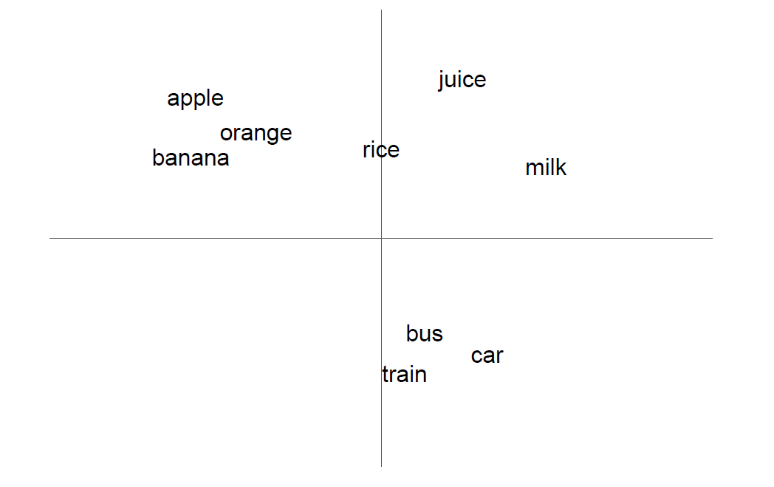
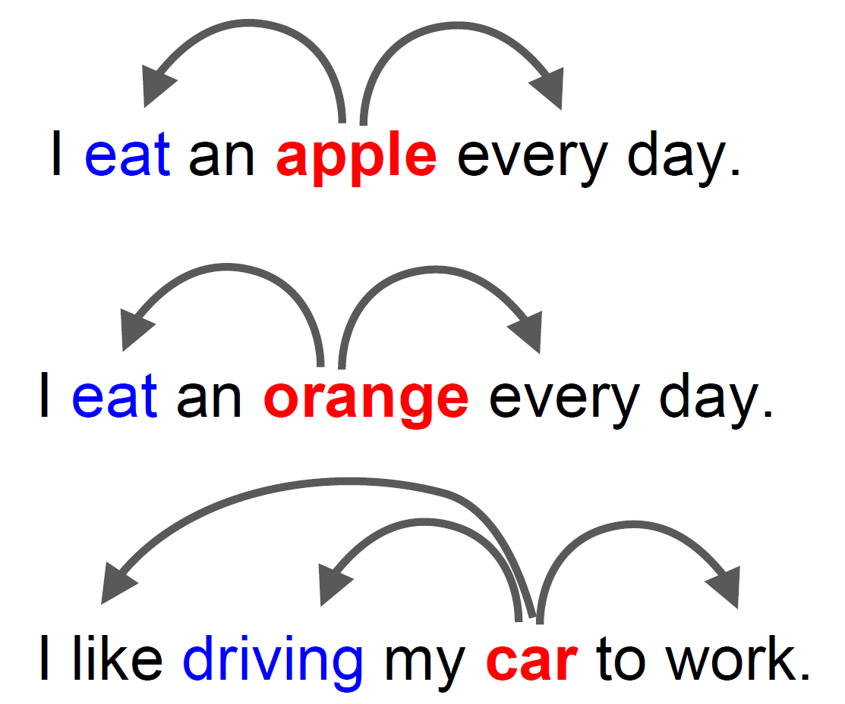
How to train word embedding model
http://bit.ly/wevi-slides
Notes:
We often say sentences
The word apple and orange often have similar context,

Slide 14
How to train word embedding model
Bengio, Y., Ducharme, R., Vincent, P. and Janvin, C.: A neural probabilistic language model, The Journal of Machine Learning Research, Vol. 3, pp. 1137–1155 (2003).
Collobert, R., Weston, J., Bottou, L., Karlen, M.,Kavukcuoglu, K. and Kuksa, P.: Natural language processing (almost) from scratch, The Journal of Machine Learning Research, Vol. 12, pp. 2493–2537 (2011).
Levy, O. and Goldberg, Y.: Dependency-Based Word Embedings., ACL, pp. 302–308 (2014).
Mikolov, T., Sutskever, I., Chen, K., Corrado, G. S. and Dean, J.: Distributed Representations of Words and Phrases and their Compositionality, NIPS, pp. 3111–3119 (2013).
Pennington, J., Socher, R. and Manning, C. D.: Glove: Global Vectors for Word Representation, EMNLP, pp. 1532–1543(2014).
Melamud, O., Goldberger, J. and Dagan, I.: context2vec: Learning generic context embedding with bidirectional lstm, Proceedings of The 20th SIGNLL Conference on Computational Natural Language Learning, pp. 51–61 (2016).
Salle, A., Idiart, M. and Villavicencio, A.: Matrix Factorization using Window Sampling and Negative Sampling for Improved Word Representations, The 54th Annual Meeting of the Association for Computational Linguistics, p. 419 (2016).
Bojanowski, P., Grave, E., Joulin, A. and Mikolov, T.: Enriching Word Vectors with Subword Information, Transactions of the Association for Computational Linguistics, Vol. 5, pp. 135–146 (2017).

Slide 15
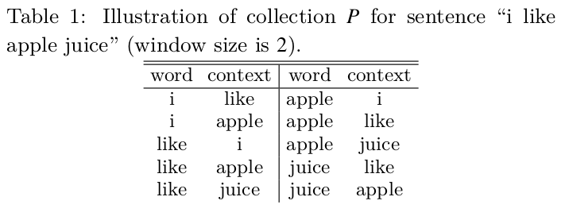
What is Word2Vec
Linear context
Notes:
The first step of word2vec
there are a lot of ways to define the context,
given a target word, the left 2 words and right 2 words

Slide 16
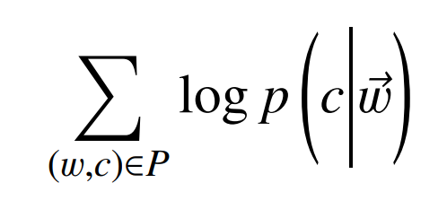
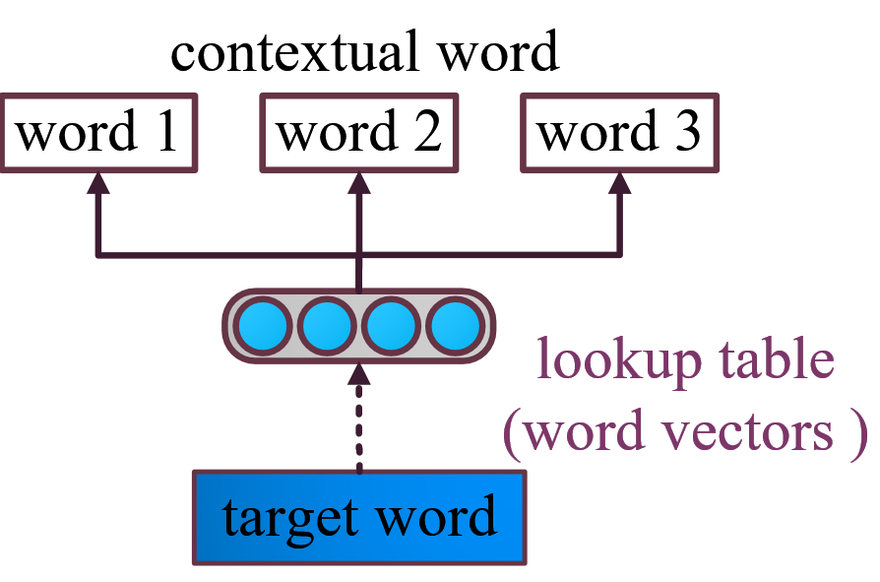
What is Word2Vec

Slide 17
What is Word2Vec
http://bit.ly/wevi-slides
Notes:
let’s look at the example again

Slide 18
How to evaluate word embedding model
Word similarity
apple orange 0.82
banana orange 0.78
bus car 0.83
bus apple 0.2
train apple 0.15
Notes:
now we know xxxx
the final step is evaluation

Slide 19
How to evaluate word embedding model
Agirre, E., Alfonseca, E., Hall, K., Kravalova, J., Paşca, M. and Soroa, A.: A study on similarity and relatedness using distributional and wordnet-based approaches, NAACL, Association for Computational Linguistics, pp. 19–27 (2009).
Bruni, E., Boleda, G., Baroni, M. and Tran, N.-K.: Distributional semantics in technicolor, ACL, Association for Computational Linguistics, pp. 136–145 (2012).
Finkelstein, L., Gabrilovich, E., Matias, Y., Rivlin, E., Solan, Z., Wolfman, G. and Ruppin, E.: Placing search in context: The concept revisited, WWW, ACM, pp. 406–414 (2001).
Hill, F., Reichart, R. and Korhonen, A.: Simlex-999: Evaluating semantic models with (genuine) similarity estimation, Computational Linguistics (2016).
Luong, T., Socher, R. and Manning, C. D.: Better Word Representations with Recursive Neural Networks for Morphology., CoNLL, pp. 104–113 (2013).
Radinsky, K., Agichtein, E., Gabrilovich, E. and Markovitch, S.: A word at a time: computing word relatedness using temporal semantic analysis, WWW, ACM, pp. 337–346 (2011).
Zesch, T., Müller, C. and Gurevych, I.: Using Wiktionary for Computing Semantic Relatedness., AAAI, Vol. 8, pp. 861–866 (2008).

Slide 20
How to evaluate word embedding model
Word analogy
a is to b as c is to what ?
Germany is to Berlin as Japan is to what?
Mikolov, T., Sutskever, I., Chen, K., Corrado, G. S. and Dean, J.: Distributed Representations of Words and Phrases and their Compositionality, NIPS, pp. 3111–3119 (2013).
Gladkova, A., Drozd, A. and Matsuoka, S.: Analogy-based Detection of Morphological and Semantic Relations With Word Embeddings: What Works and What Doesn’t.,
Notes:
bofang visiting student

Slide 21
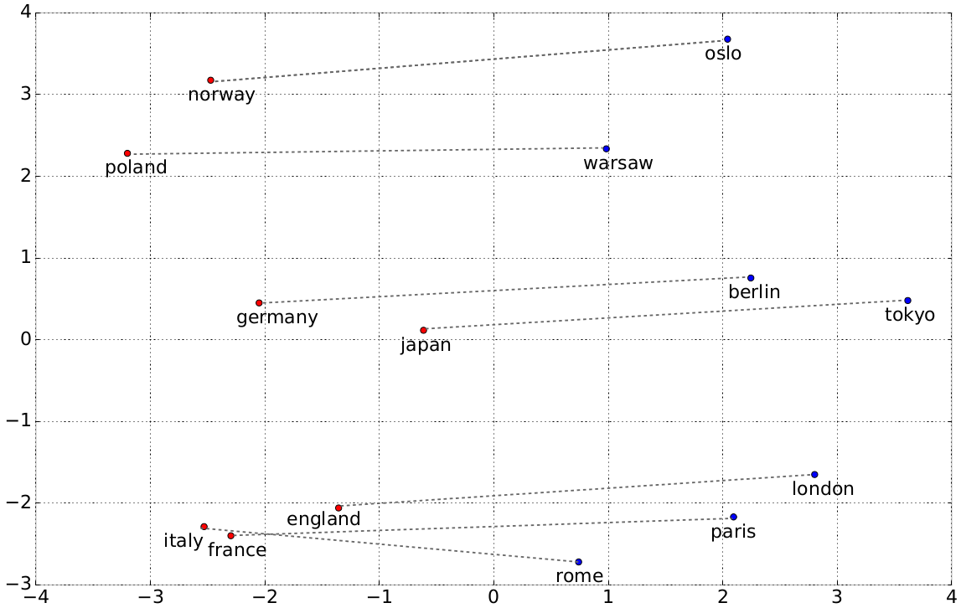
How to evaluate word embedding model
Word analogy
Berlin - Germany + Japan ≈ Tokyo
Mikolov, T., Sutskever, I., Chen, K., Corrado, G. S. and Dean, J.: Distributed Representations of Words and Phrases and their Compositionality, NIPS, pp. 3111–3119 (2013).
Gladkova, A., Drozd, A. and Matsuoka, S.: Analogy-based Detection of Morphological and Semantic Relations With Word Embeddings: What Works and What Doesn’t.,
Notes:
How do we answer this kind of question using word embeddings,
It turns out that we can solve it by simple linear algebra.

Slide 22
Conclusion
Embedding transform human language meaningfully into a numerical form
Word2Vec
Evaluation
Notes:
we have a vecto project that you can use to do a lot of things related to word embedding,

Slide 23
Outline
Introduction
Overview
Objective function
Context definition
Attention
Subword-level word embeddings
English
Japanese
Evaluation
Scaling
Conclusion

Slide 24
Overview
Attention
Objective Functions
Evaluation
word embeddings
Context Definition
Compositionality
(Word)
Scaling
Distributional Hypothesis
words that are used and occur in the same contexts tend to purport similar meanings

Slide 25
Overview
Attention
Objective Functions
Evaluation
word embeddings
Context Definition
Compositionality
(Word)
Scaling
Distributional Hypothesis
words that are used and occur in the same contexts tend to purport similar meanings

Slide 26
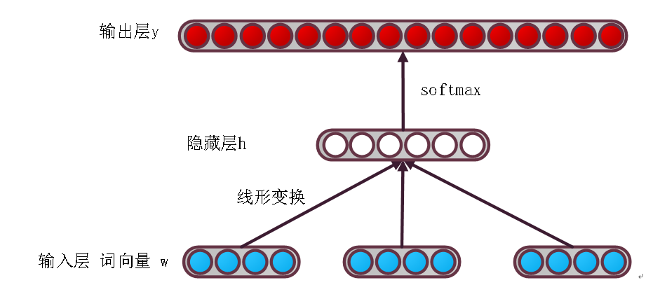
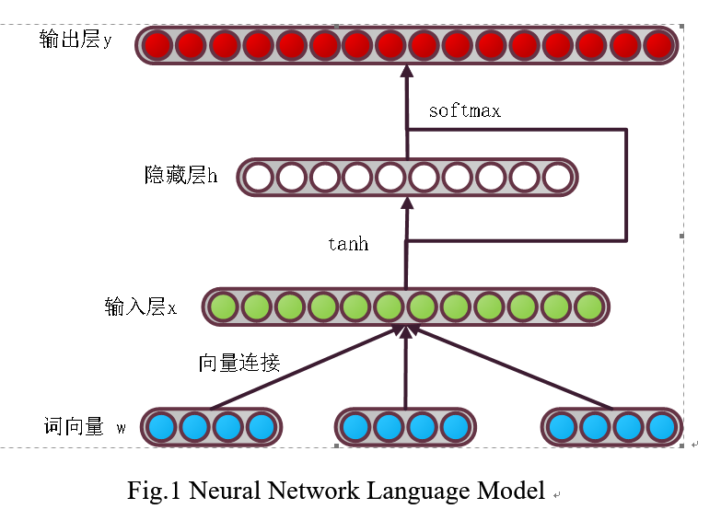
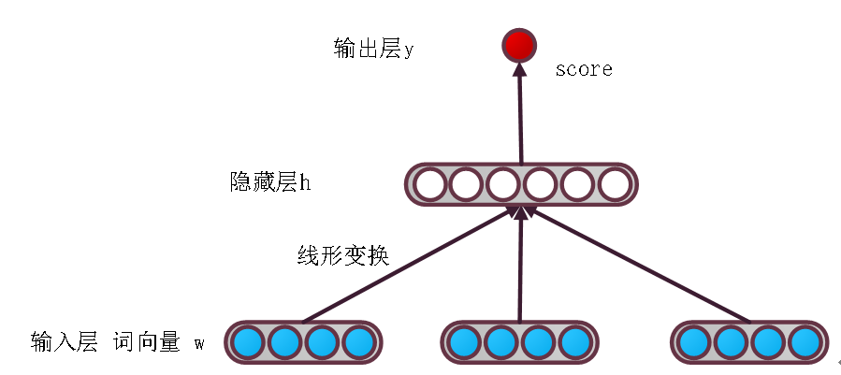
Overview
Objective Functions
Network architecture
Loss
Optimization

Slide 27
Overview
Objective Functions
Network architecture
Loss
Optimization

Slide 28
Overview
Objective Functions
Bengio, Y., Ducharme, R., Vincent, P. and Janvin, C.: A neural probabilistic language model, The Journal of Machine Learning Research, Vol. 3, pp. 1137–1155 (2003).
Collobert, R., Weston, J., Bottou, L., Karlen, M.,Kavukcuoglu, K. and Kuksa, P.: Natural language processing (almost) from scratch, The Journal of Machine Learning Research, Vol. 12, pp. 2493–2537 (2011).
Mikolov, T., Sutskever, I., Chen, K., Corrado, G. S. and Dean, J.: Distributed Representations of Words and Phrases and their Compositionality, NIPS, pp. 3111–3119 (2013).
Pennington, J., Socher, R. and Manning, C. D.: Glove: Global Vectors for Word Representation, EMNLP, pp. 1532–1543(2014).
Melamud, O., Goldberger, J. and Dagan, I.: context2vec: Learning generic context embedding with bidirectional lstm, Proceedings of The 20th SIGNLL Conference on Computational Natural Language Learning, pp. 51–61 (2016).

Slide 29
Overview
Objective Functions
Theoretically equivalent
word2vec & PMI (Levy and Goldberg, 2014)
word2vec & GloVe (Suzuki and Nagata, 2015)
word2vec & PCA (Cotterell et al., 2017)
Empirically similar
word2vec & GloVe & PMI (Levy et al. 2015)

Slide 30
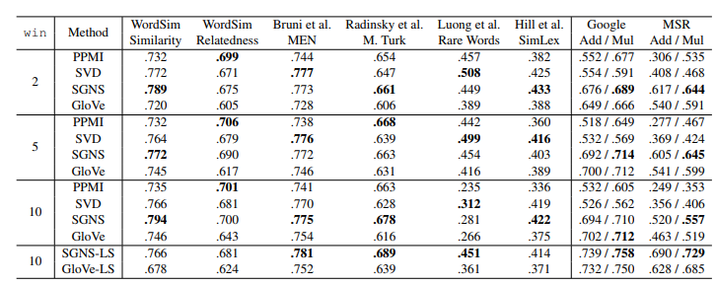
Overview
Models may not be important
Levy, Omer, Yoav Goldberg, and Ido Dagan. "Improving distributional similarity with lessons learned from word embeddings." Transactions of the Association for Computational Linguistics 3 (2015): 211-225.

Slide 31
Overview
Attention
Objective Functions
Evaluation
word embeddings
Context Definition
Compositionality
(Word)
Scaling
Distributional Hypothesis
words that are used and occur in the same contexts tend to purport similar meanings

Slide 32
Overview
Context Definition
Context types and representations
Investigating Different Context Types and Representations for Learning Word Embeddings [PDF][code]
Bofang Li, Tao Liu, Zhe Zhao, Aleksandr Drozd, Anna Rogers, Xiaoyong Du
EMNLP 2017, Copenhagen, Denmark.

Slide 33
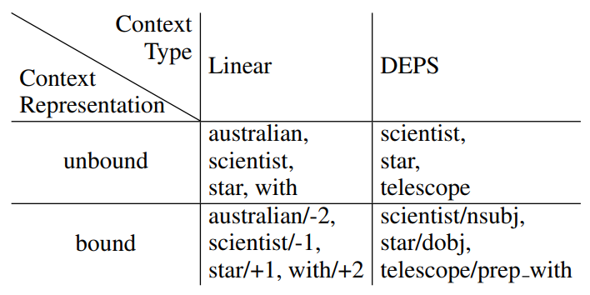
Overview
Context Definition
Context types and representations
Investigating Different Context Types and Representations for Learning Word Embeddings [PDF][code]
Bofang Li, Tao Liu, Zhe Zhao, Aleksandr Drozd, Anna Rogers, Xiaoyong Du
EMNLP 2017, Copenhagen, Denmark.

Slide 34
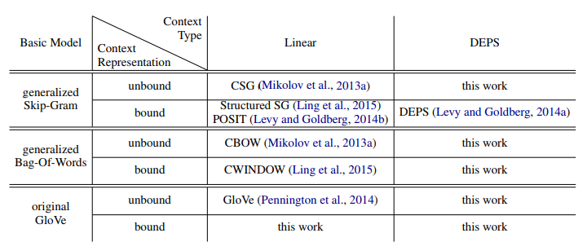
Overview
Context Definition
Context types and representations

Slide 35
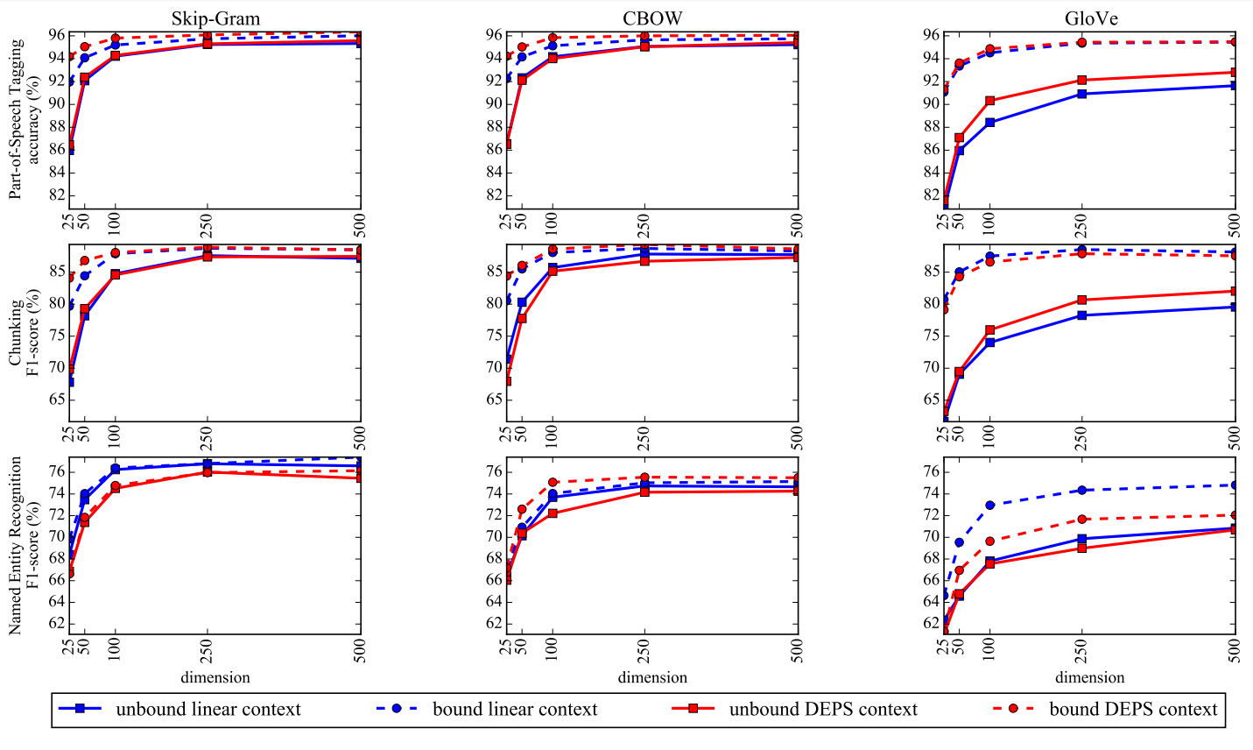
Overview
Context Definition
Context types and representations
Investigating Different Context Types and Representations for Learning Word Embeddings [PDF][code]
Bofang Li, Tao Liu, Zhe Zhao, Aleksandr Drozd, Anna Rogers, Xiaoyong Du
EMNLP 2017, Copenhagen, Denmark.

Slide 36
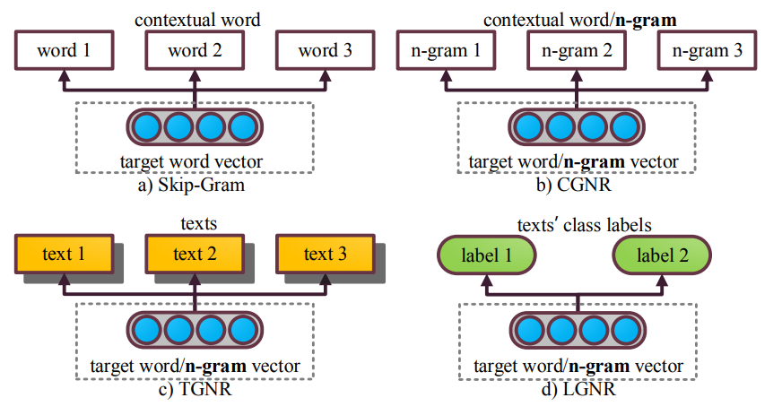
Overview
Context Definition
Neural bag-of-ngrams
context word guided n-gram representation
text guided n-gram representation
label guided n-gram representation
Neural Bag-of-n-grams [PDF][code]
Bofang Li, Tao Liu, Zhe Zhao, Puwei Wang, Xiaoyong Du
AAAI 2017, San Francisco, California USA.

Slide 37
Overview
Context Definition
Neural bag-of-ngrams
context word guided n-gram representation
text guided n-gram representation
label guided n-gram representation
Neural Bag-of-n-grams [PDF][code]
Bofang Li, Tao Liu, Zhe Zhao, Puwei Wang, Xiaoyong Du
AAAI 2017, San Francisco, California USA.

Slide 38
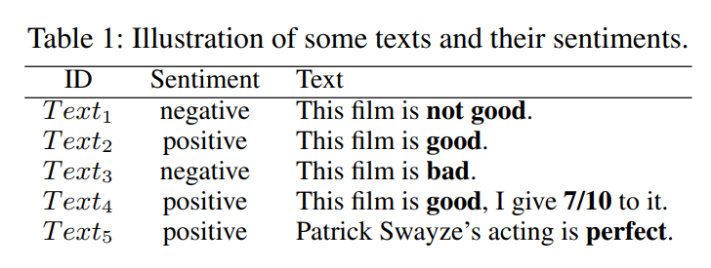
Overview
Context Definition
Neural bag-of-ngrams
context word guided n-gram representation
text guided n-gram representation
label guided n-gram representation
Neural Bag-of-n-grams [PDF][code]
Bofang Li, Tao Liu, Zhe Zhao, Puwei Wang, Xiaoyong Du
AAAI 2017, San Francisco, California USA.

Slide 39
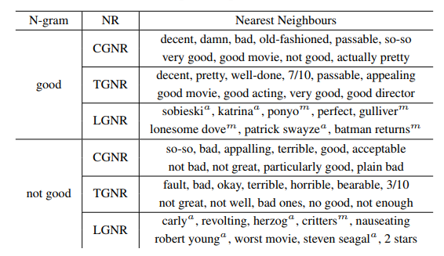
Overview
Context Definition
Neural bag-of-ngrams
context word guided n-gram representation
text guided n-gram representation
label guided n-gram representation
Neural Bag-of-n-grams [PDF][code]
Bofang Li, Tao Liu, Zhe Zhao, Puwei Wang, Xiaoyong Du
AAAI 2017, San Francisco, California USA.

Slide 40
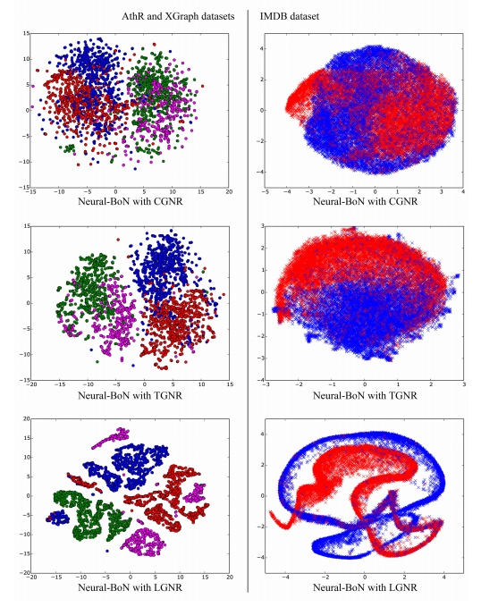
Overview
Context Definition
Neural bag-of-ngrams
context word guided n-gram representation
text guided n-gram representation
label guided n-gram representation
Neural Bag-of-n-grams [PDF][code]
Bofang Li, Tao Liu, Zhe Zhao, Puwei Wang, Xiaoyong Du
AAAI 2017, San Francisco, California USA.

Slide 41
Overview
Attention
Objective Functions
Evaluation
word embeddings
Context Definition
Compositionality
(Word)
Scaling
Distributional Hypothesis
words that are used and occur in the same contexts tend to purport similar meanings

Slide 42
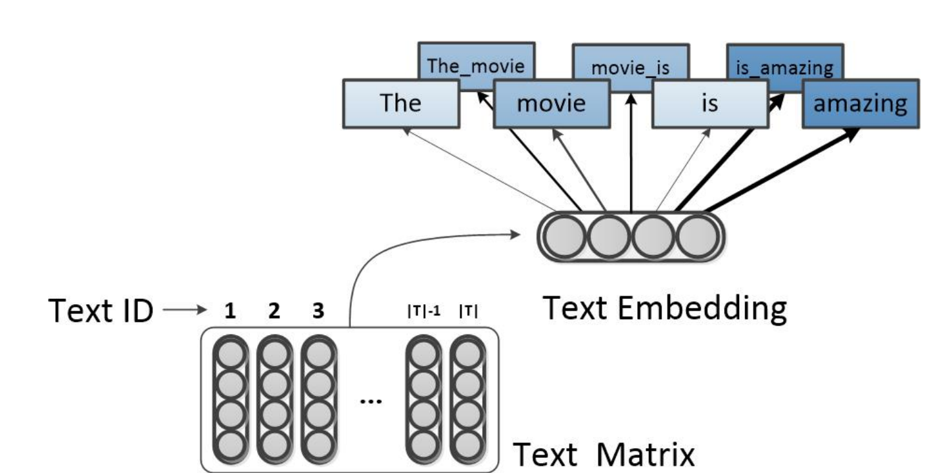
Overview
Attention (relevance)
sentiment classification
Weighted Neural Bag-of-n-grams Model: New Baselines for Text Classification [PDF]
Bofang Li, Zhe Zhao, Tao Liu, Puwei Wang, Xiaoyong Du
COLING 2016, Osaka, Japan.

Slide 43
Overview
Attention
Objective Functions
Evaluation
word embeddings
Context Definition
Compositionality
(Word)
Scaling
Distributional Hypothesis
words that are used and occur in the same contexts tend to purport similar meanings
Notes:
That is, how do we compose a word from it’s charaters.

Slide 44
Outline
Introduction
Overview
Objective function
Context definition
Attention
Subword-level word embeddings
English
Japanese
Evaluation
Scaling
Conclusion

Slide 45
Outline
Introduction
Overview
Objective function
Context definition
Attention
Subword-level word embeddings
English
Japanese
Evaluation
Scaling
Conclusion

Slide 46
Subword-level Word Embeddings
Morphology (word’s form)
useable <-> usable
color <-> colour
Out-of-vocabulary (OOV) words
misspelled word
represemtation -> representation
rare words
physicalism -> physic
Subword-level Composition Functions for Learning Word Embeddings [PDF]
Bofang Li, Aleksandr Drozd, Tao Liu, Xiaoyong Du
NAACL workshop SCLeM 2018, New Orleans, Louisiana.
Notes:
The word2vec algorithm considers word as the smallest unit, so we call it word-level word embedding.
There is one problem of word-level word embedding models.
For example, we can not assign a vector for this word, since it’s probably not in the vocabulary.
But as human, we know it’s a mis..
Another example is physicalism,

Slide 47
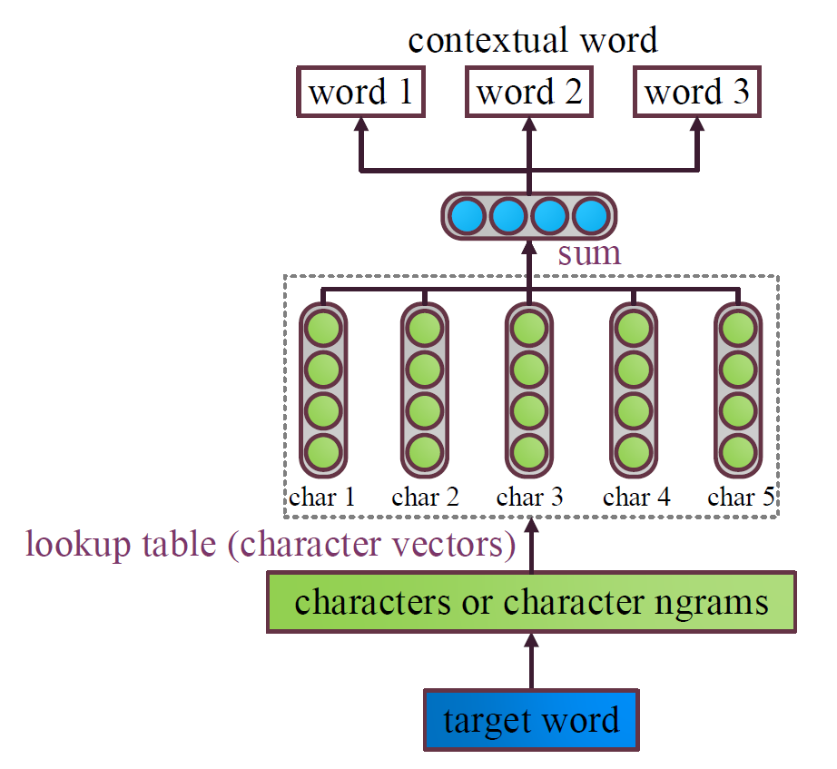
Subword-level Word Embeddings
FastText
vec(where) = vec(whe) + vec(her) + vec(ere)
vec(physicalism)= vec(physic) + vec(hysica) + vec(ysical) + vec(sicali) + vec(icalis) + vec(calism)
Simple, Fast
Subword-level Composition Functions for Learning Word Embeddings [PDF]
Bofang Li, Aleksandr Drozd, Tao Liu, Xiaoyong Du
NAACL workshop SCLeM 2018, New Orleans, Louisiana.

Slide 48
Subword-level Word Embeddings
FastText
Piotr Bojanowski, Edouard Grave, Armand Joulin, and Tomas Mikolov. 2017. Enriching word vectors with subword information. Transactions of the Association for Computational Linguistics , 5:135–146.

Slide 49
Subword-level Word Embeddings
Compositionality
Linguistics
vec(physicalism)= vec(physic) + vec(hysica) + vec(ysical) + vec(sicali) + vec(icalis) + vec(calism)
f(physicalism) = f(physic) @ f(cal) @ f(lism)
Deep learning
Subword-level Composition Functions for Learning Word Embeddings [PDF]
Bofang Li, Aleksandr Drozd, Tao Liu, Xiaoyong Du
NAACL workshop SCLeM 2018, New Orleans, Louisiana.

Slide 50
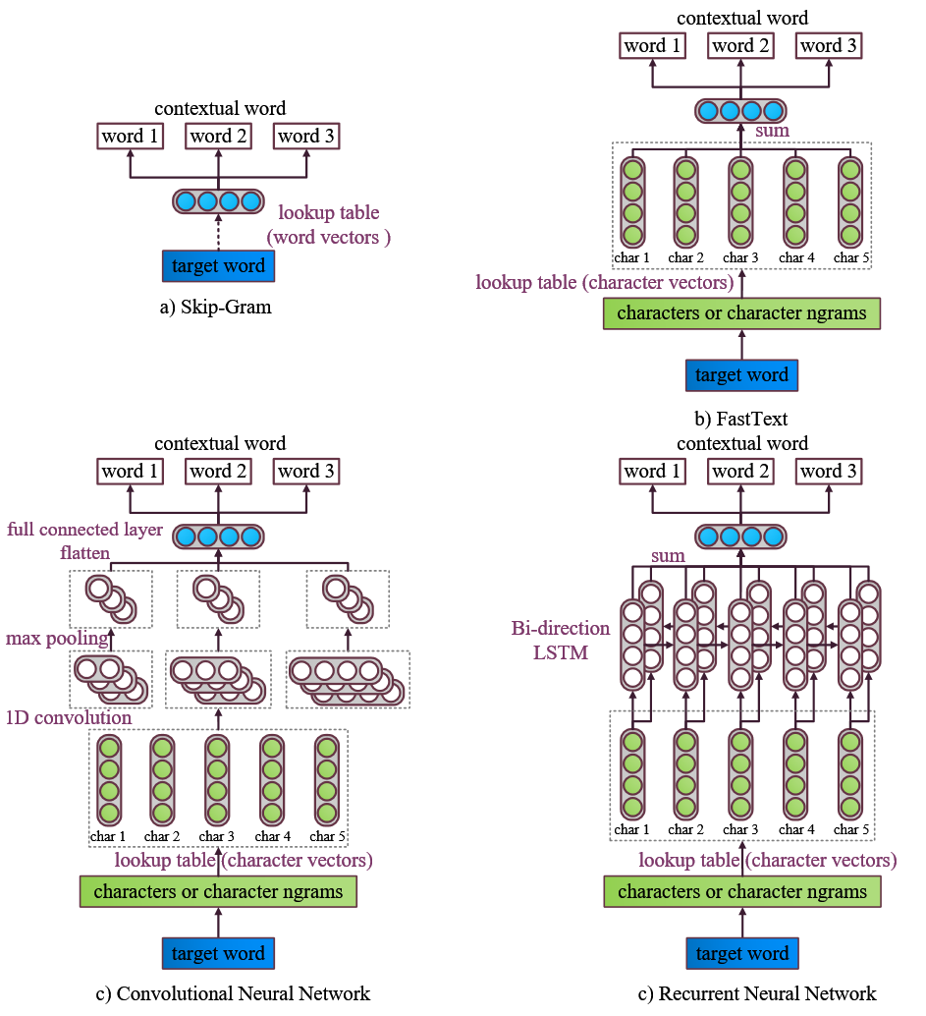
Subword-level Word Embeddings
Subword-level Composition Functions for Learning Word Embeddings [PDF]
Bofang Li, Aleksandr Drozd, Tao Liu, Xiaoyong Du
NAACL workshop SCLeM 2018, New Orleans, Louisiana.
Notes:
Here i just extend FastText by replacing the summation operation with deep neural networks.
convolutional neural network and bi-directional long short-term memory.

Slide 51
Memory
FastText
a, aa, aaa, aab, aac, … ,
bba, bbc, …, zzz
CNN/RNN
a, b, c, …, z
abc = CNN(a, b, c)
Notes:
Probably the biggest advantage of using deep neural network is we need less memory.
I know it may sounds
as it turns out,
as for ngrams, it can be represented by the composition of characters.
Here is a table of memory footprint.
it’s quite clear that our model, cnn and rnn comuse a lot less memory.

Slide 52
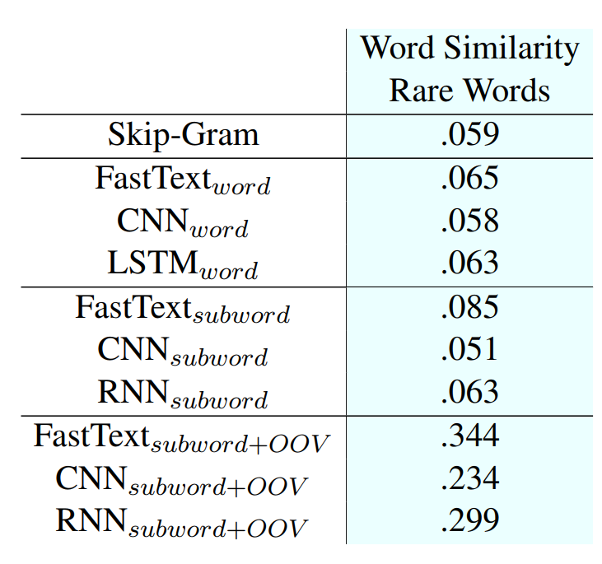
Experiments
Expanding the Vocabulary
represemtation
= CNN(r,e,p,r,e,s,e,m,t,a,t,i,o,n)
Notes:
The first experiment we did is
For examples, suppose we have a word like this, it’s a misspelled word, so it’s not in the vocabulary and don’t have corresponding vector.
What we do is send this word to CNN to get it’s vector.
Actually, the only different between this word and word ‘representation’ is one character, so the final vector should be similar.
Here we test this on a rare word similarity dataset.
The bottm three models are the version that expand the vocabulary, they outperform other models in a large margin.

Slide 53
Experiments
Quantitative Analysis
target word: physicists
Notes:
We try to find the most similar words to physicists in the vector space
The original word2vec doesn’t capture morphology information at all.
Fasttext can capture some morphology
as for our RNN and CNN model, they can find most morphology related words.

Slide 54
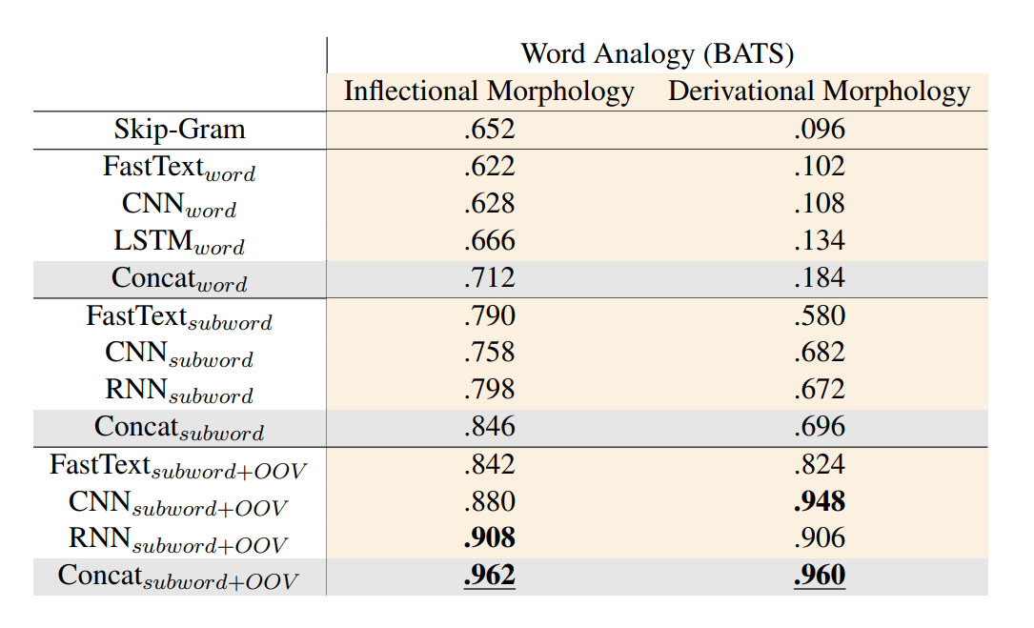
Experiments
Morphology Related Task
Word Analogy
Inflectional Morphology
nasty -- nastier
asking -- asks
Derivational Morphology
famous -- famously
explain -- explainable
Notes:
If we use those subword-level models, we get way better performance.
The concatenation is also better than individual model,
We get even further improvements if we expand the vocabulary.

Slide 55
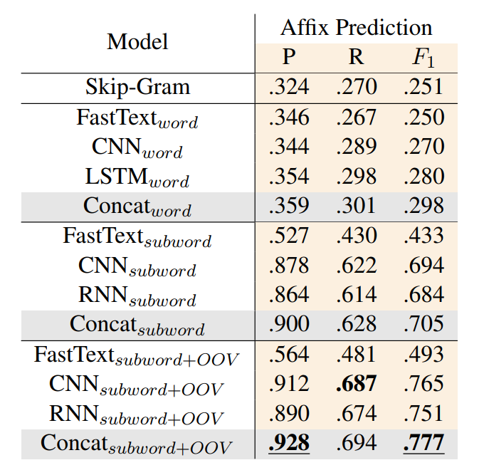
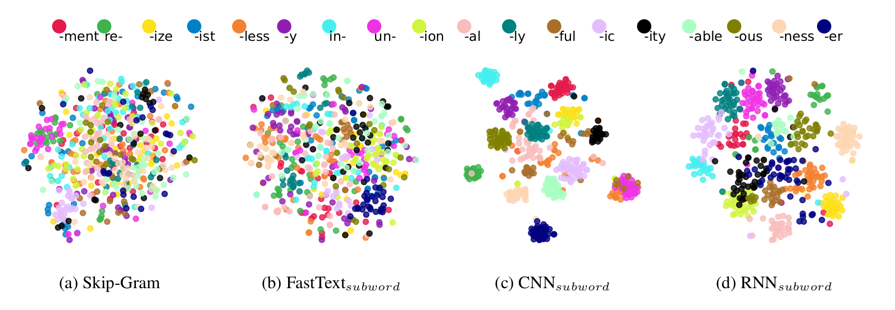
Experiments
Morphology Related Task
Affix Prediction
Notes:
Each point in this figure
For original word2vec and fasttext, the results are kind of mixed.
However, our CNN and RNN subword models can clearly distinguish the difference between different affix.

Slide 56
Conclusion
Subword composition functions like CNN and RNN(LSTM) have much smaller parameters than FastText
Subword-level word embeddings are able to expand the vocabulary
Subword-level word embeddings are suitable for morphology related tasks
Pre-trained embeddings downloadable at http://vecto.space/

Slide 57
Overview
Attention
Objective Functions
Evaluation
word embeddings
Context Definition
Compositionality
(Word)
Scaling
Distributional Hypothesis
words that are used and occur in the same contexts tend to purport similar meanings

Slide 58
Outline
Introduction
Overview
Subword-level word embeddings
English
Japanese
Evaluation
Scaling
Conclusion

Slide 59
Japanese subword-level word embeddings

Slide 60
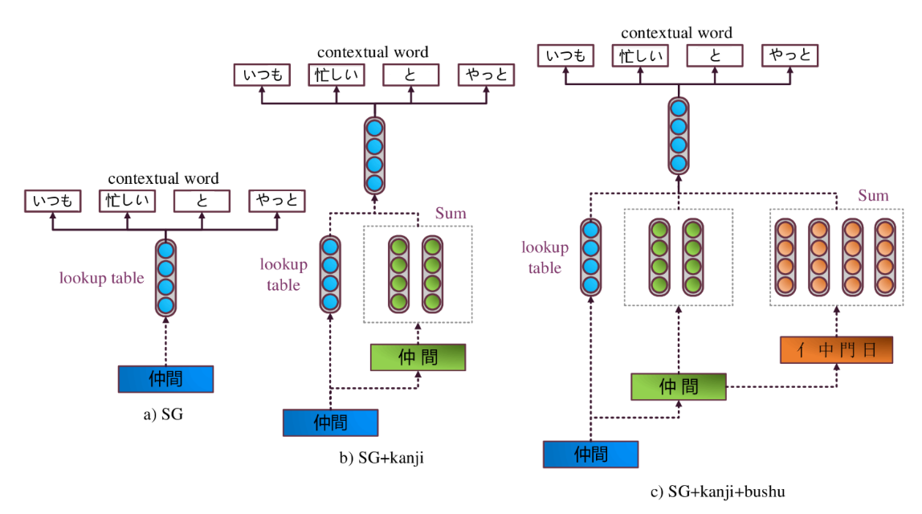
Japanese subword-level word embeddings
いつも 忙しい 仲間 と やっと 会 え た
Subcharacter Information in Japanese Embeddings: When Is It Worth It [PDF]
Marzena Karpinska, Bofang Li, Anna Rogers and Aleksandr Drozd
ACL workshop RELNLP 2018, Melbourne, Australia.
Notes:
So I designed three level of japanese word embedding.

Slide 61
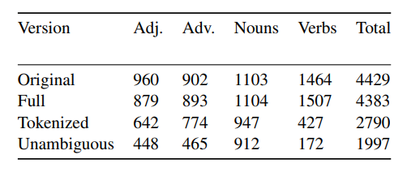
Datasets
Japanese Word Similarity - jSIM
Full
苛立たしい - 忌ま忌ましい moved from verbs to adjectives
Tokenized
早く来る
Unambiguous
終わっ
終わった,
終わって,
終わっちゃう
Yuya Sakaizawa and Mamoru Komachi. 2017. Construction of a Japanese Word Similarity Dataset. In Proceedings of the Eleventh International Conference on Language Resources and Evaluation (LREC 2018), Miyazaki, Japan. European Language Resources Association (ELRA).

Slide 62
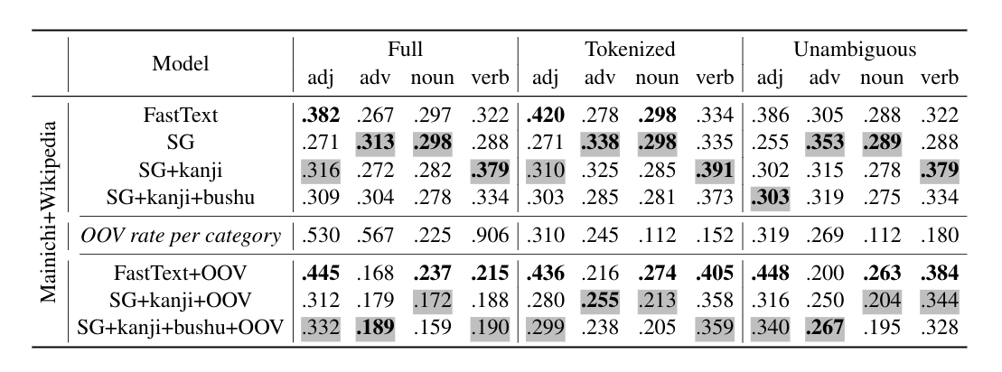
Datasets
Japanese Word Similarity - jSIM
Notes:
This result of japanese word similarity is very mixed.
It doen’t show any information, so I will just skip this one.

Slide 63
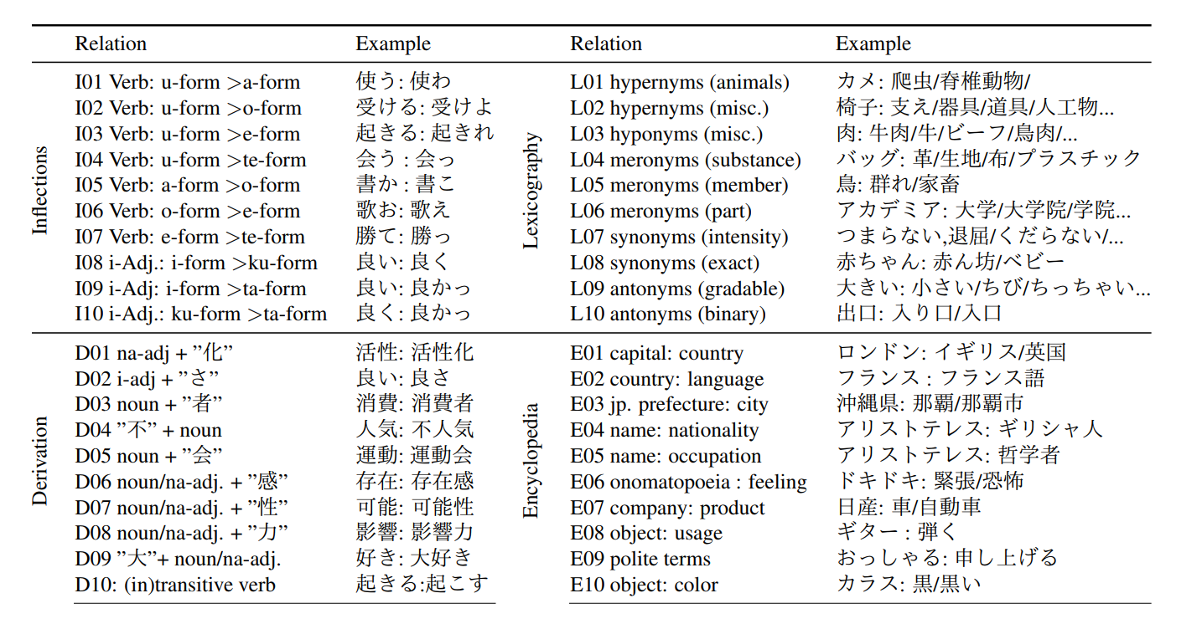
Datasets
Japanese Word Analogy - JBATS
神奈川県 is to 横浜 as 愛知県 is to (名古屋)

Slide 64
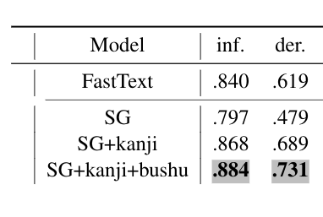
Experiments
Japanese Word Analogy
Notes:
The japanses analogy results is very similar to english.
We can easy improve the performance of word2vec by add kanji, we can further

Slide 65
Experiments
Quantitative Analysis
Notes:
Given a bushu, we list the closest kanjis and words to that bushu.
In the left part of this table is the bushu of illness, all the kanjis we found a related to illneess. Even though most of the kanjis don’t have illness bushu. There are also some hitagana and katakara words.
In the right part of the table is the bushu of beast, it’s actually very interesting that we find human nature near to this bushu.

Slide 66
Conclusion
kanji bushu
Japanese Word Similarity - jSIM
Japanese Word Analogy - JBATS
Kanji helps morphology related task
Bushu further improves model’s performances
Datasets downloadable at http://vecto.space/

Slide 67
Future work
Word analogy dataset
ENGLISH
JAPANESE
POLISH
KOREAN
RUSSIAN
CHINESE

Slide 68
Overview
Attention
Objective Functions
Evaluation
word embeddings
Context Definition
Compositionality
(Word)
Scaling
Distributional Hypothesis
words that are used and occur in the same contexts tend to purport similar meanings

Slide 69
Evaluation of word embeddings
Evaluating the evaluation methods
Given a task, which method should we use to test the quality of word embeddings?
Evaluating the Evaluation Methods for Word Embeddings
Bofang Li, Aleksandr Drozd
Work in Progress

Slide 70
Evaluation of word embeddings
Evaluating the evaluation methods
Given a task, which method/model should we use to test the quality of embeddings?
Cosine similarity
Euler distance
Manhattan distance

Slide 71
Evaluation of word embeddings
Evaluating the evaluation methods
Given a task, which method/model should we use to test the quality of embeddings?

Slide 72
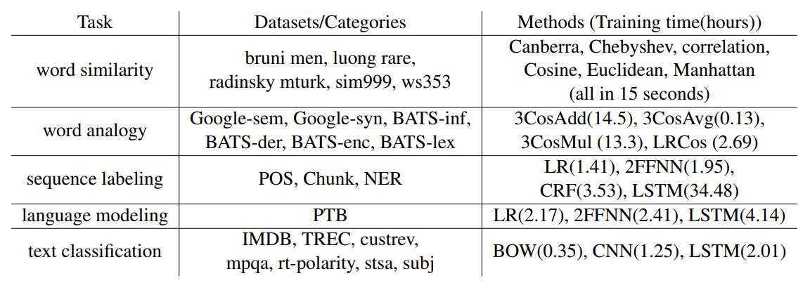
Evaluation of word embeddings
Evaluating the evaluation methods
Experiment setups (tasks, datasets and methods)

Slide 73
Evaluation of word embeddings
Evaluating the evaluation methods
Experiment setups (embeddings)

Slide 74
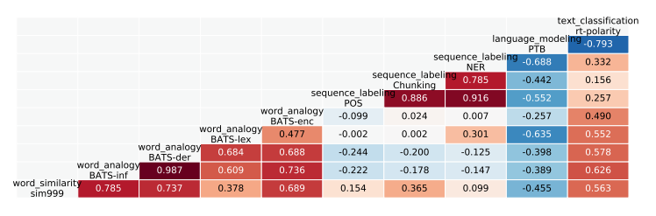
Evaluation of word embeddings
Evaluating the evaluation methods
Correlations between tasks

Slide 75
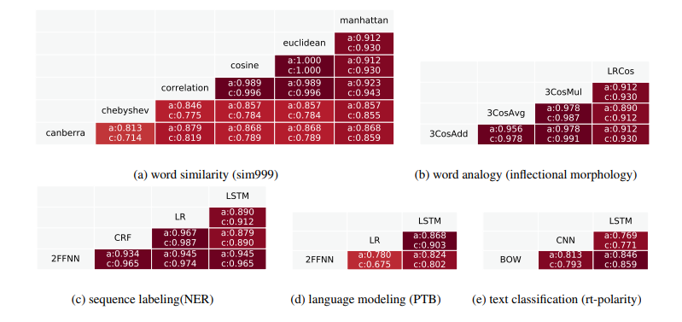
Evaluation of word embeddings
Evaluating the evaluation methods
Correlations between methods within the same task

Slide 76
Conclusion
ANY methods can be used for evaluating word embeddings
Simple methods are preferred
implementation simplicity
time efficiency

Slide 77
Overview
Attention
Objective Functions
Evaluation
word embeddings
Context Definition
Compositionality
(Word)
Scaling
Distributional Hypothesis
words that are used and occur in the same contexts tend to purport similar meanings

Slide 78
Overview
Subword-level Composition Functions for Learning Word Embeddings [PDF]
Bofang Li, Aleksandr Drozd, Tao Liu, Xiaoyong Du
NAACL workshop SCLeM 2018, New Orleans, Louisiana.

Slide 79
Overview

Slide 80
Overview
around 1 hour on 100M corpus
Wikipedia: 12G
5 days
Common Crawl: 215 G May 2018 - June 2018
3 months
Subword-level Composition Functions for Learning Word Embeddings [PDF]
Bofang Li, Aleksandr Drozd, Tao Liu, Xiaoyong Du
NAACL workshop SCLeM 2018, New Orleans, Louisiana.
Scaling Word2Vec with Uniform Word Sampling
Bofang Li, Aleksandr Drozd, Satoshi Matsuoka
SWoPP 2018, Kumamoto, Japan.

Slide 81
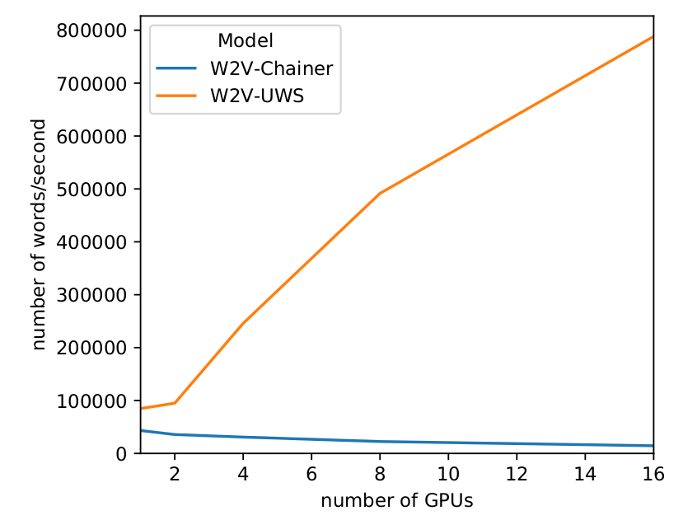
Overview
Subword-level Composition Functions for Learning Word Embeddings [PDF]
Bofang Li, Aleksandr Drozd, Tao Liu, Xiaoyong Du
NAACL workshop SCLeM 2018, New Orleans, Louisiana.
Scaling Word2Vec with Uniform Word Sampling
Bofang Li, Aleksandr Drozd, Satoshi Matsuoka
SWoPP 2018, Kumamoto, Japan.

Slide 82
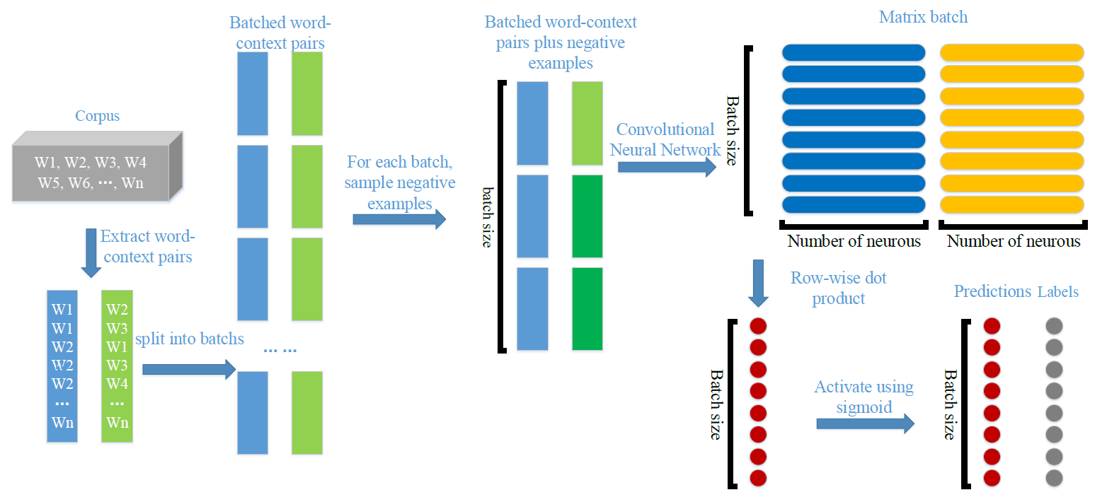
Background
Word2Vec-Chainer （Subword-CNN）

Slide 83
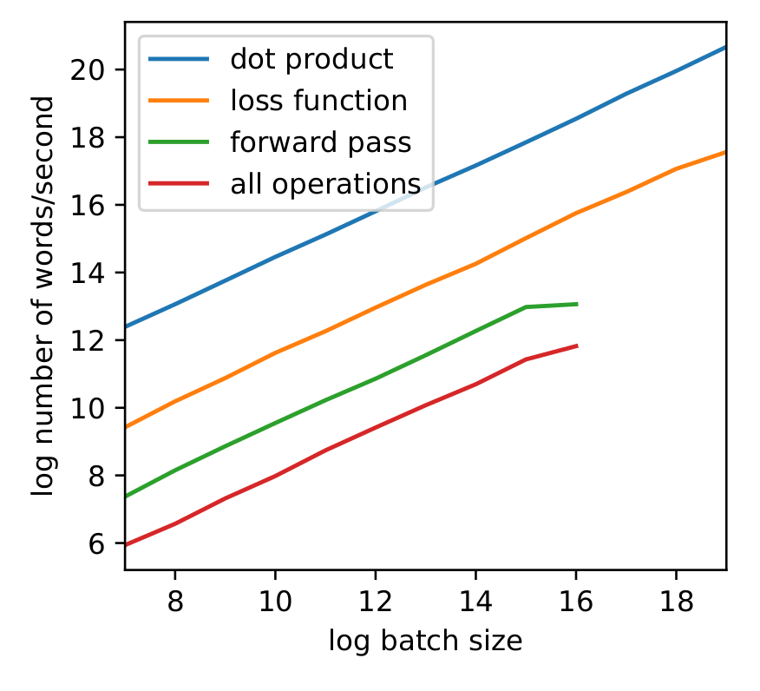
Profiling Training Speed on GPUs
dot product: calculate the row-wise dot product of two input matrices directly using CuPy.
loss function: calculate the loss of two input matrices directly using CuPy.
forward pass: calculate the loss of a batch of word pairs using Chainer.
all operations: train the full model using Chainer.

Slide 84
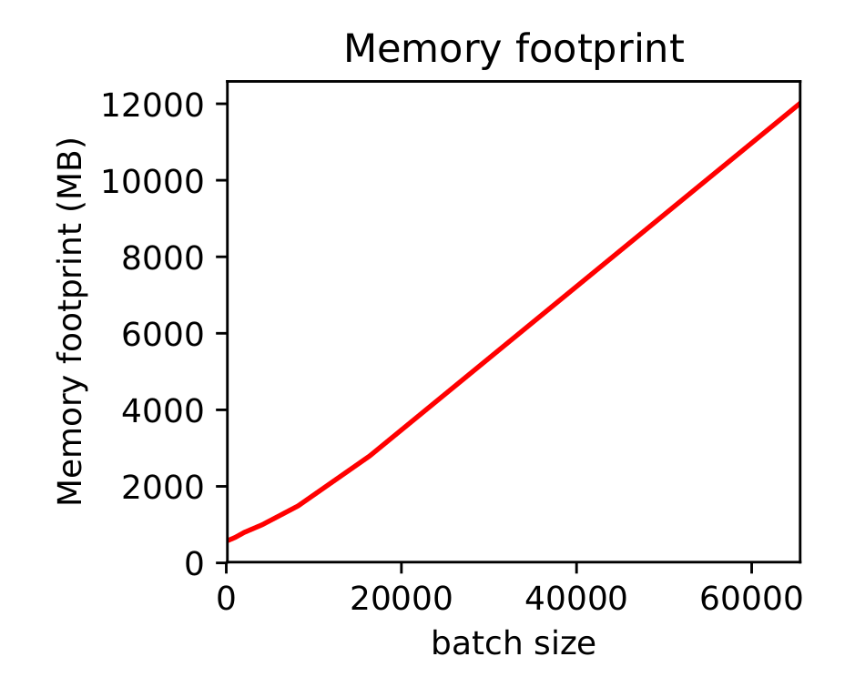
Issues with Large Batch Size
Tesla K80 GPU
12G Memory
maximum batch size 2^16=65536

Slide 85
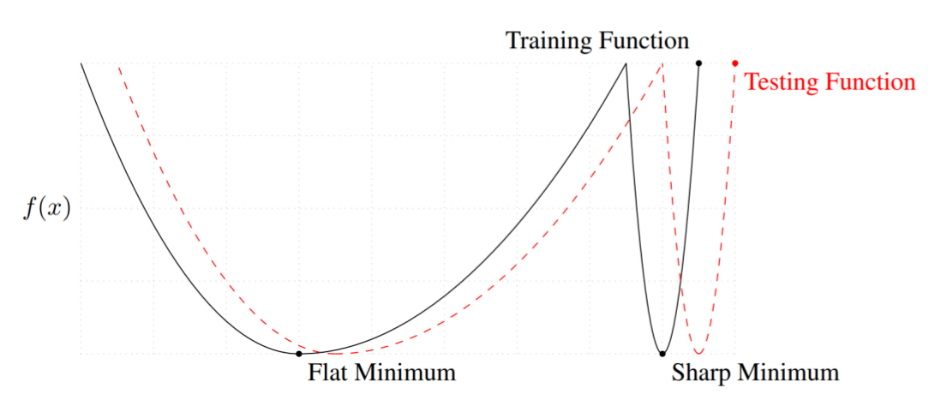
Issues with Large Batch Size
Keskar, N. S., Mudigere, D., Nocedal, J., Smelyanskiy, M.and Tang, P. T. P.: On large-batch training for deep learning: Generalization gap and sharp minima, arXiv preprintarXiv:1609.04836 (2016).
Notes:
the x-axis is the parameter, y

Slide 86
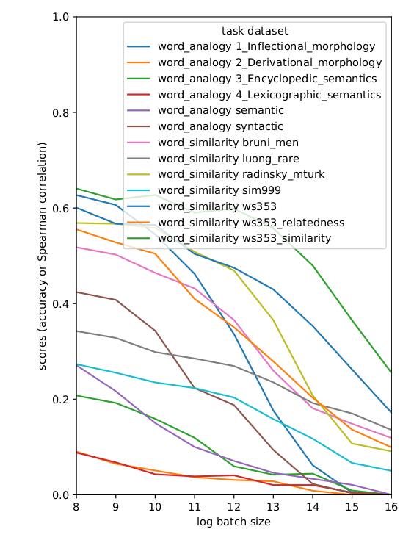
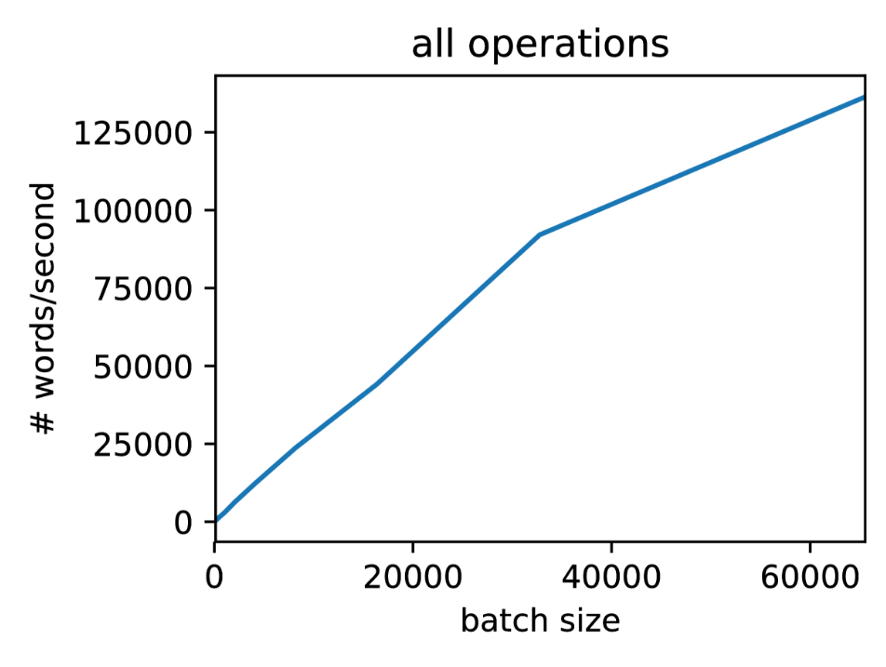
Issues with Large Batch Size
batch size of W2V-Chainer
2^10=1024
Notes:
need to find a way to increase the batch size
So, I need to use batch size 1024 in the following experiments,
And coincidentally,
Now the question becomes can we increase the batch size without accuracy drop.

Slide 87
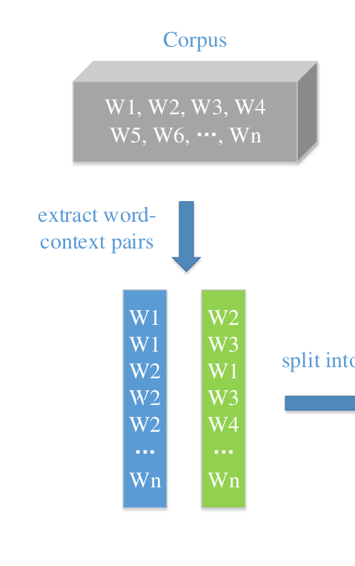
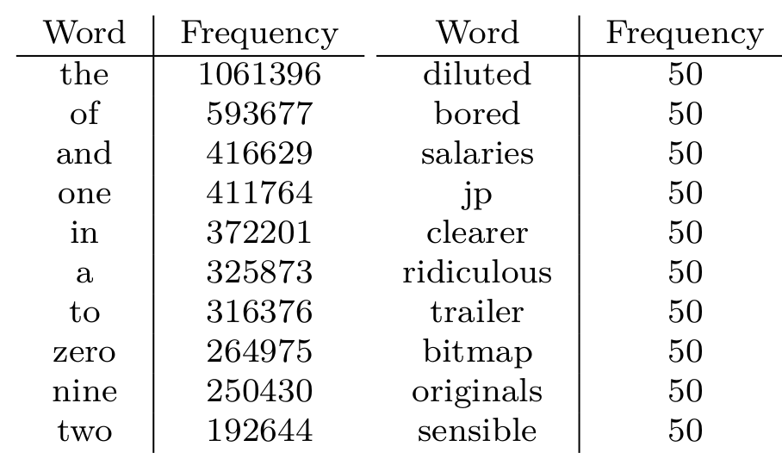
Issue with Low-Frequency Words
Number of updates depend on the frequency
The vector of ‘of’ updates 10000 times more than the vector of ‘salaries’
Notes:
absurd

Slide 88
Uniform Word Sampling (W2V-UWS)
Treat words equally
Fix the number of contextual words
Batch size equals to the vocabulary size
10,000 ~ 100,000
Notes:
In my algorithm, I treat words equally.
That means, no matter the fequency of the word, I will assign equal number of contextual words.
For those high frequency words, I will randomly discard their contextual words.
For those low frequency words,

Slide 89
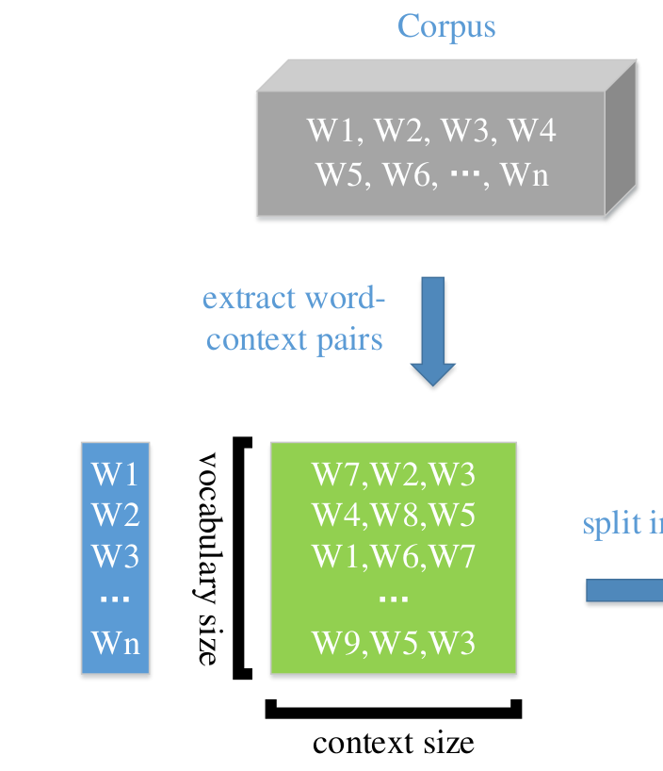
Uniform Word Sampling
Notes:
each row in this matrix,
and the number of column is equal to context size, which is a hyper-parameter.

Slide 90
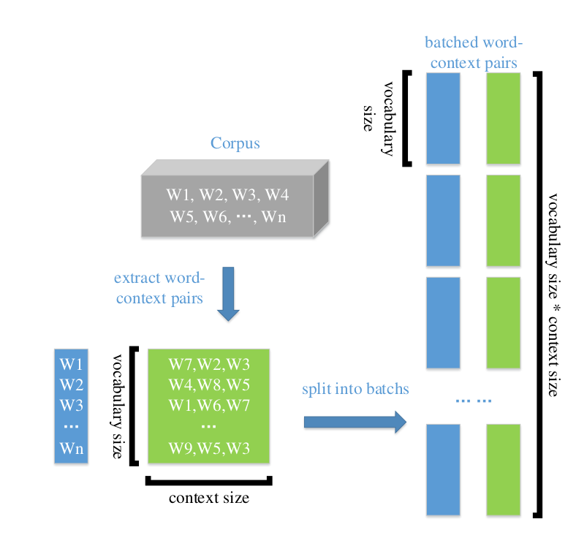
Uniform Word Sampling
Notes:
I will split this matrix into batchs based on columns. Each column is aasigined to a batch.
each word will appear once and only once in this blue box

Slide 91
Uniform Word Sampling

Slide 92
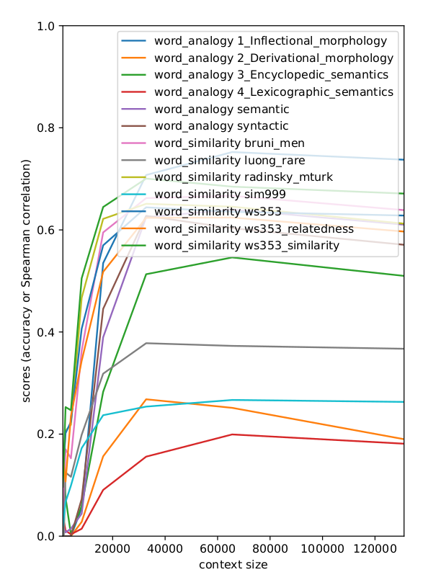
Experiments
Impact of context size
65536

Slide 93
Experiments
Notes:
The results are kind of mixed, it’s hard to say which is better.
But overall, it’s safe to conclude that my model is no worse than others.

Slide 94
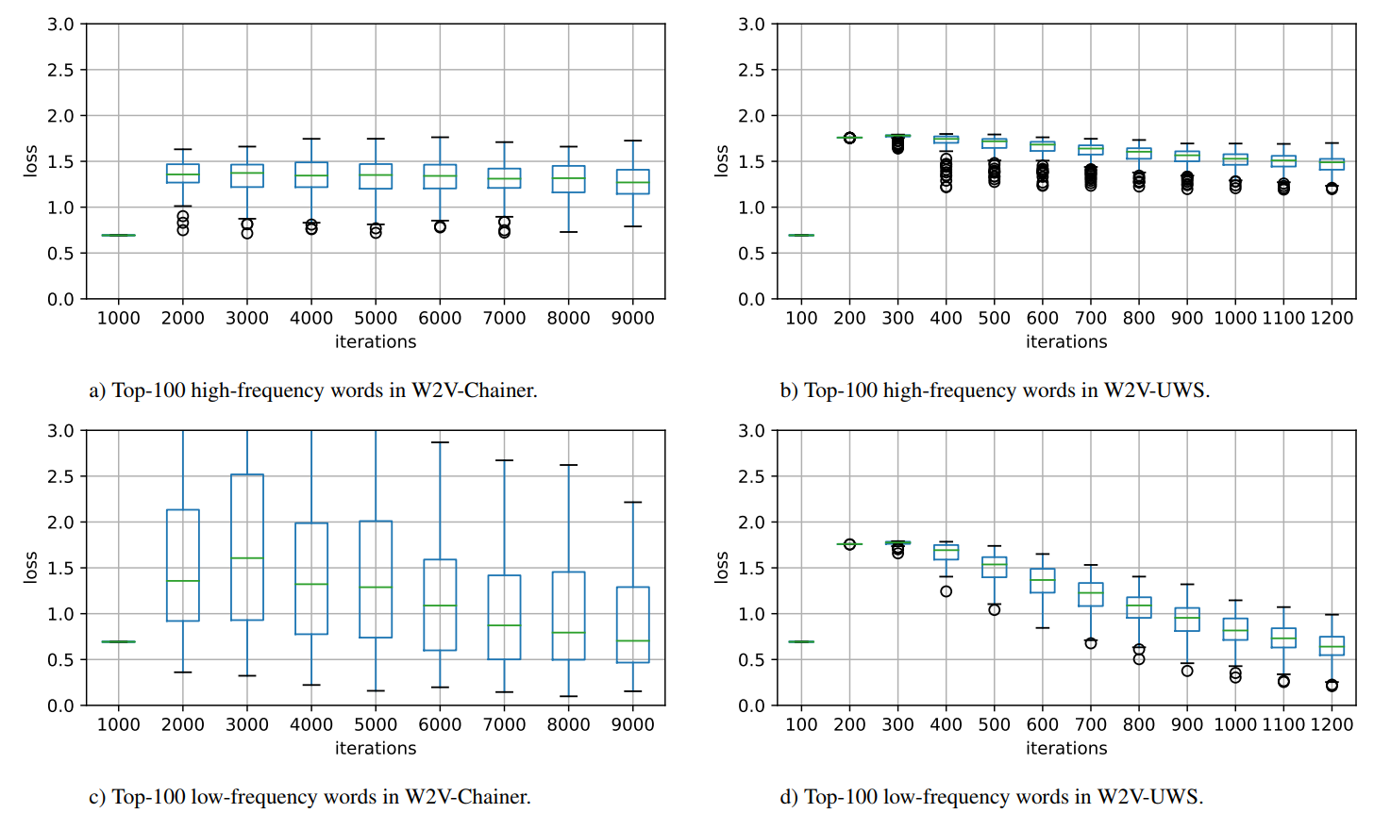
Experiments
Losses of high-frequent and low-frequent words
Notes:
The next experiment I did is to show the loss of high-frequent and low-frequent words
the left part xxx
for high frequent word, the original algorithm actually have lower loss,
for low frequent word, our model get slightly low loss. and most notably, our model have a lot low variance.
Currently I don’t have a way to show the importance of low variance. But intuitively, I would say low variance is better.

Slide 95
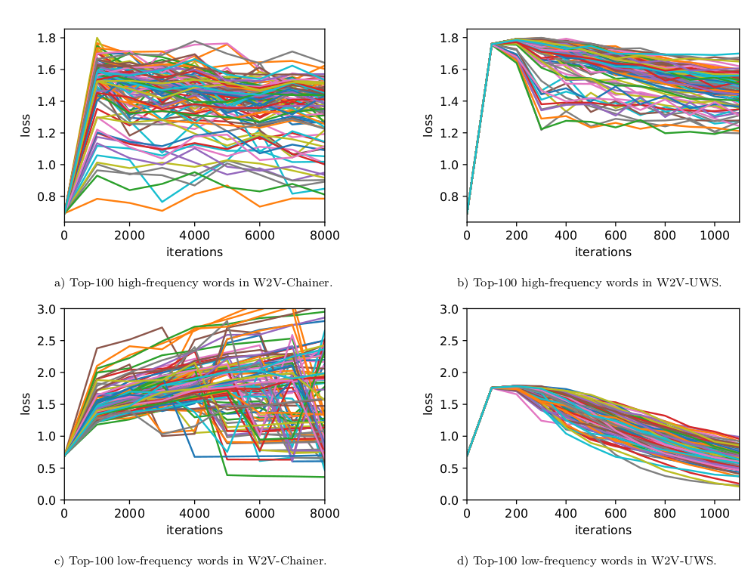
Experiments
Losses of high-frequency and low-frequency words
Notes:
it’s very nice to see that my model have this betual

Slide 96
Experiments
Scaling with Multiple GPUs and Nodes
Compared to baseline
2 times faster on single GPU
Compared to single GPU speed
5.5 times faster on 8 GPUs
7.5 times faster on 16 GPUs
Scaling Word2Vec with Uniform Word Sampling
Bofang Li, Aleksandr Drozd, Satoshi Matsuoka
SWoPP 2018, Kumamoto, Japan.

Slide 97
Conclusion
Word2Vec with Uniform Word Sampling (W2V-UWS)
treats high-frequency and low-frequency words equally
The batch size is equal to the vocabulary size
2 times faster on single GPU
Scales well
Scaling Word2Vec with Uniform Word Sampling
Bofang Li, Aleksandr Drozd, Satoshi Matsuoka
SWoPP 2018, Kumamoto, Japan.

Slide 98
Conclusion
Attention
Objective Functions
Evaluation
word embeddings
Context Definition
Compositionality
(Word)
Englihsh
Japanese
Scaling
Distributional Hypothesis
words that are used and occur in the same contexts tend to purport similar meanings

Slide 99
谢谢大家

Slide 100
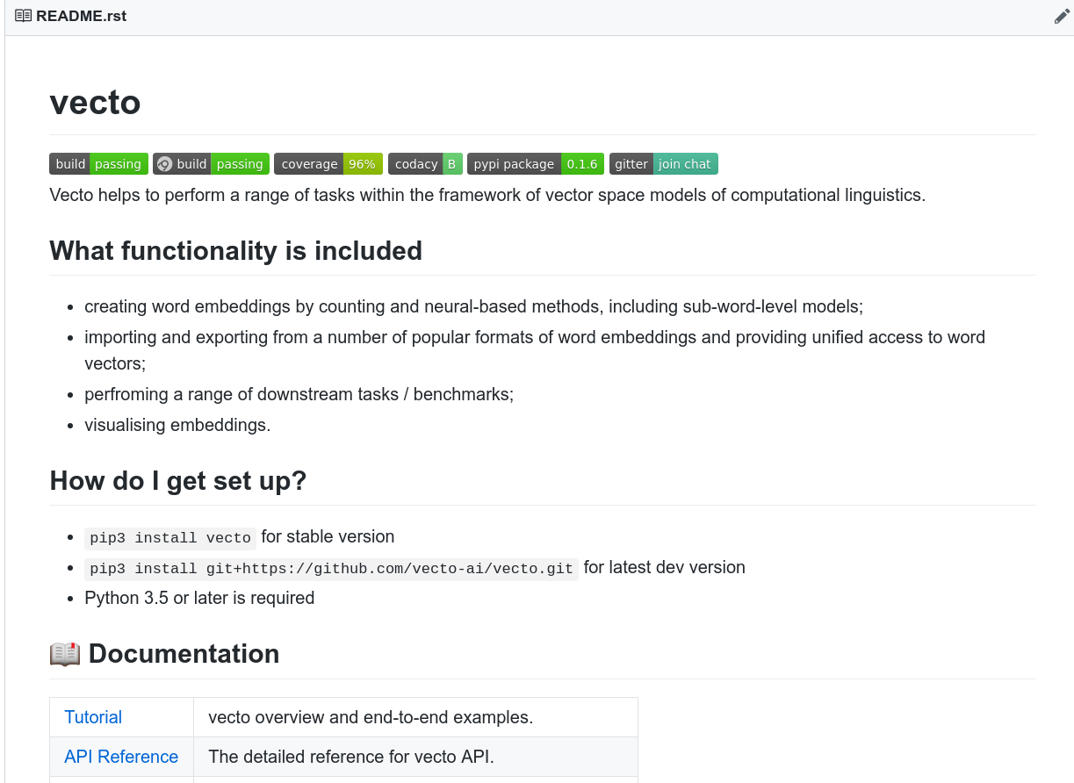
Vecto Project
http://vecto.space/
Pretrained embeddings
Training code
Datasets
Evaluation
Vecto
Aleksandr Drozd, Bofang Li, Anna Rogers, Amir Bakarov
Work in Progress
Notes:
All the
what if someone want’s to try it.
me and alex are working on this very intensively.
If you want to try word embedding, we have download pre-trained word embedding in vecto
if you want to train you own embedding, or modify a specific word embedding algorithm, we have open-sourced models that you can use.
If you already have you own embedding, you want to test it, we have all the evaluation datasets and code.

Slide 101
The (Too Many) Problems of Analogical Reasoning with Word Vectors [PDF]
Anna Rogers, Aleksandr Drozd, Bofang Li
*SEM 2017, Vancouver Canada.
Investigating Different Context Types and Representations for Learning Word Embeddings [PDF][code]
Bofang Li, Tao Liu, Zhe Zhao, Aleksandr Drozd, Anna Rogers, Xiaoyong Du
EMNLP 2017, Copenhagen, Denmark.
Subcharacter Information in Japanese Embeddings: When Is It Worth It [PDF]
Marzena Karpinska, Bofang Li, Anna Rogers and Aleksandr Drozd
ACL workshop RELNLP 2018, Melbourne, Australia.
Subword-level Composition Functions for Learning Word Embeddings [PDF]
Bofang Li, Aleksandr Drozd, Tao Liu, Xiaoyong Du
NAACL workshop SCLeM 2018, New Orleans, Louisiana.
Scaling Word2Vec with Uniform Word Sampling
Bofang Li, Aleksandr Drozd, Satoshi Matsuoka
SWoPP 2018, Kumamoto, Japan
Evaluating the Evaluation Methods for Word Embeddings
Bofang Li, Aleksandr Drozd
Work in Progress
Vecto
Aleksandr Drozd, Bofang Li, Anna Rogers, Amir Bakarov
Work in Progress

Slide 102
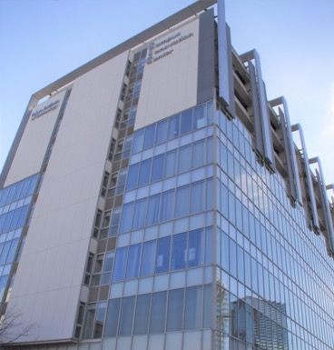
Thank You

