Slide 1
My Idea

Slide 2
Idea
Attribute-based
Attribute generation
with crowdsourcing
Product s1 : Canon EOS 40D Digital SLR Camera
Product s2 : Panasonic Dual Handset Digital Cordless Phone
Product s3 : Apple Pro Black Notebook
Product s4 : Apple MacBook Pro Silver Laptop
Product s5 : ... ...
...

Slide 3
Rule
Product s1 : Canon EOS 40D Digital SLR Camera
Product s2 : Sony Dual Handset Digital Cordless Phone
Rules (Canon, Sony)～(-1) , (Camera, Phone) ～(-1) can help us to annotate the tuples.

Slide 4
Idea
Attribute-based
Attribute generation
with crowdsourcing
Rule generation with crowdsourcing
Rule valuation with crowdsourcing
Rule valuation + Tuple checking

Slide 5
Cost-Effective Data Annotation using Game-Based Crowdsourcing
2018/11/11 JR Yang

Slide 6
Labeling Problem
t1
t2
t3
…
t1，-1
t2，+1
t3，-1
…
Annotator

Slide 7
High Quality Rule
High Coverage
The rules that cover as many tuples as possible to annotate the data.
High Precision
The rules that induce few wrong labels on their covered tuples.

Slide 8
How to obtain the high quality rule
Hand-crafted rules
Ask experts to write domain-specific labeling heuristics
Not scalable, time and effort consuming
Weak-supervision rules
Automatically generated by machines
May be very unreliable

Slide 9
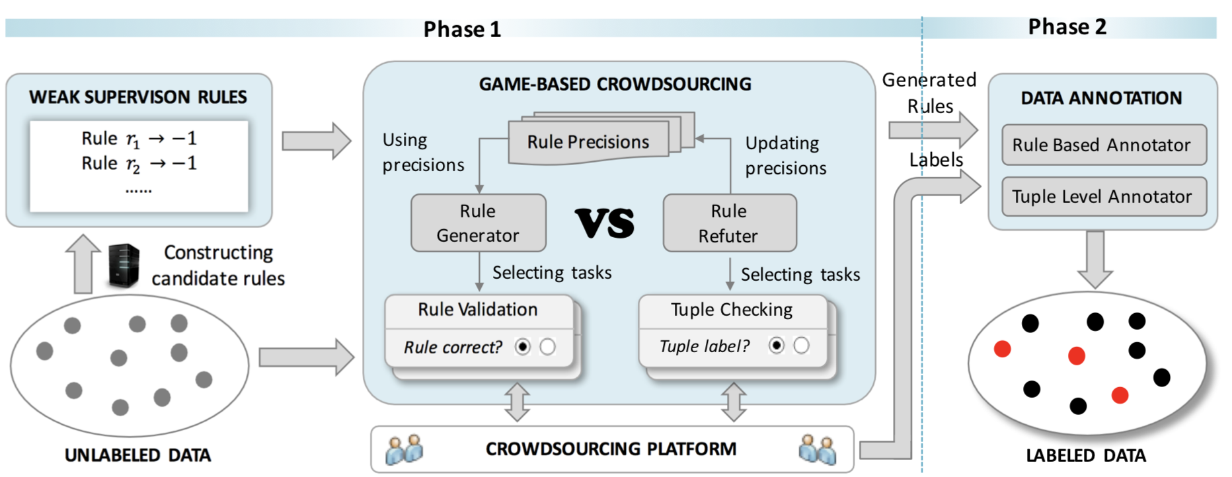
Our Method
Notes:
使用众包来生成labeling rule，以显着降低注释成本，同时也保持较高的标注质量。
第一阶段首先生成大量弱监督规则作为候选规则，接下来利用我们的game-based众包方法即CrowdGame从中选出高质量的规则，这里的高质量即高覆盖率和准确率。第二阶段，为数据集打标签，包括通过规则打的标签，也就是Rule Based Annotator，和直接对元素打的标签，也就是tuple level annotator。

Slide 10
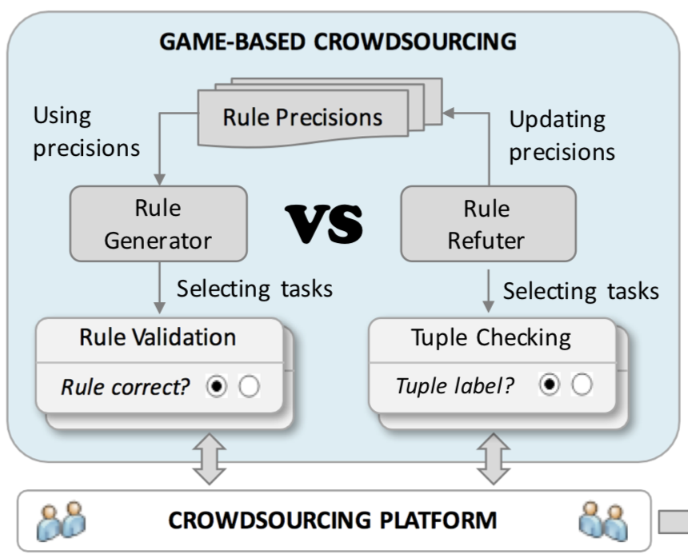
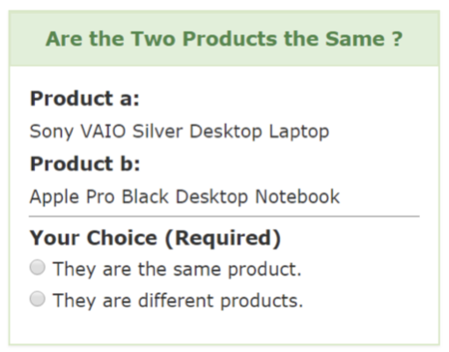
Game-Based Crowdsourcing
Notes:
CrowdGame解决的问题就是如何从质量参差不齐的候选规则中选出高质量规则。
规则覆盖率很容易获得，但是如何获取规则的准确率就很难了，我们现在想怎么知道规则准不准呢:
首先,我们想到，可以利用人特有的推理能力，直接问某个规则是否有效……
另一种方法是看看这个规则覆盖的元素都是什么标签……
但是这两种方法都是有缺憾的，方法一不准，人会犯错，比如（headphone，cellphone），方法二成本太大，因此我们用crowdgame将两种方法结合起来
我们把众包工人分成两组：一组回答规则验证任务，扮演规则生成器，而另一组回答元组检查任务，扮演规则判别器。 让两个小组进行双人博弈：规则生成器识别具有大覆盖率和准确率的高质量规则，而规则判别器试图通过检查元祖提供足够证据来“拒绝”更多规则，来对抗规则生成器，也就是生成器努力让自己足够好，好到判别器找不出错，判别器努力找生成器的错。

Slide 11
Game-Based Crowdsourcing
Loss of Rule Set
# of uncovered tuples
Excepted # of errors
Notes:
γ is a parameter between [0, 1] to balance the preference among coverage and quality of generated rules.

Slide 12
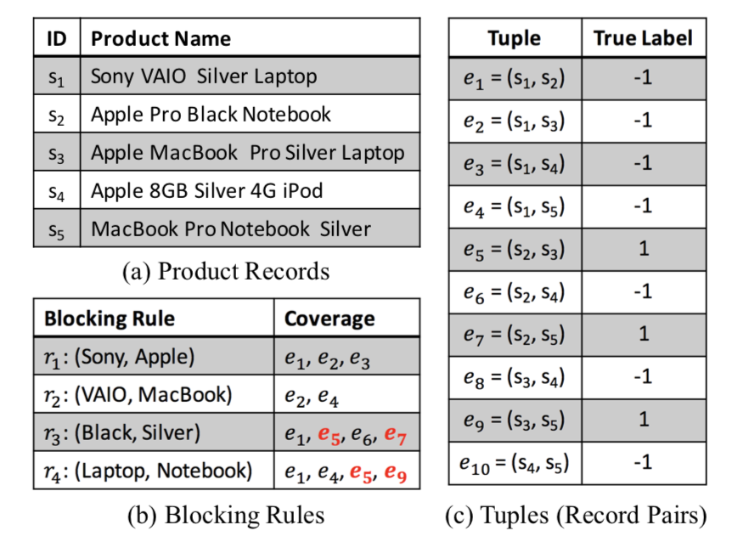
Game-Based Crowdsourcing
Examples
Set R1 = {r1} and R2 = {r1 , r3}, γ = 0.1
Φ(R1) = 0.1 * 7 = 0.7
Φ(R2) = 0.1 * 4 + 0.9 * 2 = 2.2

Slide 13
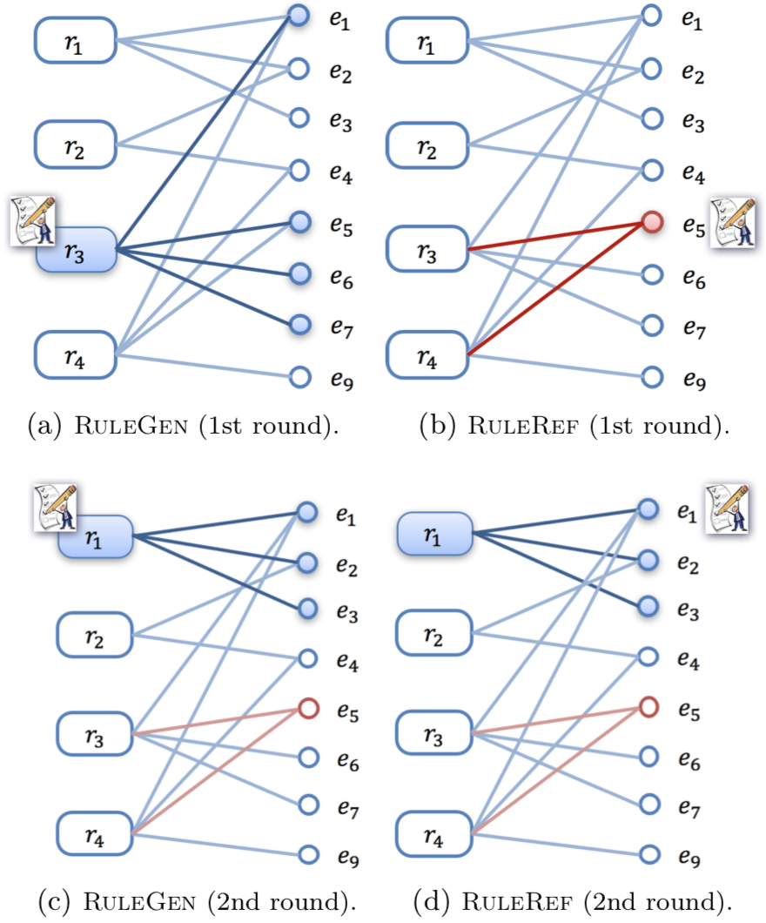
Game-Based Crowdsourcing
Rule Generator/Refuter tries to minimize/maximizer the loss.
0.1*5
0.1*5+0.9*1
0.1*6
0.1*6
Notes:
假设我们知道r1准确率为1，r3准确率为0.5，那么e1～e3标记正确的概率为1，e5～e7标记正确的概率为0.5

Slide 14
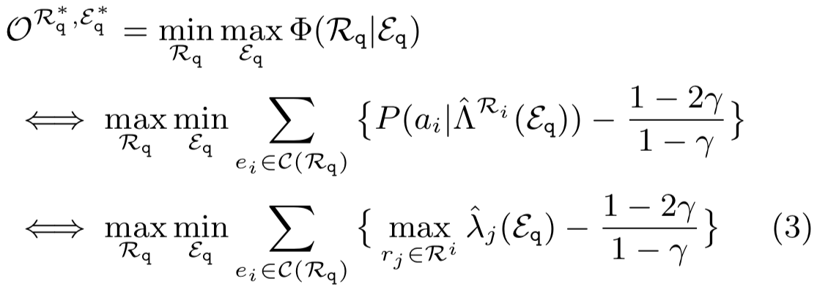
Game-Based Crowdsourcing
Minimax Objective
Notes:
由于规则有复杂的相关性，P（a|^）很难估计，我们用保守策略来得到,也就是用作用到ei的规则的最大准确率来表示，即当一个元祖可同时被准确率分别是0.2，0.7的两个规则标记时，那么这个元祖的的正确率至少为0.7

Slide 15
Task Selection
Overall
Find the optimal task sets R*_{q} and E*_{q} with constraint |R_{q}| + |E_{q}| ≤ k.
Set Cover Problem
NP-Hard
Prove
Greedy-based approximation algorithm
Notes:
从直观上看，生成器愿意选择覆盖数大，准确率高的规则，且回淘汰掉准确率不大于后面这个常数的规则任务
判别器被高准确率规则覆盖，且可间接影响更多其他元祖的元祖任务

Slide 16
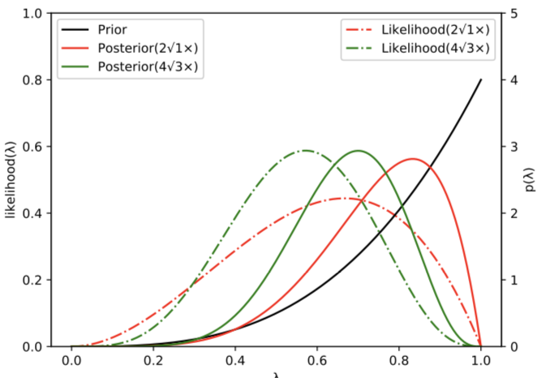
Rule Precision Estimation
Bayesian estimation
Prior, crowd rule validation results.
Data Observation, crowd results on tuple checking.
Posterior, Prior + Data Observation
Notes:
先验分布：Beta分布
数据观察：伯努利分布
它们共轭

Slide 17
Candidate Rules Construction
Candidate Rules for Entity Matching
Word Mover’s Distance (WMD)
Candidate Rules for Relation Extraction
Keywords
Point-wise mutual information (PMI)

Slide 18
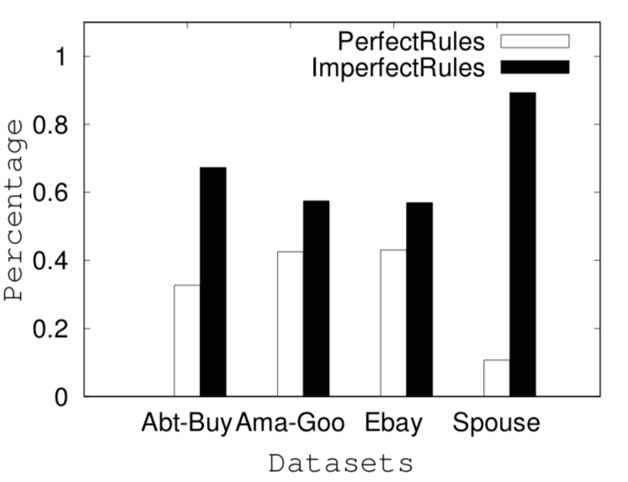
Experiments
Datasets & Statistics

Slide 19
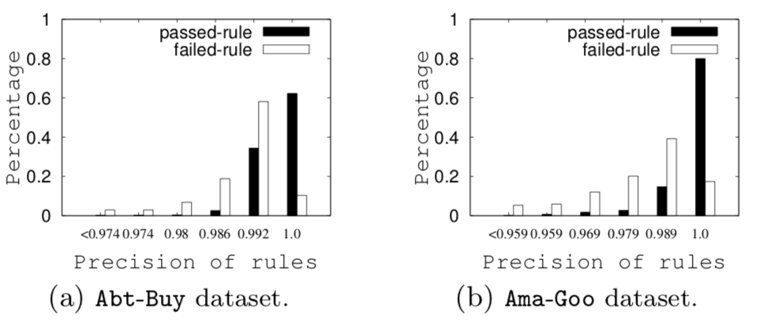
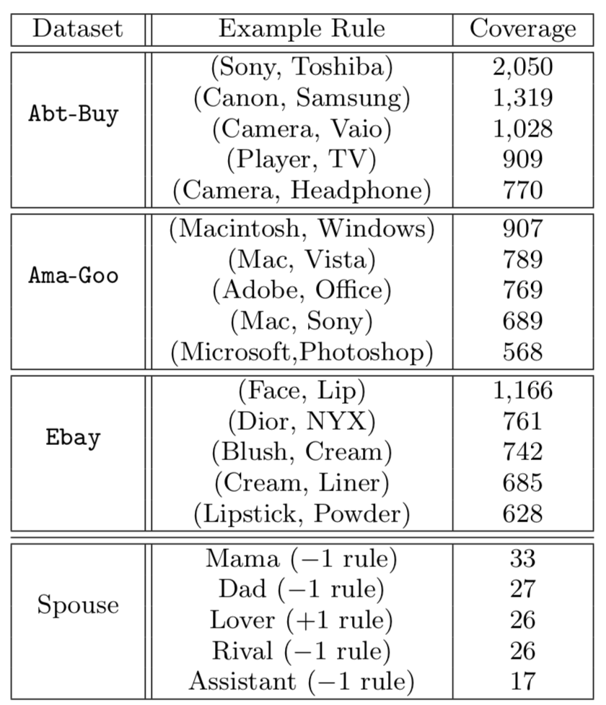
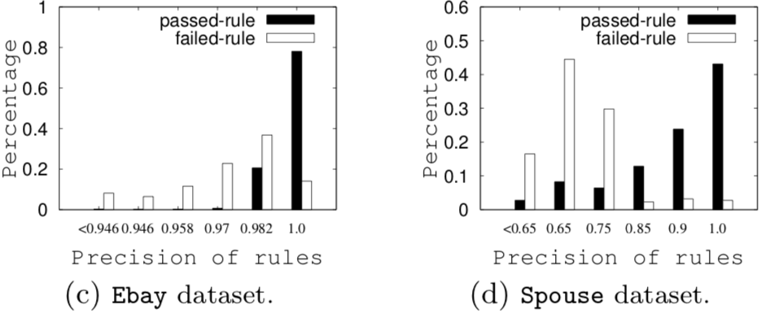
Experiments
Datasets & Statistics

Slide 20
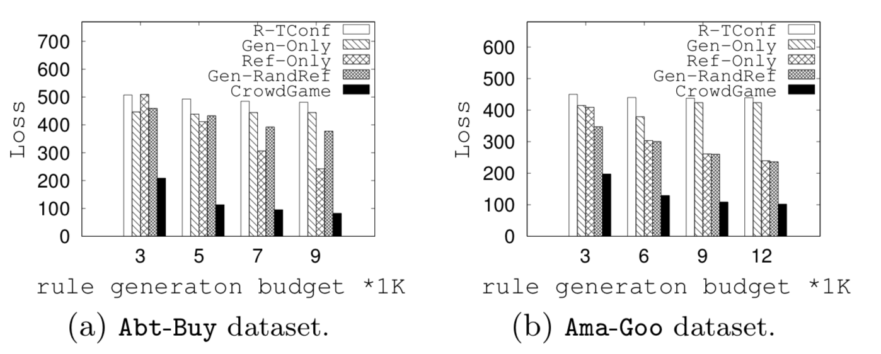
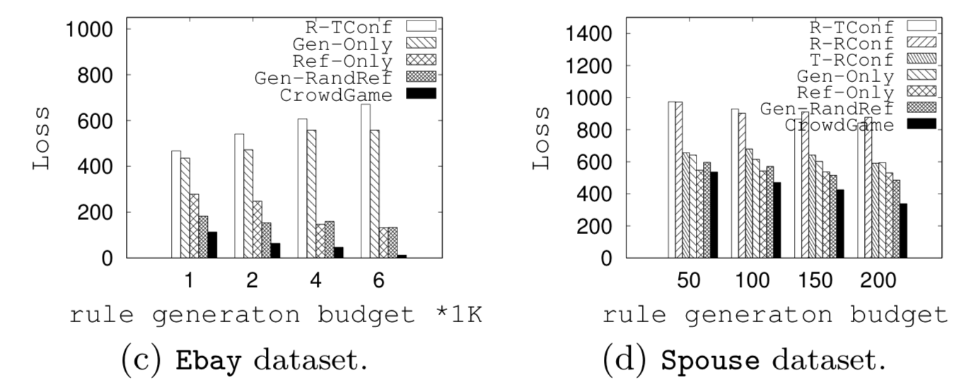
Experiments

Slide 21
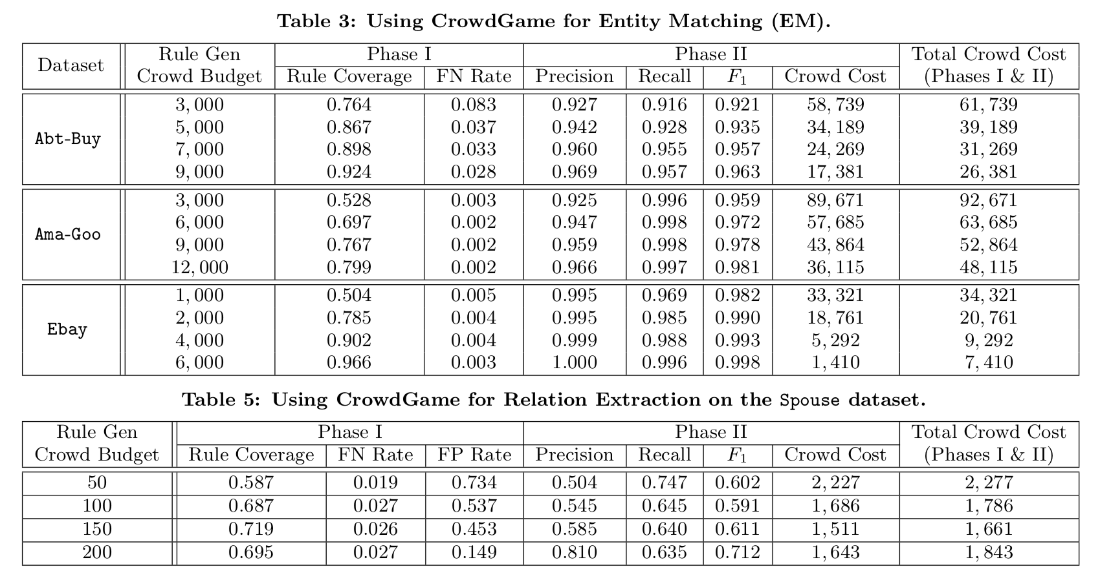
Experiments

Slide 22
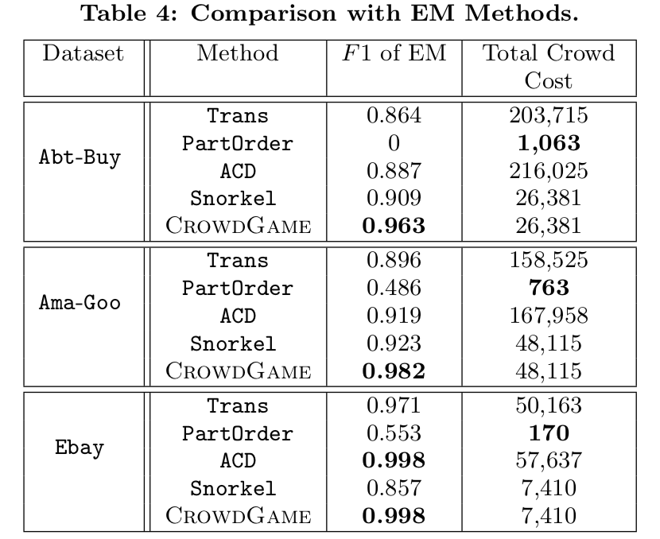
Experiments

Slide 23
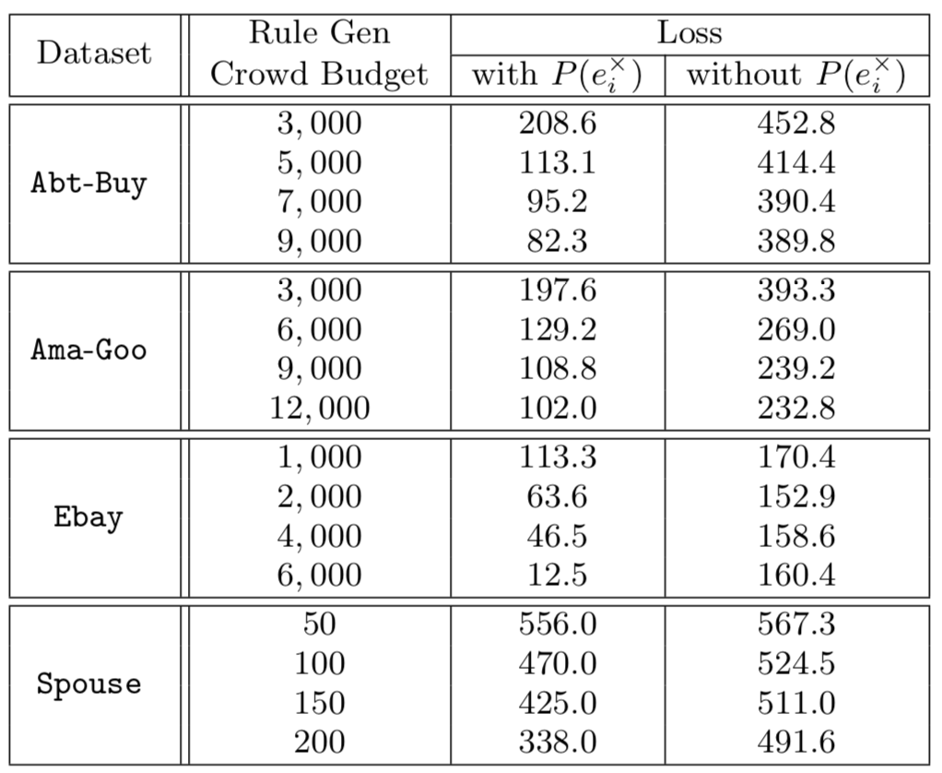
Experiments

Slide 24
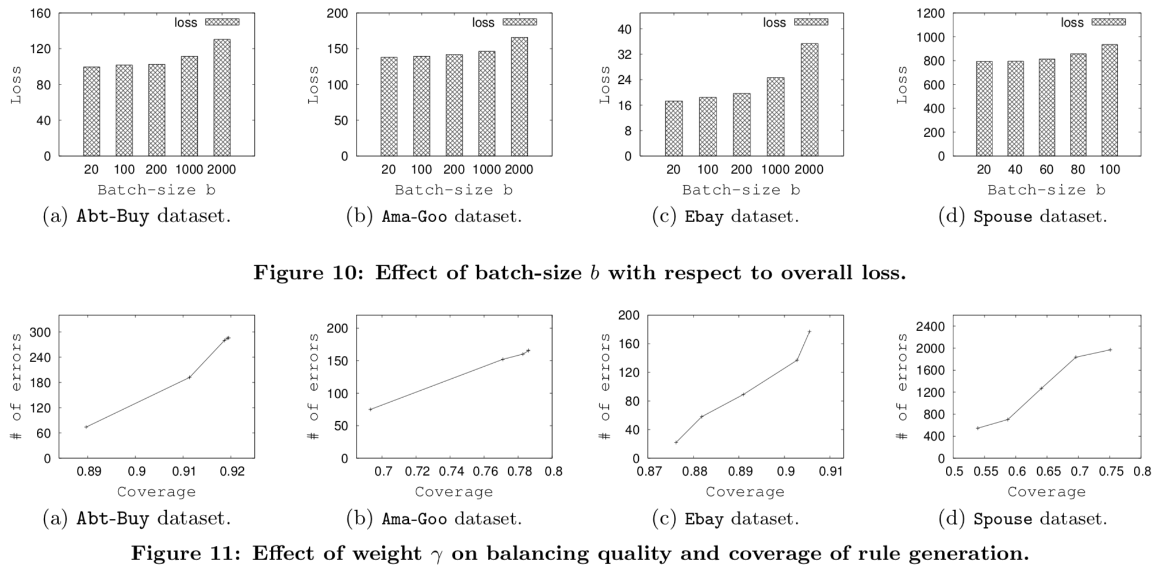
Experiments

