Slide 1

ALOR: Adaptive Layout Optimization of Raft Groups for Heterogeneous Distributed Key-Value Stores
Yangyang Wang, Yunpeng Chai, and Xin Wang
Renmin University of China

Slide 2


Heterogeneous clusters
Heterogeneity: I/O performance
Why are there heterogeneous clusters?
  Disks such as SSDs are used for a long time, performance will be reduced
  High disk damage rate, replacement of new disk is better performance and higher cost performance
  New hardware such as high-end SSDs and NVMs are expensive, and only a subset of these devices can be deployed in a cluster to achieve higher cost performance

Slide 3
Raft in heterogeneous clusters
Raft vs. Paxos
  more understandable
  better foundation for building
  practical systems
Raft has the heterogeneous feature
  Leader plays a more important role
    All read and write requests → leader
    Only the leader apply log is completed → user

Slide 4
Raft in heterogeneous clusters
Problems
  Traditional homogeneous solution does not fully use the performance of fast nodes
    e.g., leader on a slow node → write perfomace ↓
  Concentrate data and leaders on fast nodes → overload
  How to achieve the appropriate layout of data and leaders?
Solution
  ALOR

Slide 5
ALOR
1. Leader Migration in Raft Groups
2. Skewed Data Layout based on Cold Data Migration

Slide 6
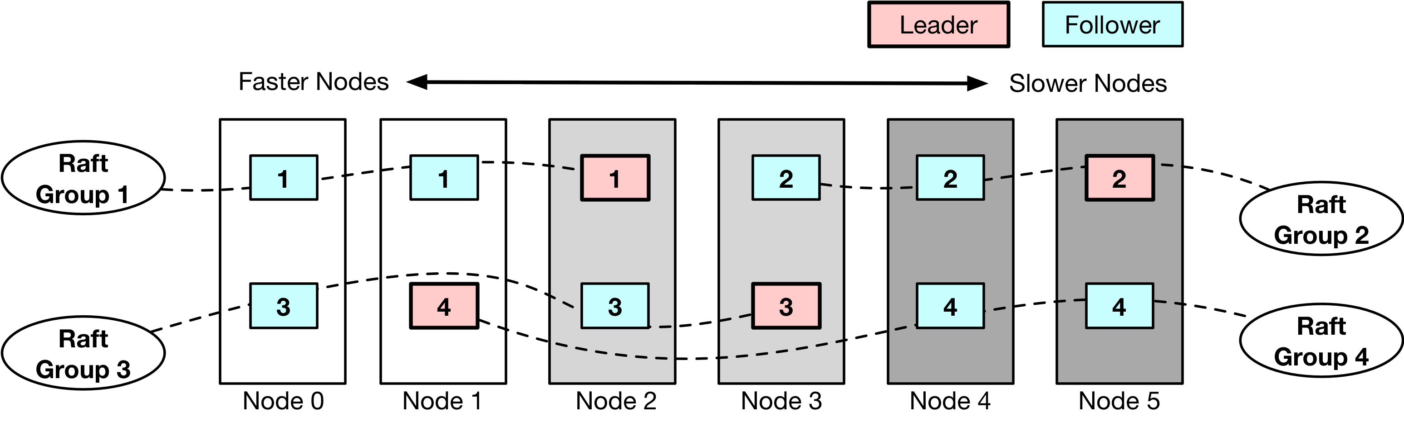
1 Leader Migration in Raft Groups
1.1 Leader (not reading hot data) → best node in a Raft group

Slide 7
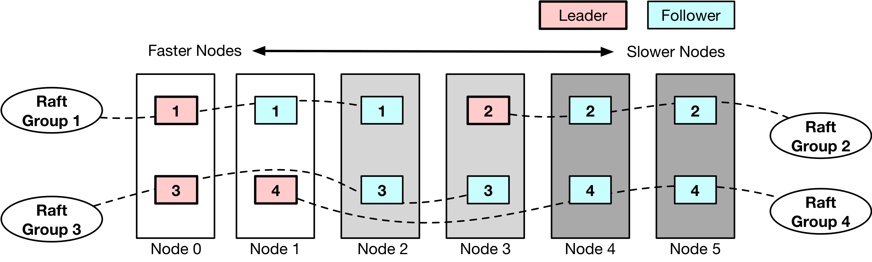
1 Leader Migration in Raft Groups
1.1 Leader (not reading hot data) → best node in a Raft group

Slide 8
1 Leader Migration in Raft Groups
1.1 Leader (not reading hot data) → best node in a Raft group
1.2 Leaders of reading hot data → evenly distributed

Slide 9
1 Leader Migration in Raft Groups
1.1 Leader (not reading hot data) → best node in a Raft group
  Writing can return quickly
  Writing faster → faster reading
    linear consistency
      read operations ← all the previous write operations have been completed
1.2 Leaders of reading hot data → evenly distributed
  Balanced reading

Slide 10
2 Skewed Data Layout based on Cold Data Migration
Target
  Appropriate layout of data
Content
  2.1 Skewed Data Layout
  2.2 KV Performance Estimation
  2.3 Cold Data Migration

Slide 11
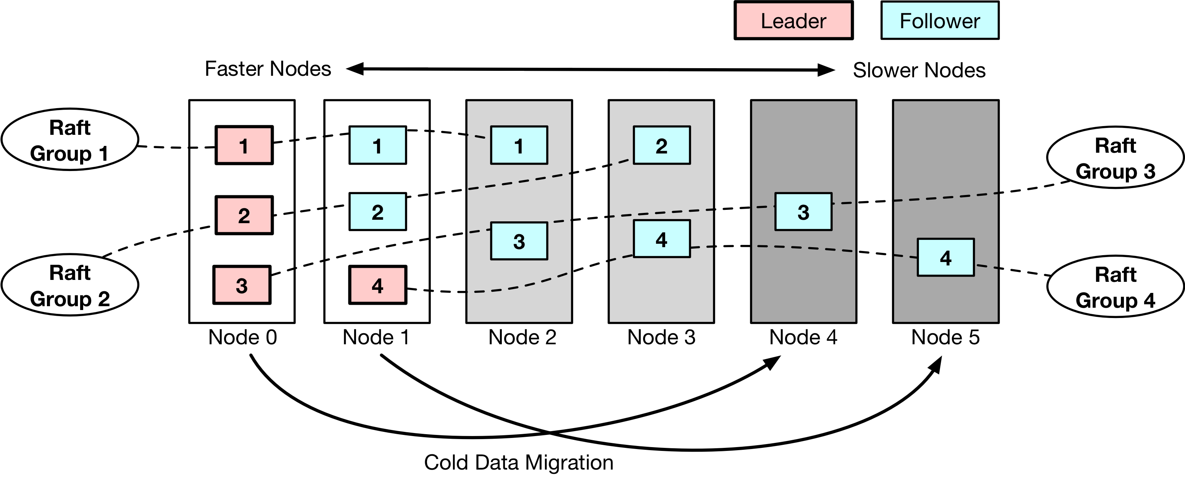
2.1 Skewed Data Layout
Faster nodes → more data
Disk-filling speed = KV accessing performance

Slide 12
2.2 KV Performance Estimation
Prepared work
  1. Test I/O (fio) and KV performance
    several representative nodes
  2. Fit I/O and KV performance
Running
  Automatically test I/O performance and estimate KV performance
    beginning
    idle, fix the estimate

Slide 13
2.3 Cold Data Migration
Threshold: e.g., 95% of its capacity
Overhead: small
  sequential read and write

Slide 14
Implementation
ALOR (https://github.com/vliulan/ALOR)
  based on TiKV and PD
TiKV
  distributed KV storage system
  based on Raft
  uses RocksDB
  open source
PD
  the managing component

Slide 15
Evaluation Setup
Number of nodes | 8
TiKV | 6
PD | 1
Go-YCSB | 1
System | Centos 7 3.10.0
DRAM | 4GB
NVM | emulated by DRAM
High-end SSD | PCIe
Plain SSD | SATA
Capacity of each TiKV node | set to 5GB
Number of copies | 3
Filling the cluster | 5GB*6/3=10GB
Go-YCSB
  Benchmark
  Go language version of YCSB

Slide 16
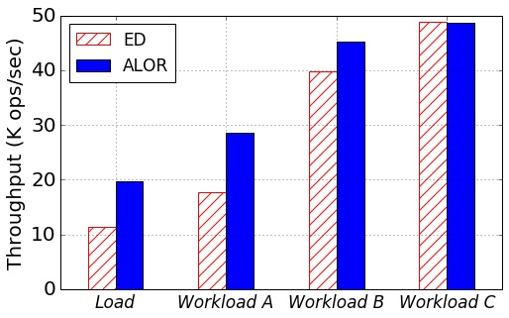
Overall Results
Load | insert-only
Workload A | 50:50 read/update
Workload B | 95:5 read/update
Workload C | read-only
6 TiKV nodes
  1 NVM, 2 high-end SSDs, 3 plain SSDs
Data
  10G, fill the cluster
ED
  traditional Even Distribution solution
ALOR vs. ED
  Throughput
    Load: 72.6% ↑
    Workload A: 61.5% ↑
    Workload B: 13.7% ↑
    Workload C: very close

Slide 17
Overall Results
Average latency and 99th percentile latency
  On average
    ALOR vs. ED: 24.54% ↓ and 21.32% ↓
Writing faster → faster reading
↓
↓

Slide 18
Overall Results
Throughput and lantency during the load process

Slide 19
Impacts of Different Heterogeneous Cofigurations
N: NVM H: high-end SSD P: plain SSD
  2N2H2P(2 NVMs, 2 high-end SSDs, 2 plain SSDs)

Slide 20
Impacts of System Scale
different TiKV nodes
  4, 5, 6

Slide 21
Analysis of ALOR Components
ALOR
  leader migration 31.45%
  skewed data layout based on cold data migration 68.55%
LMO
  leader migration only

Slide 22
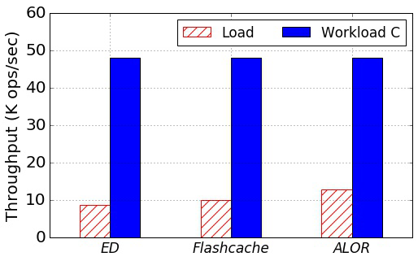
ALOR vs. Homogeneous Hybrid Device Solution
Homogeneous Hybrid Device Solution
  use Flashcache to combine NVMs and plain SSDs into hybrid devices
ALOR vs. Flashcache: 28.57% ↑

Slide 23
Conclusion
Match the inherent heterogeneity of Raft groups and the hardware heterogeneity of distributed key-value stores
ALOR achieves an appropriate layout of data and Raft leaders in a heterogeneous distributed key-value storage system through the leader migration and the skewed data layout mechanisms
ALOR can promote the write throughput by up to 72.6% than the even data distribution solution, while achieving similar read performance

Slide 24
Thank you!
https://github.com/vliulan/ALOR
ypchai@ruc.edu.cn

